Slide 1




Conducting Research:
Session 2
Adolescent Citizen Scientist Training

Slide 2
Today’s Agenda
Ethical considerations when conducting research
Community based participatory research (CBPR)
What it means to be an adolescent citizen scientist (ACS)

Slide 3

What steps do you need to take to conduct research?
  Identify a research question
  Review existing information
  Design a study
  Collect data
  Analyze data
  Make conclusions
  Consider implications

Slide 4
Does a researcher need approval?
  Identify a research question
  Review existing information
  Design a study
  Collect data
  Analyze data
  Make conclusions
  Consider implications
YES!
Researchers need to get proper approval at multiple stages in the research process.

Slide 5
Institutional Review Board (IRB) Approval is Needed
  What is an IRB? A safety committee that ensures your project won't harm the people you are studying or break any privacy rules
  Research working with people requires a high level of responsibility to participants.
  Institutions that have researchers as employees (e.g., universities) have an IRB and researchers must apply for approval.
  Ensures research is ethical.

Slide 6
IRB Ensures Core Principles of Ethical Research
Respect for persons, beneficence and justice. What does this mean?
No Harm: Make sure nobody gets hurt physically, gets stressed out, or feels unsafe.
Privacy: Ensure participants' private data and secrets stay locked and only researchers can access them.
No Tricking People: Check that participants know exactly what they are signing up for.
Fairness: Prevent researchers from taking advantage of people or treating them unfairly.
Notes:
What his means:

Slide 7
CITI (Collaborative Institutional Training Initiative)
Online educational platform that teaches people who will be involved in conducting research the ethical guidelines and legal regulations required to conduct research
Format: A series of web-based reading modules with short, multiple-choice quizzes to ensure the user’s understanding of the material
Required by University Institutional Review Boards (IRB)
Time commitment: Depends on modules that need to be completed
Certificate: Provided upon completion
A “research driver’s license”
Notes:
High school students can get CITI (Collaborative Institutional Training Initiative) training by registering through a partnering university or institution, or by paying as an independent learner. Because CITI primarily serves academic institutions and research hospitals, most students access it for free by affiliating with a research program they are participating in.

Slide 8
Small Group Activity
Review published focus group paper
Look for ethical protections
Notes:
See open access article: van der Wal, Amber & Valkenburg, Patti & Driel, Irene. (2024). In Their Own Words: How Adolescents Use Social Media and How It Affects Them. Social Media + Society. 10. 10.1177/20563051241248591.
Point out that names are not listed, acknowledgement of approval by IRB,, explanation of assent and consent, explanation of purpose, disclosing to participants that there is a one-way mirror, consent for recording.
High school students can get CITI (Collaborative Institutional Training Initiative) training by registering through a partnering university or institution, or by paying as an independent learner. Because CITI primarily serves academic institutions and research hospitals, most students access it for free by affiliating with a research program they are participating in.

Slide 9
What is community-based participatory research (CBPR)?
Partnership: academic researchers and local community members work together as equal contributors to the entire process of research.
  Identifying a research question
  Reviewing existing information
  Designing a study
  Collecting data
  Analyzing data
  Making conclusions
  Considering implications

Slide 10

Why do community-based participatory research?
The community has knowledge needed to solve issues.
Builds community support and buy-in.
Key personnel are heard and valued - crucial for gaining support when it’s time to implement a new program or policy.
Maximizes resource efficiency - research helps determine cost-effective and practical use of limited resources
Avoids unintended consequences - poorly planned solutions can sometimes create new problems.

Slide 11
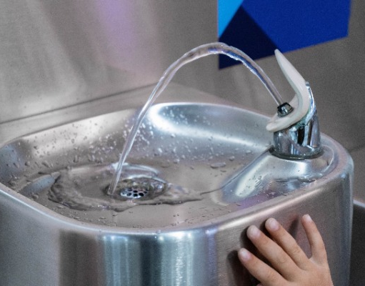
Example – Water Fountains
To increase water consumption and decrease disposable plastic water bottle use among high school students and staff the board of education allocated money to install water bottle filling stations and fountains throughout the high schools in the school district. Stations were installed.
Was CBPR used? How could this intervention have been improved?
Are there risks to the success of this intervention?
Notes:
Do they know if this a priority for the schools? How would engaging the community have improved the intervention?
Community members in that district may not trust the water quality due to negative experiences (e.g., poor water taste, distrust of quality because reports of contaminants in the water supply have been reported in nearby cities, fear of getting sick as water in home country was not safe to drink ). Community-based research would have taken into consideration student and staff concerns. In addition, if most people drink people drink bottled water at home and at school then students don’t carry refillable bottles. If community-based research was conducted the intervention could have been improved – some suggestions: 1) clearly visible high quality water purification system added to the stations so users are aware the water is safe, with water promotion efforts explaining that purification has been prioritized 2) distribution of refillable water bottles

Slide 12

What does it mean to be an Adolescent Citizen Scientist?
Engaging young people in the community as full partners in community research!

Slide 13
ACS Research Benefits the Community
Community impact: ACS can identify local health, environmental, or social issues and contribute to solutions, driving positive change and improving community well-being.
Empowerment and ownership: Involving adolescents in research empowers them to take ownership of issues that affect their lives and communities. Training next generation to be advocates and community leaders.
Relevant perspectives: Provides unique insights and perspectives on community issues, particularly those that affect their age group.

Slide 14
Youth who Participate in an ACS Program Benefit
Informed decision-making: By participating in research, teens can better understand the data and evidence that inform community decisions.
Skill development: Participating in community research helps teens develop critical skills such as data collection, analysis, teamwork, and communication.
Building networks: Engaging in research allows teens to connect with peers, mentors, and community leaders, fostering a sense of belonging and collaboration.

Slide 15
Wrap-up
Thinking about the information you’ve heard about research…
Was anything you heard new or surprising?
Do you think about research in a new way?
How do you feel about being an Adolescent Citizen Scientist?

Slide 16

Thank you!
Bluesky
@UConnRudd.Bsky.Social
LinkedIn
UConn Rudd Center for Food Policy and Health
Website
uconnruddcenter.org/adolescent-citizen-scientists

