Slide 1

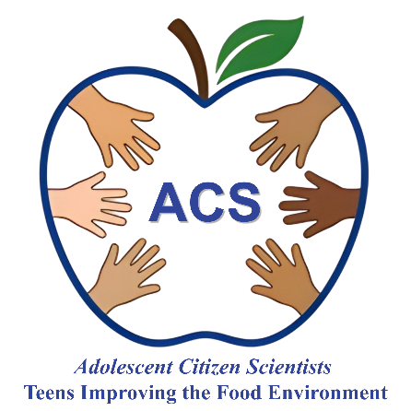


What is research?
Session 1
Adolescent Citizen Scientist Training

Slide 2
Today’s Agenda
What is research?
How does research inform public health programs and policies?
What are the differences between qualitative and quantitative research?
How do we decide what type of research method to use?
When you hear the word “research” what comes to mind?

Slide 3

What is research?
Research is a systematic process of inquiry that involves gathering, analyzing, and interpreting information to increase understanding of a topic or issue.
Experimental studies - Changing one variable to see how it affects another variable while keeping everything else the same.
Observational studies - Observing with no intervention
Focus group studies - Exploring to understand something

Slide 4
Experimental Studies
Looking for cause and effect
Involves manipulation or assignment to a group
Uses numbers in analysis
Can test if a specific change fixes a problem
Does turning off phone notifications for two hours before bedtime increase the average number of hours 9th-grade students sleep?

Slide 5
Observational Studies
Observes with no intervention
Watching and recording behaviors or asking about behaviors.
No intervention – no request to change behaviors or assignment to a group.
Used observed or self-reported data.
Is the number of hours 9th-grade students spend on mobile devices each day related to the number of hours they sleep each night?

Slide 6
Focus Group Studies
Group discussion led by a moderator. Used to better understand concepts, thoughts, and experiences
  Open-ended questions generate discussion.
Utilizes follow-up questions to probe.
Explore adolescents’ understanding of the common marketing techniques used to promote sweetened drinks.

Slide 7
Why conduct research?
Helps make informed choices.
Helps identifying needs. Gaps in knowledge and areas of need.
Evaluates interventions/policy. What works, what doesn’t, and why.
Guides policy development. Leads to better outcomes.
After increasing the quality of the fresh fruit and vegetable offerings during lunch at a high school cafeteria was there an increase in consumption of fresh fruits and vegetables?

Slide 8
What is social science research?
Informs public health
Studies the social, economic, and behavioral factors that influence health outcomes within populations
It's about understanding human behavior, actions, and beliefs
Can be quantitative or qualitative

Slide 9
What is quantitative research?
It involves the collection and analysis of data to identify patterns, test hypotheses, and make predictions.
Used in economics, health sciences, and market research.
It typically uses:
  Surveys
  Observations
  Experiments
  Existing data sets

Slide 10
What is qualitative research?
Captures:
Opinion
Experiences
Perceptions
It typically uses:
Interviews
Focus groups
Answers Why?
How?

Slide 11
Activity: Qualitative vs. Quantitative Research
Qualitative: explores "why" and "how" using non-numerical data to understand concepts and experiences, participants provide their perceptions
Quantitative: uses "how many" and "how much" with numerical data from surveys or experiments to measure and test variables.
Do these examples represent qualitative or quantitative research? Explain!
Conducting a focus group (small group discussion) with classmates to determine how they choose what clubs to participate in.
Surveying students to determine how many participate in clubs.

Slide 12
Let’s talk about food!

Slide 13
Small Group Activity
Participate in a brief focus group
Fill out a survey
Group discussion
Notes:
Utilize “How you decide what food to eat” focus group guide and have one researcher be the moderator with the youth as participants. After, have youth participants take the “How you decide what food to eat survey.” Compare and contrast the type of information gained from each. See next slide for assistance.

Slide 14
Survey Research vs. Focus Groups
Survey Research
Focus Groups
Can collect info from large groups
Not flexible. Need to know what to include.
Fast and efficient—good for large groups, can be anonymous
Results are generalizable.
Can be easily compared and turned into charts or statistics
Less detail because answers are limited to the choices given
Interactive conversation
Guided discussion to explore and understand
Flexible, follow-up questions can be asked to further explore
Perspectives shared, and an participants hear and consider other people’s perceptions.
Results are not generalizable, but researchers get rich details

Slide 15
Wrap-up
Thinking about what you’ve learned about research during today’s session…
What stood out to you?
Do you think about research in a new way?
Would you like to conduct qualitative or quantitative research?

Slide 16


Thank you!
Bluesky
@UConnRudd.Bsky.Social
LinkedIn
UConn Rudd Center for Food Policy and Health
Website
uconnruddcenter.org/adolescent-citizen-scientists

