Slide 1




Designing a Communication Plan
Adolescent Citizen Scientist Training

Slide 2
Today’s Agenda
Components of a communication plan
Analyzing an existing public health campaign
Creating your own communication plan

Slide 3
Why do you need a communication plan?
Maximize the results of your program:
Get the best message
To the right people
In the most effective places

Slide 4

Communication Plan Components
Background
Program goal
Communication goal
Audiences
Key messages
Methods/tactics
Steps
Materials
Resources
Timeline
Evaluation

Slide 5
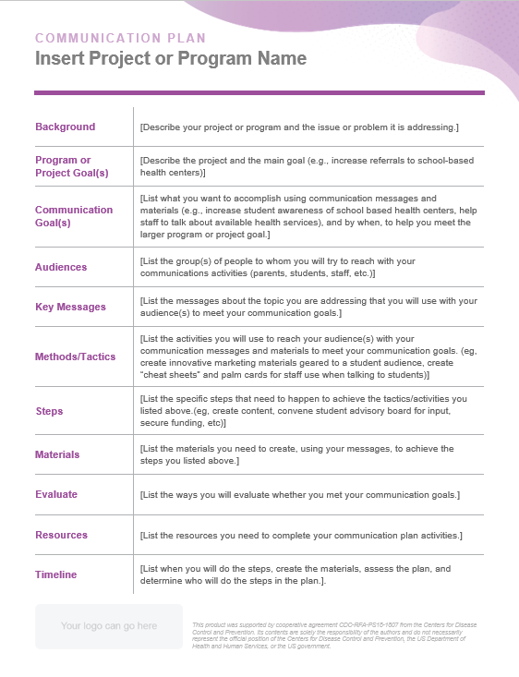
Communications Plan Template
View at:
https://www.cdc.gov/healthy-youth/communication-toolkit/communication-planning.html

Slide 6

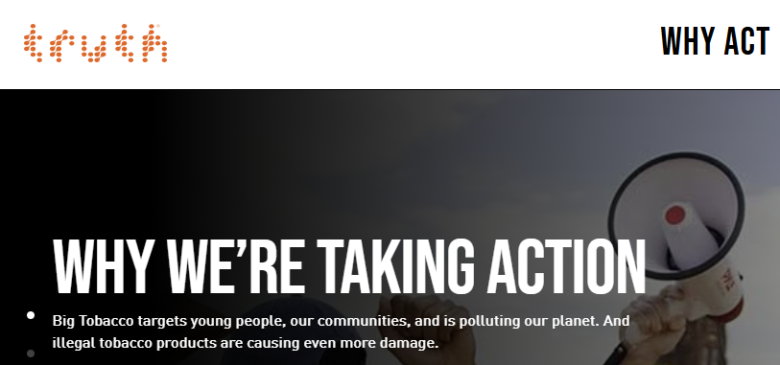
Example: “truth” Campaign - Background
View at: www.thetruth.com

Slide 7
What were their goals?
Program goals:
Reduce teens’ use of tobacco products
Communication goals:
Counteract perceptions that tobacco use is “cool”
Increase awareness and concerns about the unhealthy impact of tobacco use

Slide 8
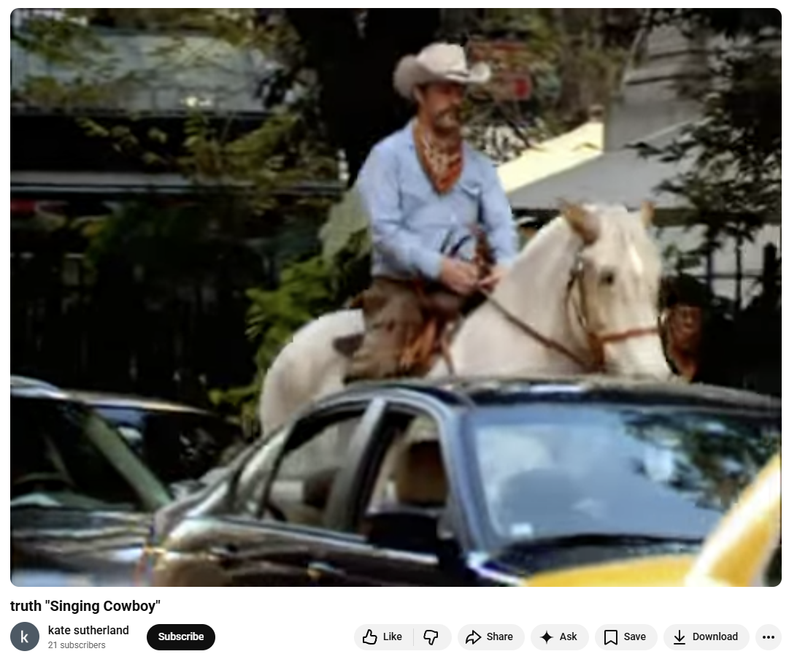
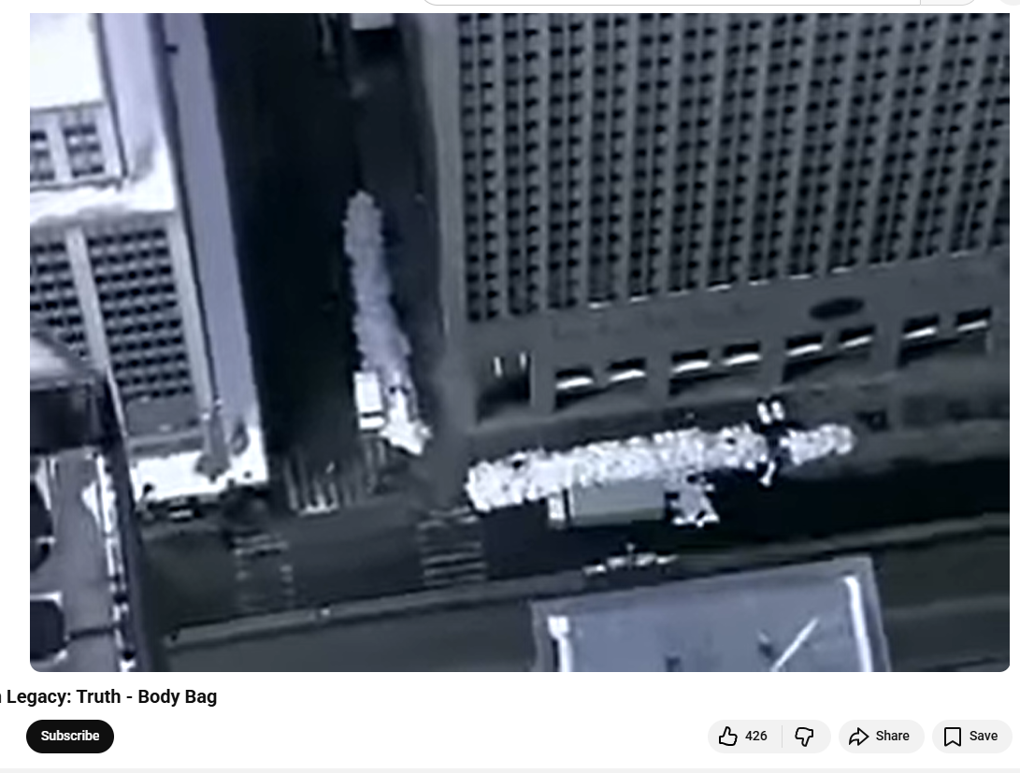
“truth” Campaign Ads
https://www.youtube.com/watch?v=v_cMQt3nmjI
https://youtu.be/S0fJyeW3v4o

Slide 9
Who, what and how?
Methods/tactics:
TV advertising
Website with resources to help quit
Advocacy campaign
Key messages:
Smoking can seriously harm you
Tobacco advertising is deceptive
Youth can fight back
Audience:
Teens who smoke or may consider it

Slide 10
How to implement?
Steps:
What specific things do you need to do?
Timeline:
When will you work on and complete each of those steps?
Materials:
What items do you need for each step?
Examples: ads, social media posts, website
Resources:
What do you need to obtain those materials?
Examples: people, supplies, money

Slide 11
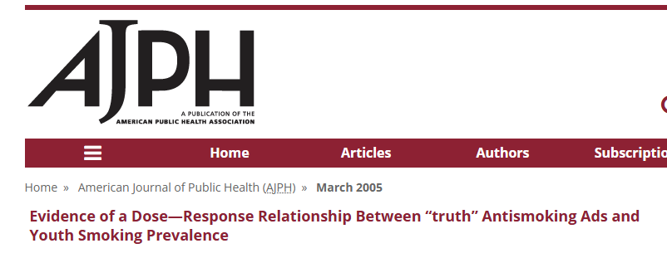
How do you know it worked?
Evaluation:
Research study -
Objectives. In early 2000, the American Legacy Foundation launched the national “truth” campaign, the first national antismoking campaign to discourage tobacco use among youths. We studied the impact of the campaign on national smoking rates among US youths (students in grades 8, 10, and 12).
Methods. We used data from the Monitoring the Future survey in a pre/post quasi-experimental design to relate trends in youth smoking prevalence to varied doses of the “truth” campaign in a national sample of approximately 50000 students in grades 8, 10, and 12, surveyed each spring from 1997 through 2002.

Slide 12
Results from Research Study
Results. The campaign accounted for a significant portion of the recent decline in youth smoking prevalence. Smoking prevalence among all students declined from 25.3% to 18.0% between 1999 and 2002 and the campaign accounted for approximately 22% of this decline.
Success!

Slide 13
Creating your own communication plan
What are your objectives?
Program goal
Communication goal(s)
Audience(s)
What will you say and how?
Key messages
Methods/tactics

Slide 14
Mapping out the details
Steps
Materials
Resources
Timeline
Evaluation

Slide 15


Thank you!
Bluesky
@UConnRudd.Bsky.Social
LinkedIn
UConn Rudd Center for Food Policy and Health
Website
uconnruddcenter.org/adolescent-citizen-scientists

