Slide 1

Co-designing the Food Resource Guides
Adolescent Citizen Scientist Program

Slide 2
What is program co-design?
A way to design a program considering input from key personnel at the beginning and throughout the design process.
Key personnel include:
  People or organizations who can implement or guide the program.
  Those who will benefit from the program.

Slide 3
Goal: Decrease food insecurity among Hartford Public High School (HPHS) students and families
  Formative research informed this goal, including focus group findings , discussions with HPHS students, teachers, and staff, and consultation with community advisory board.
  Wanted to develop a feasible and sustainable way to achieve goal.

Slide 4

Highlights of the Co-design Journey

Slide 5


Meeting with Interim Lead of HPHS Food Pantry
School food pantry available to students and their families
Students have a high levels of responsibility for their families
Even though staff work to make them welcome, students in need may not reach out:
    Feeling embarrassed/ashamed
    Limited pantry hours and refrigerator & freezer capacity
    Inconvenient – students live further away, hard to carry bags
Can increase awareness of school pantry
Other food resources are needed

Slide 6
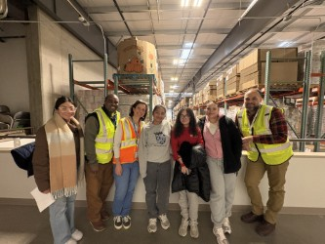
Visit to Connecticut Foodshare
Food bank in Connecticut
Met with staff responsible for volunteers, mobile food pantry, and coordinating with food pantries
Supports over 600 food pantries and other food programs
Supports over 100 mobile food pantry sites – delivers fruits, vegetables, and other nutritious food
They ensure clients at pantries they support are treated with dignity, not asked personal questions

Slide 7
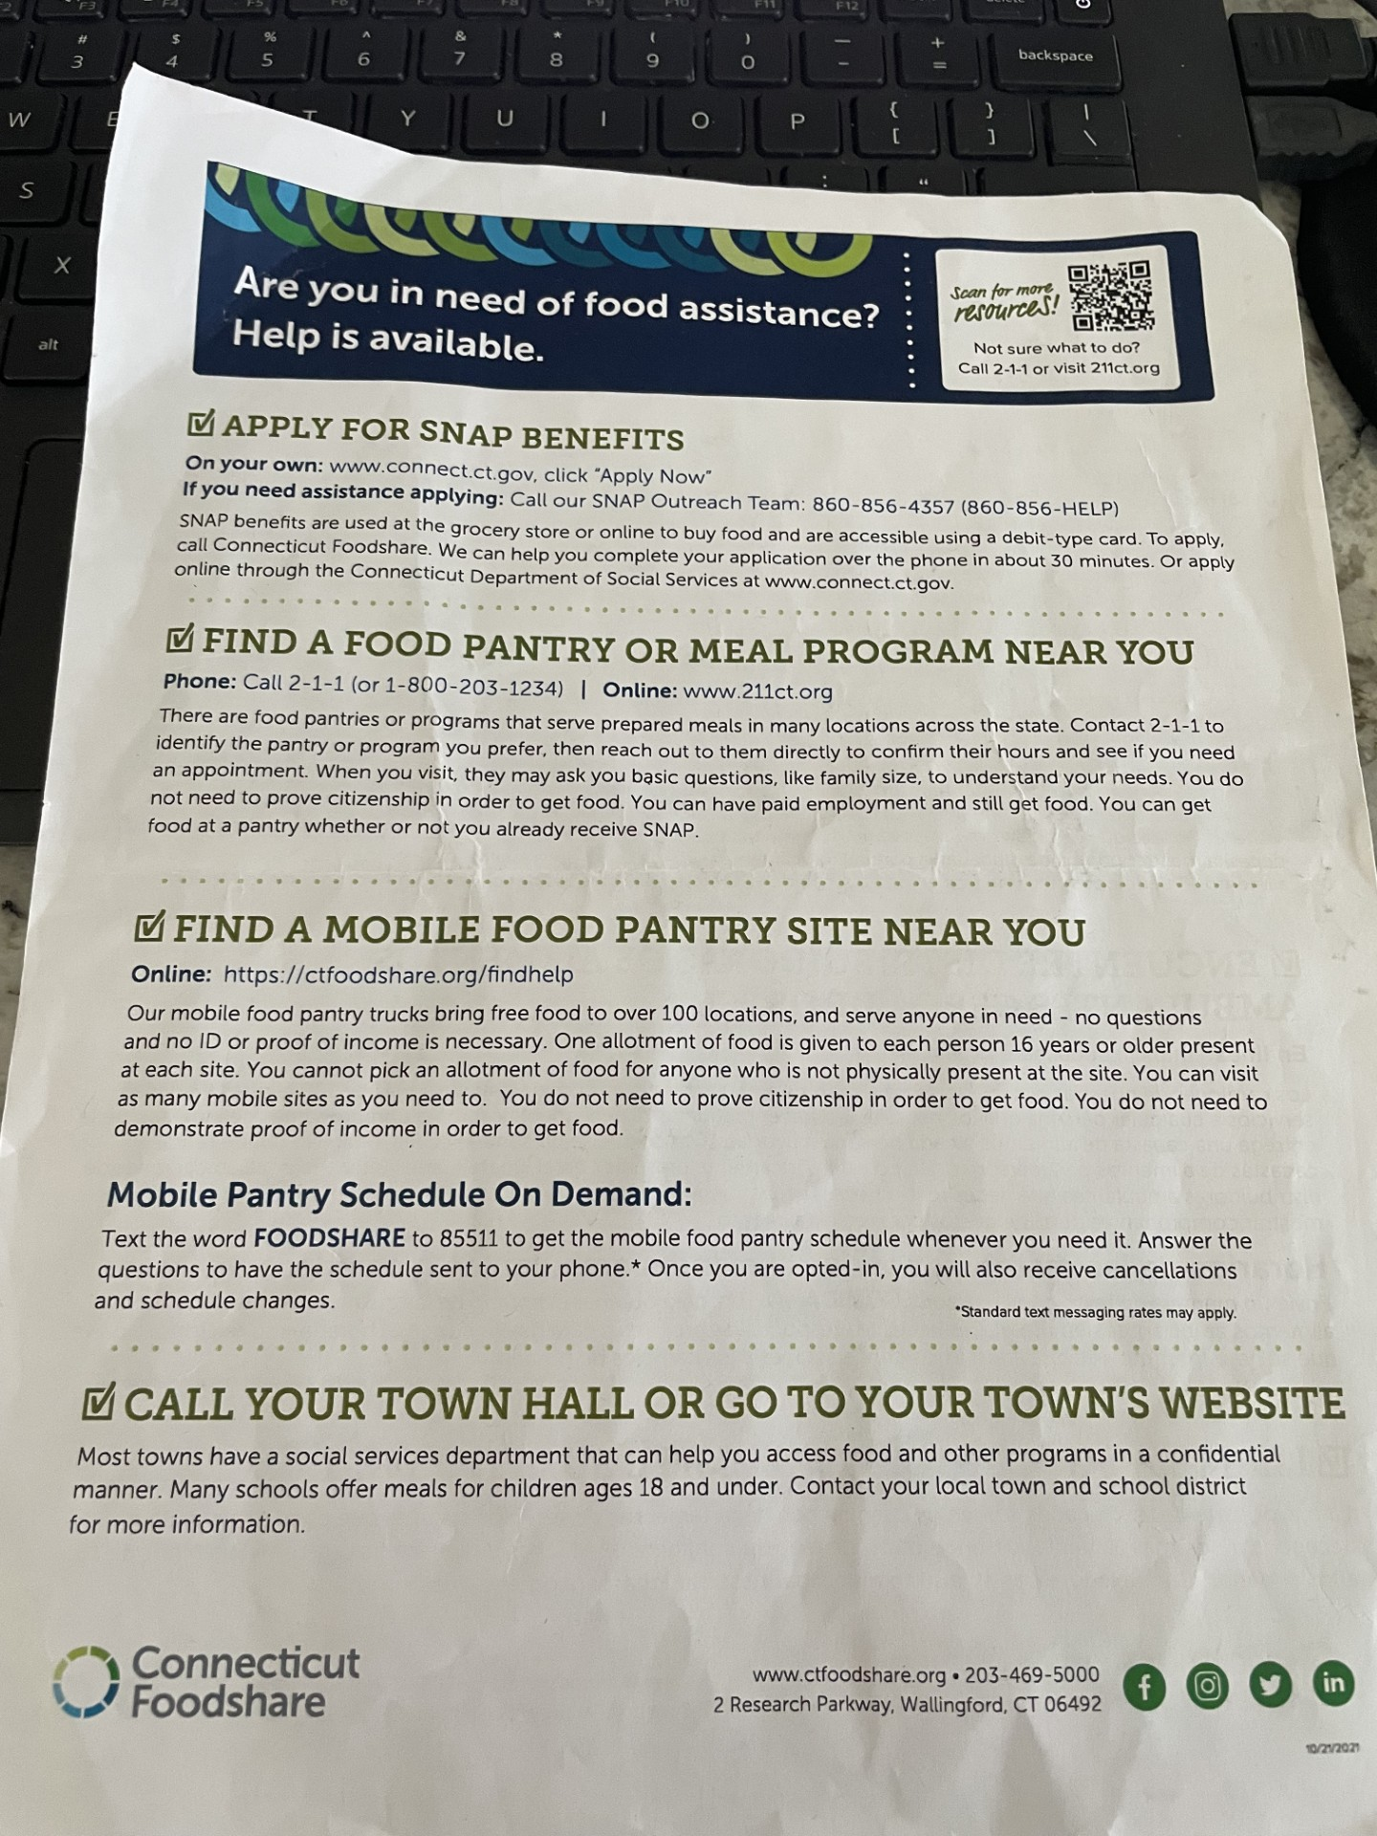
Connecticut Foodshare’s Food Assistance Sheet
We learned about this resource during visit to CT Foodshare
This sheet helped to inspire our project

Slide 8
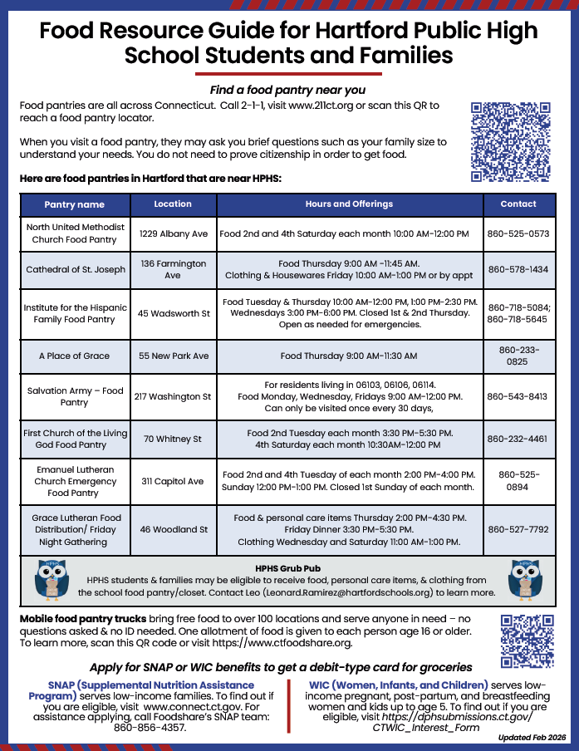
1st Version of Guide - Single Page
Since HPHS has many Portuguese- and Spanish-speaking families, the guide was created in English, Spanish, and Portuguese
QR codes and links to online locators for food pantries, mobile food pantry trucks
List of food pantries near HPHS with hours and what they offer, Teresita from CT Foodshare advised
How to access our school food pantry
Contact information for support in signing up for WIC and SNAP benefits

Slide 9
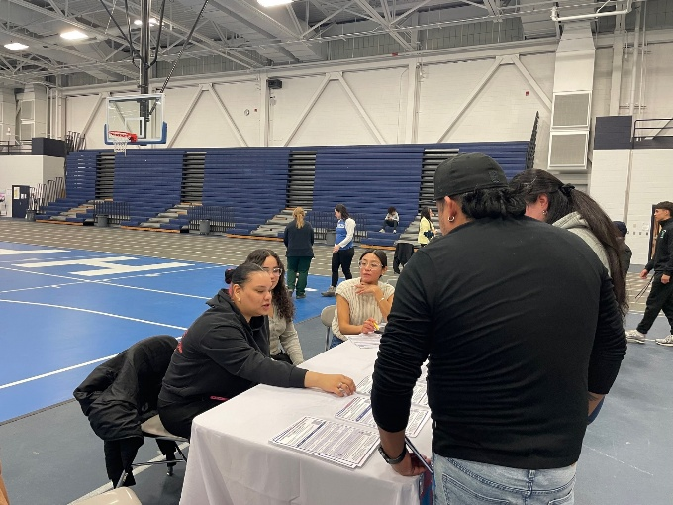
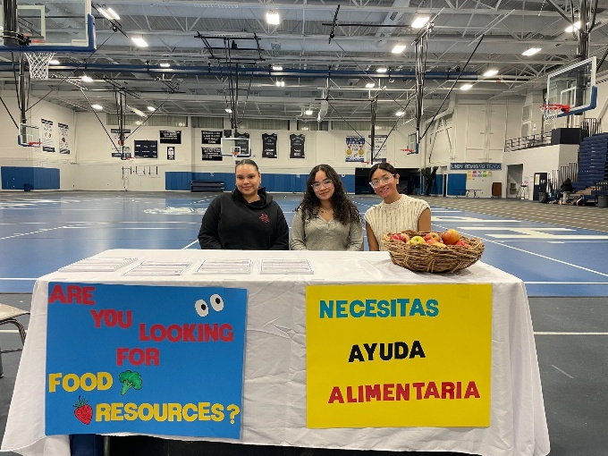
Parent-Teacher Conference
School administrators asked us to distribute food assistance information
Handed out first version of the guide (English, Spanish, and Portuguese)
Parents appreciated the information, most discussions were with Spanish-speaking families

Slide 10
Made an Improved Version of Guide
Created and refined with feedback from key personnel (students, school counselor and administrators, parents, food bank staff)
Wanted it colorful, eye-catching, appealing to students
Needed larger font size, spread information out to two pages
Selected a slogan to use on guide, posters and social media posts, important for dissemination to have consistent message
Added language that takes away stigma, embarrassment
Included summer meal information

Slide 11
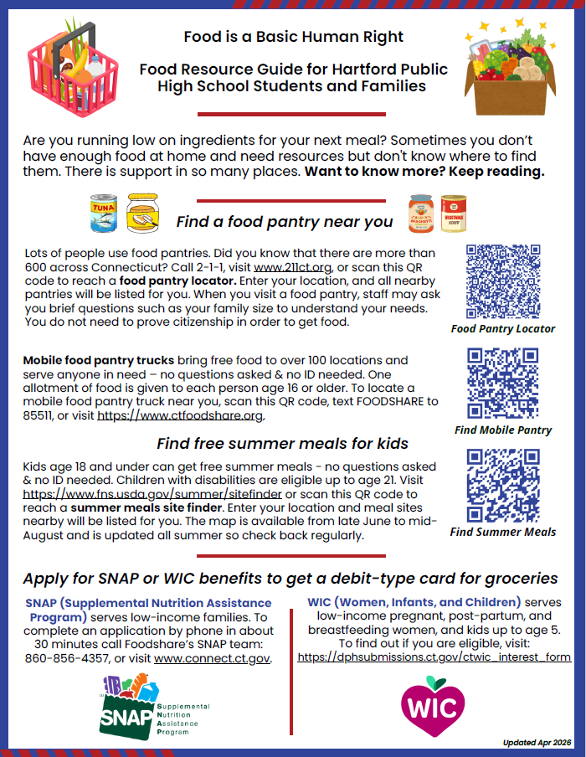
2-Sided Version, Front
In English, Spanish, and Portuguese
Slogan and non-stigmatizing language, colorful
QR codes and links to online locators for food pantries, mobile food pantry trucks, summer meal program
Contact info for support in signing up for WIC and SNAP benefits

Slide 12
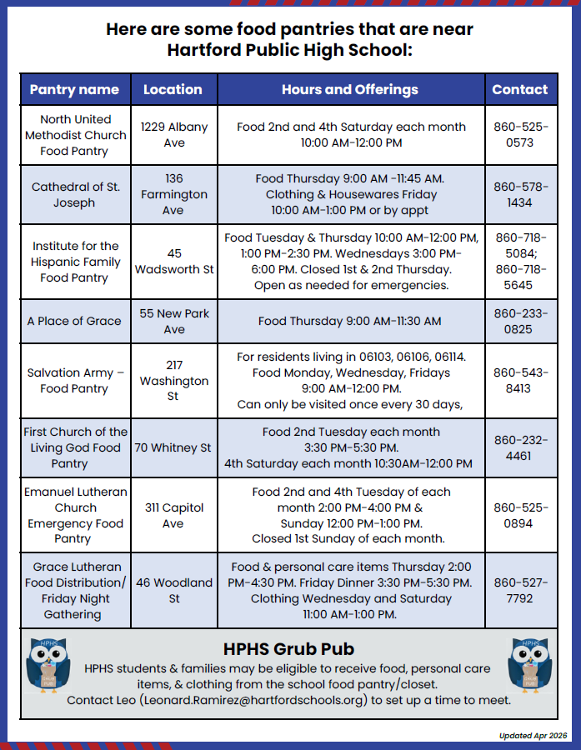
2-Sided Version, Back
List of food pantries near HPHS with hours and what they offer
How to access our school food pantry

Slide 13
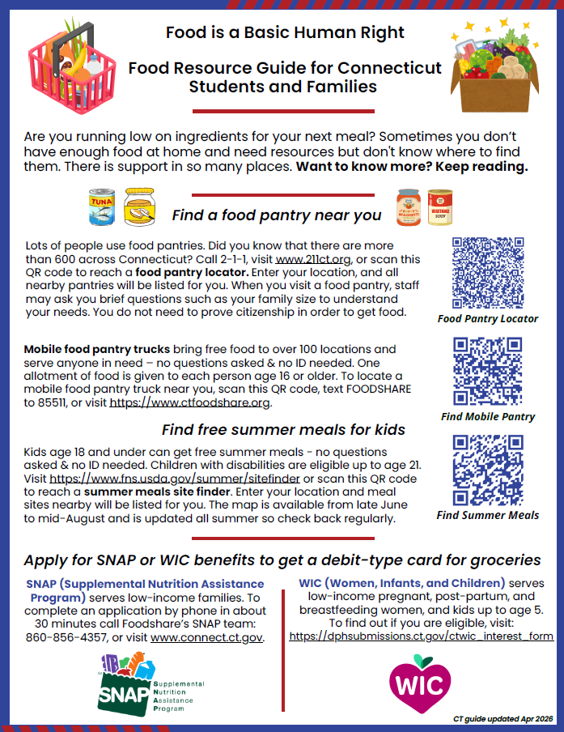
All CT Guide
Changed title to: Food Resource Guide for Connecticut Students and Families
Created after realizing the information on the first page of the guide would be helpful for people across Connecticut, not just HPHS families
Removed 2nd page with list of food pantries near HPHS and how to access school food pantry
Guide is 2-sided, same information on front in English and back in Spanish

Slide 14
Ensured these Food Guides Will Last
Confirmed with staff from CT Foodshare that links and contact information on the guides are stable
The food pantries near HPHS listed on the HPHS Food Guide are well established and all have phone numbers listed in case hours of operation change.

Slide 15
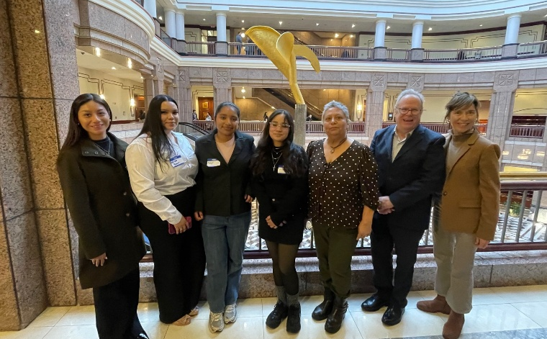
Site Visits and Experiences that Contributed to the Co-Design

Slide 16
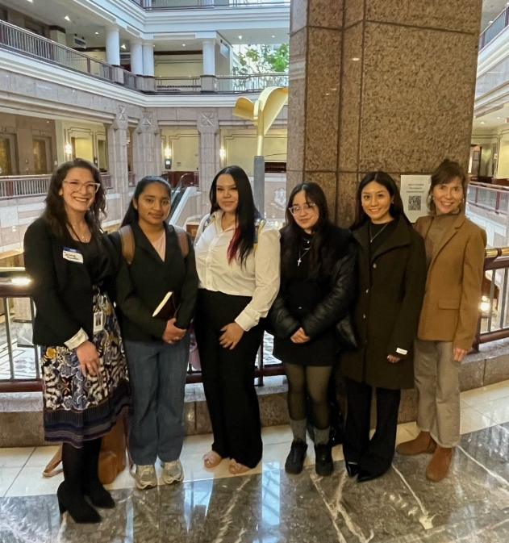
Moving Beyond Implications Statehouse Convening
Event where researchers present to CT legislators
Learned that research is important to convince legislators to support policies
Community members are invested in community change, can make a difference
First time in statehouse
Met Representative Jaime Foster

Slide 17
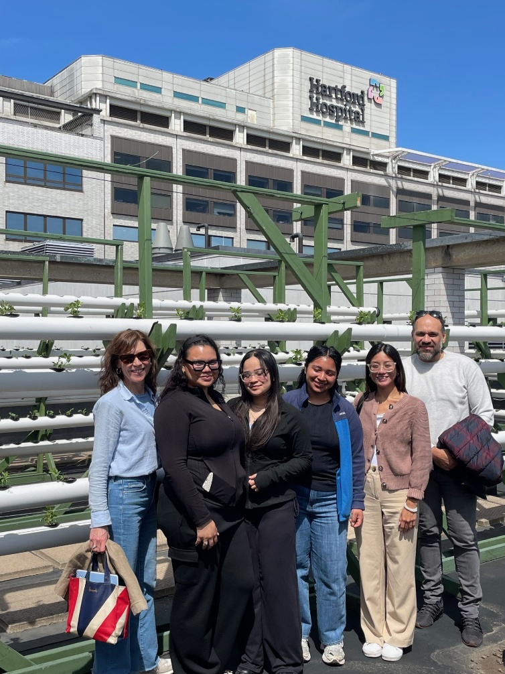
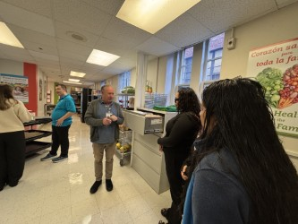
Hartford Hospital Food4Health Clinic
Produce prescription program, different than food pantry
Addresses health issues related to diet
Located in hospital
Encourages clients to try new fruits and vegetables
Provides coaching and recipes
Very welcoming
First time seeing vegetables growing on rooftop, hydroponic garden

Slide 18
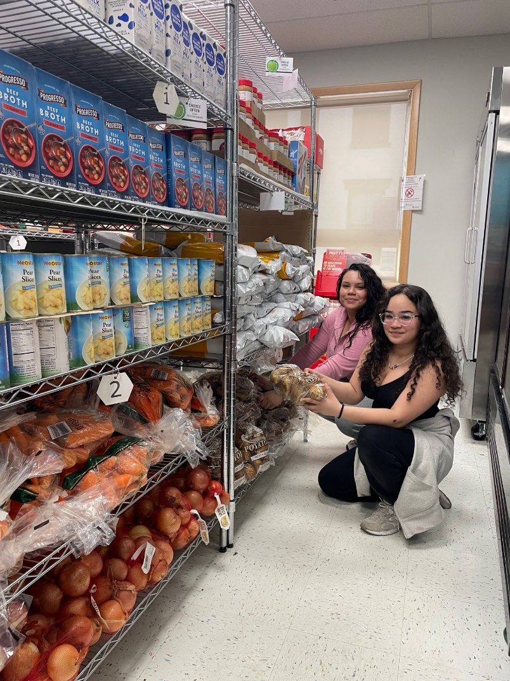
Institute for Hispanic Health Food Pantry
Highly organized
Kind to clients
Stocks fresh vegetables, meat, and fish
Good refrigeration
We assisted in stocking shelves and helping clients select food
Provides food, personal care items, baby clothing, and books
Worked with staff and committed community volunteers

Slide 19
Major Key Personnel who Contributed
Community Advisory Board members
CT Foodshare staff
Community food pantry staff members and volunteers
HPHS students and parents, and teachers, counselors and other school staff, especially former and current HPHS food pantry leads
Hartford School District leadership
ReadyCT team
ACS program team

Slide 20


Thank you!
Bluesky
@UConnRudd.Bsky.Social
LinkedIn
UConn Rudd Center for Food Policy and Health
Website
uconnruddcenter.org/adolescent-citizen-scientists

