Slide 1




Food Access and Community Resources: Session 4
Adolescent Citizen Scientist Training

Slide 2
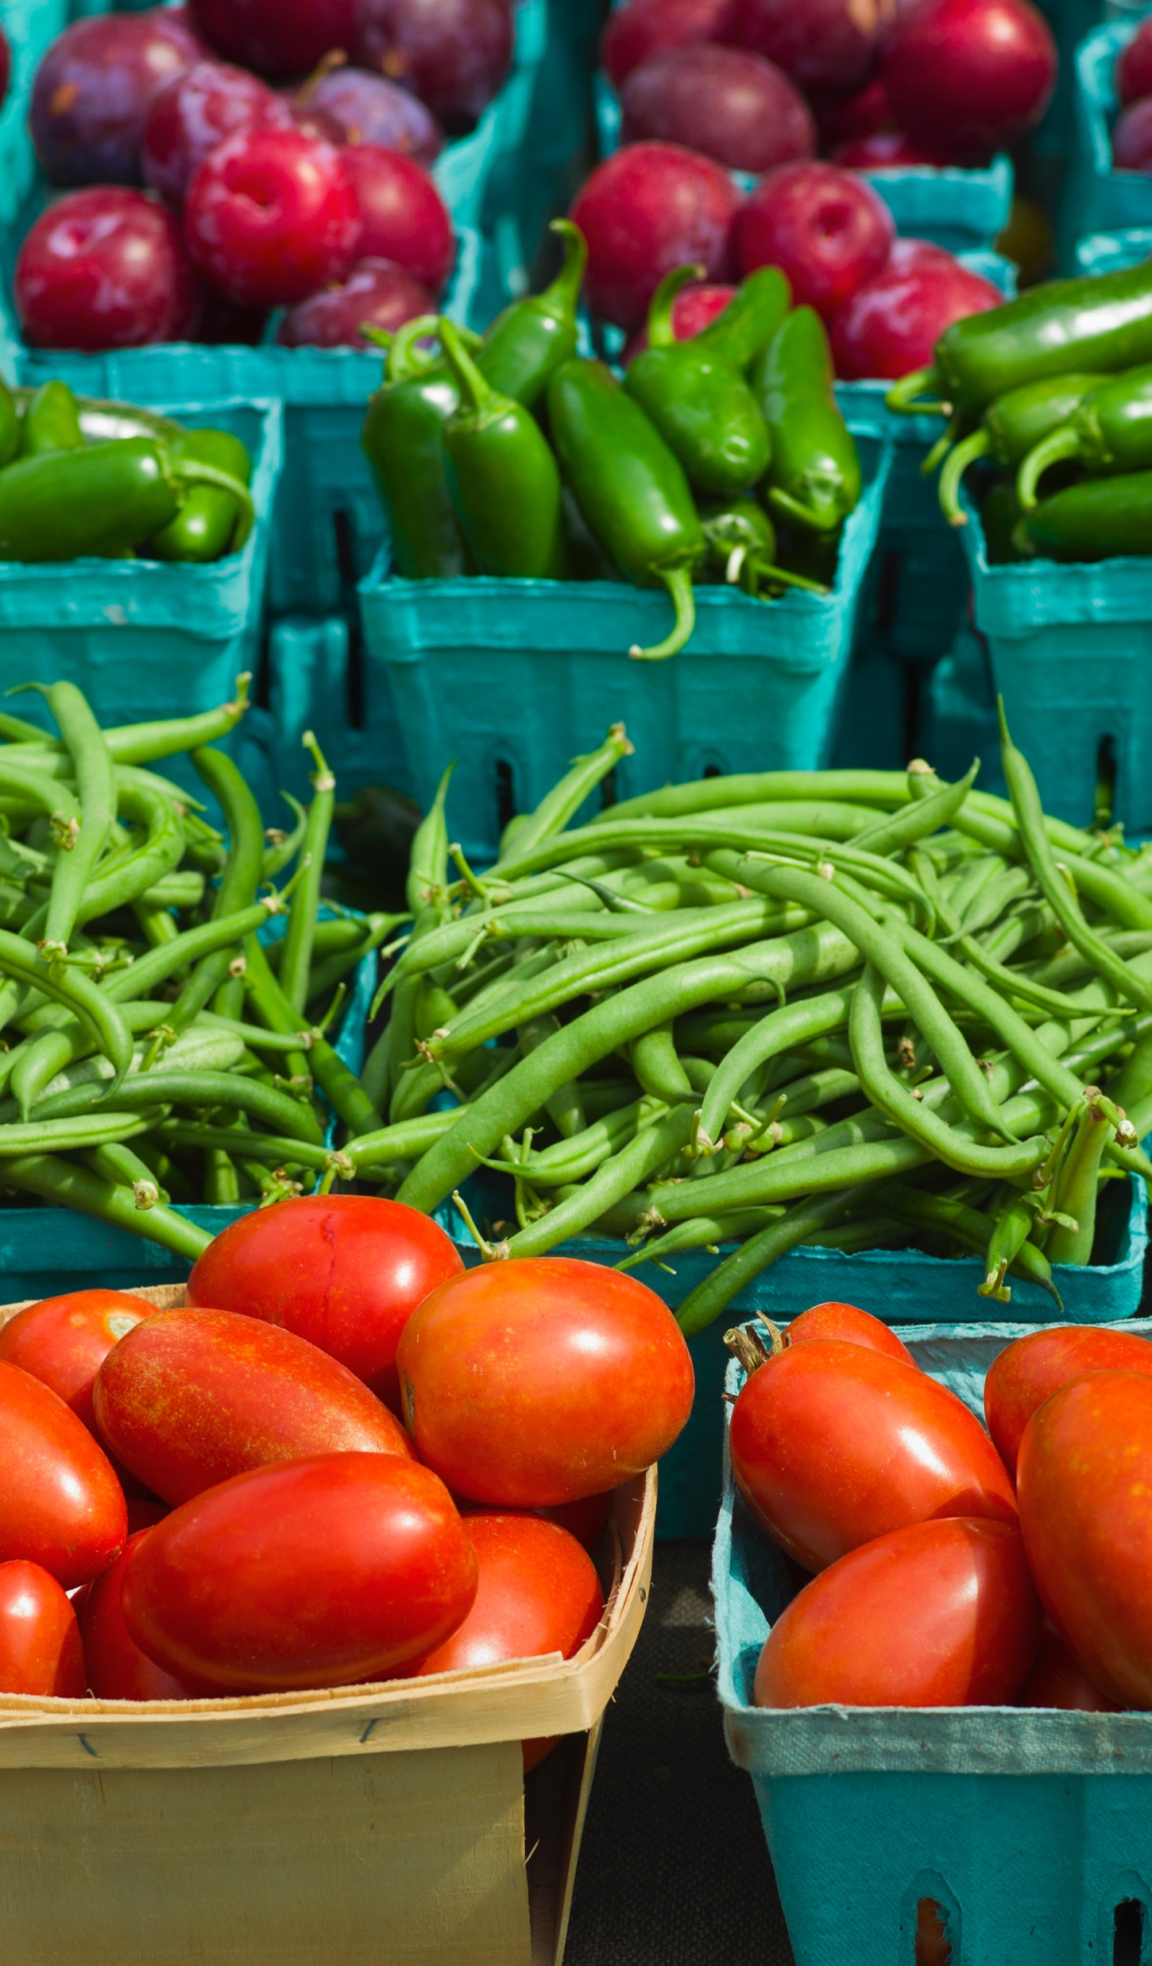
Learning Objectives
By the end of this session, students will be able to:
Explain what food insecurity is and how it affects health and wellbeing.
Recognize barriers that can make it difficult for people to access healthy foods.
Identify community resources and food assistance programs available to support individuals and families.
Discuss ways communities can improve access to healthy foods and reduce food insecurity.

Slide 3
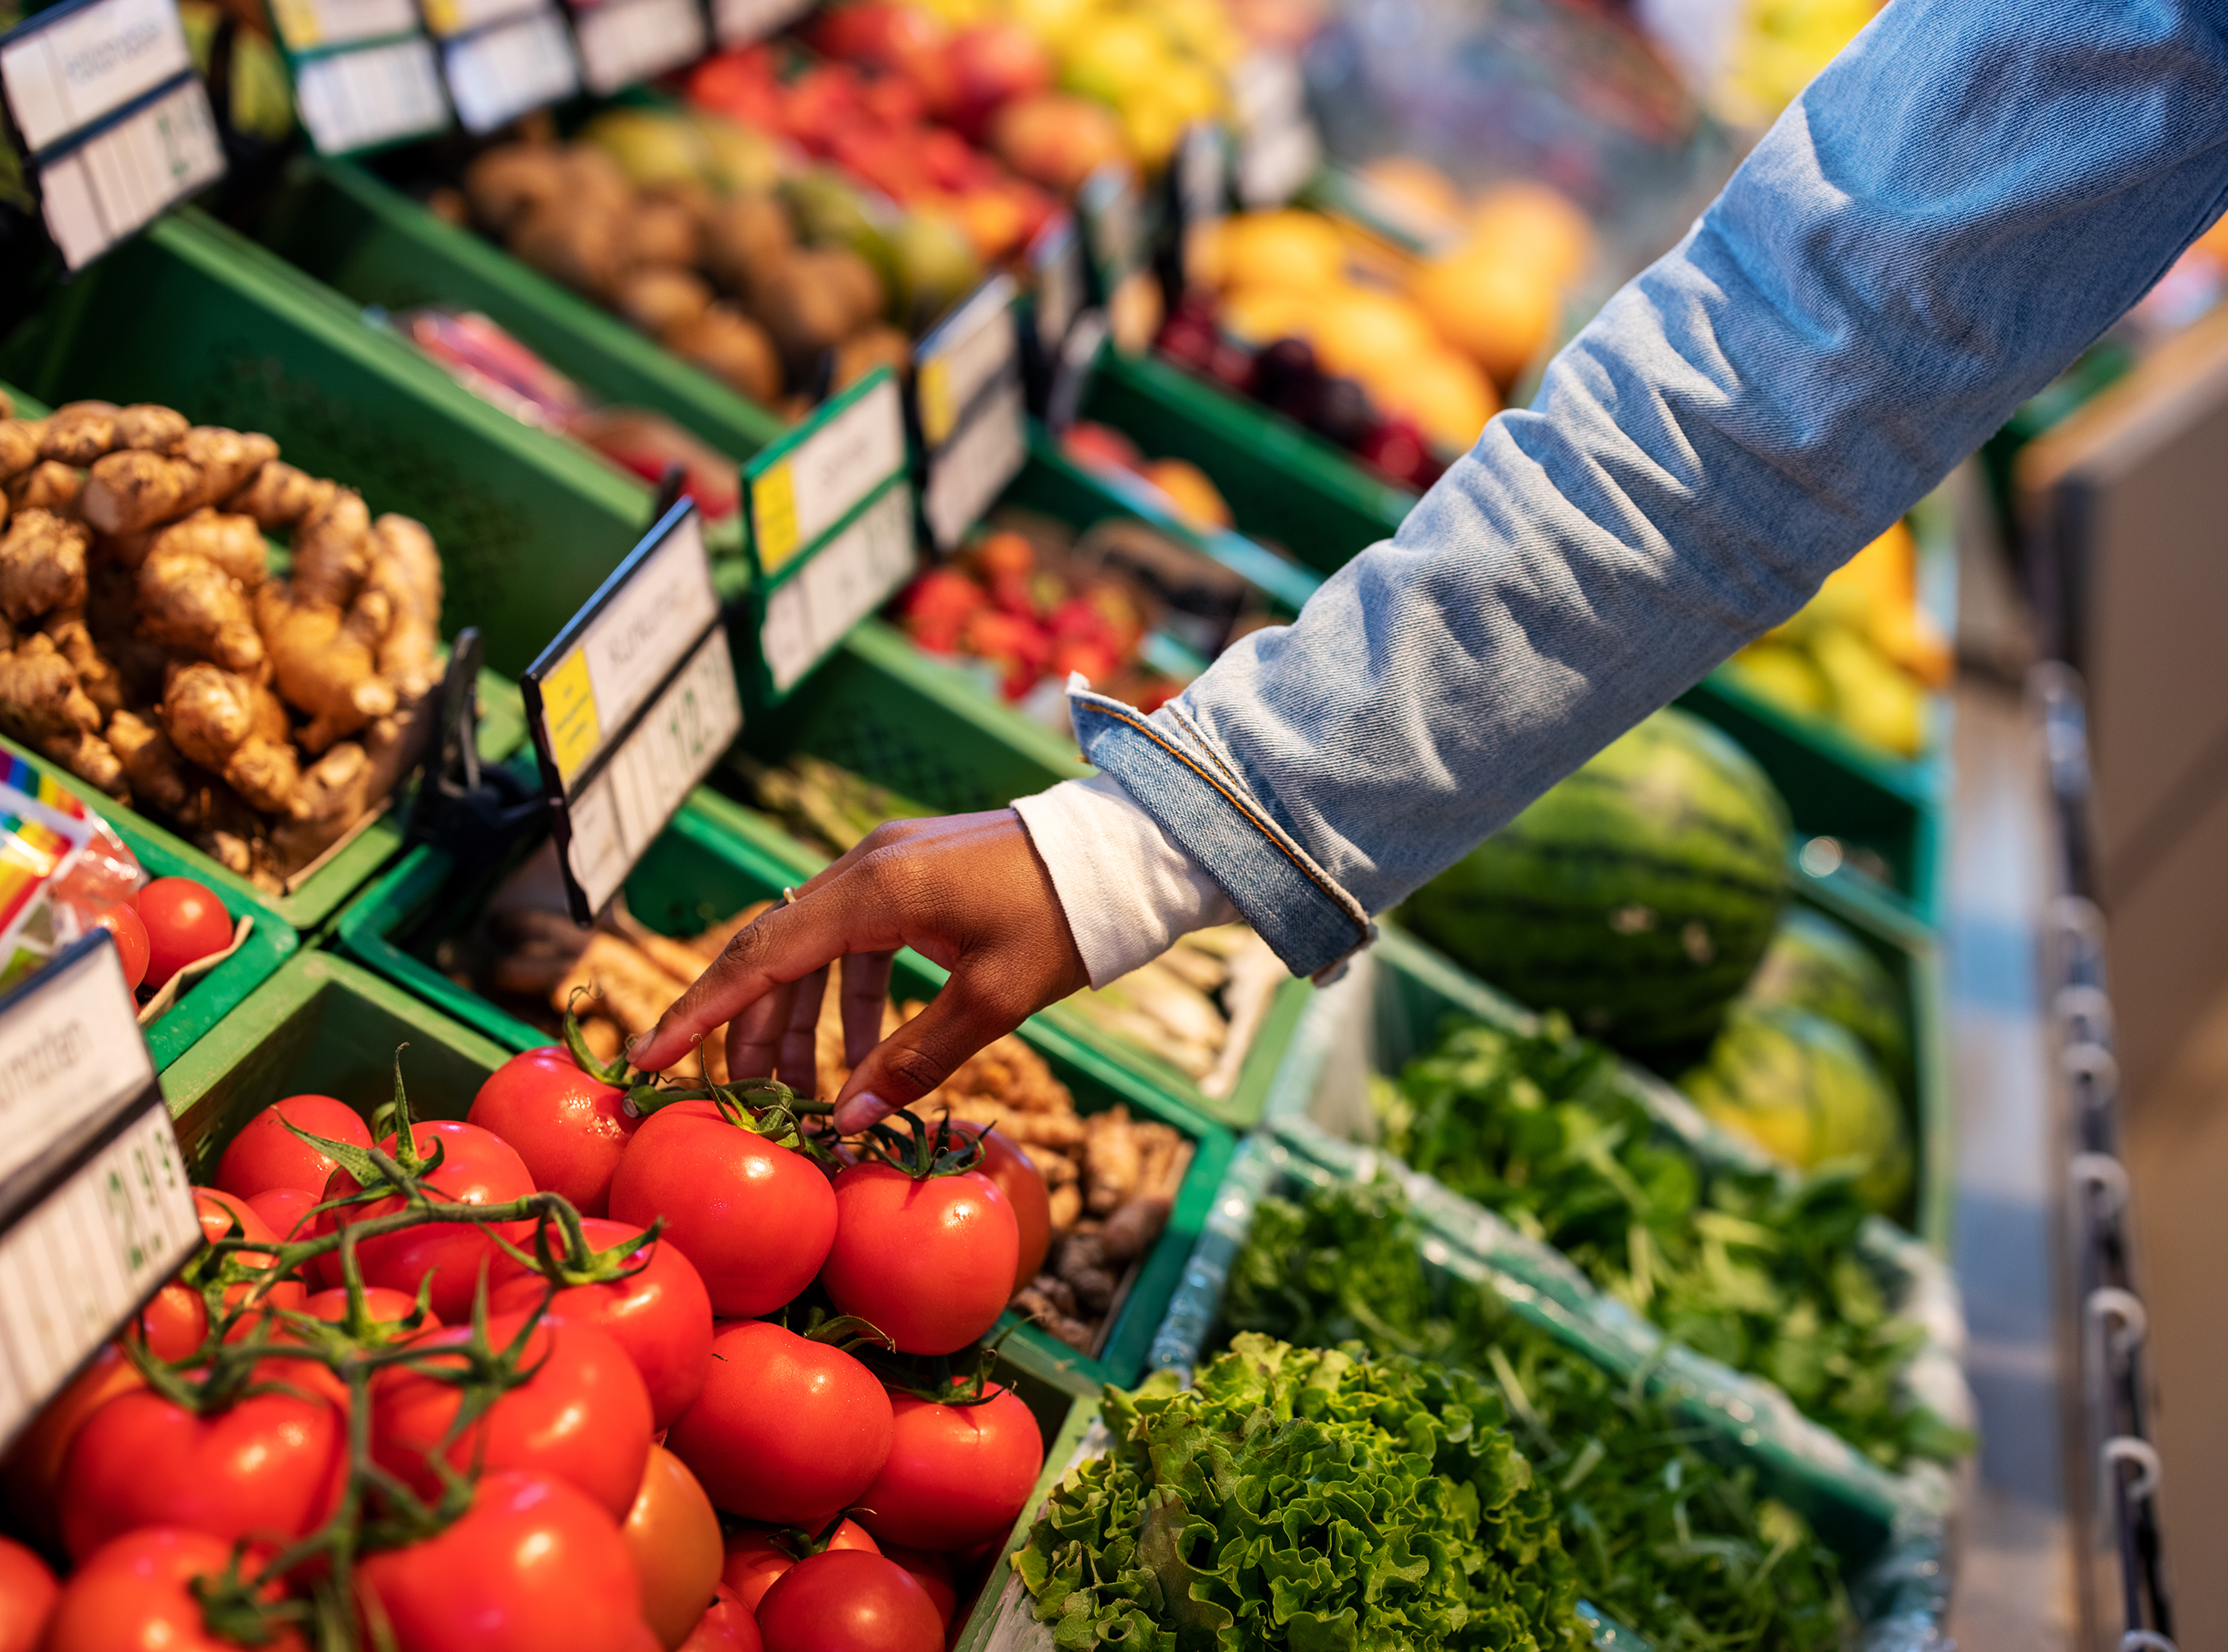
Discussion Questions
What makes it easy or difficult for you to eat healthy foods?
Does everyone in our community have the same access to healthy foods? Why or why not?
What challenges might families face when trying to purchase healthy foods?

Slide 4
What is food security versus food insecurity?
Food security is when “people, at all times, have physical, social and economic access to sufficient, safe and nutritious food which meets their dietary needs and food preference for an active and healthy life” (Food and Agriculture Organization)
Food insecurity is the lack of consistent access to enough safe, nutritious food needed for an active and healthy life
Food insecurity “is a household level economic and social condition of limited or uncertain access to adequate food” (USDA)

Slide 5
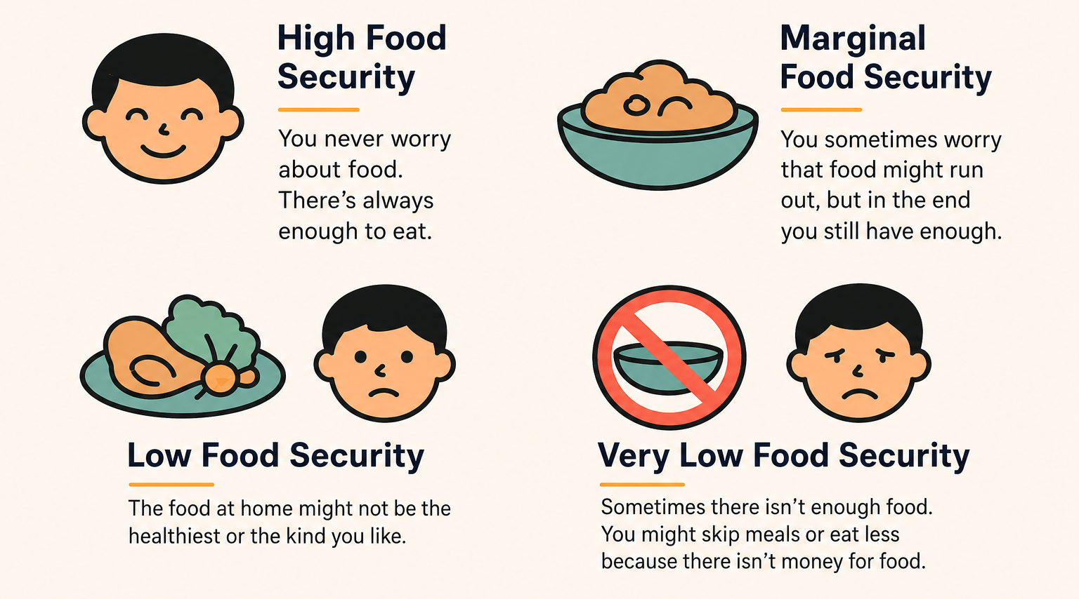
Levels of Food Security
Source: Food Security in the U.S. - Definitions of Food Security | Economic Research Service

Slide 6

Causes of Food Insecurity
Income: Healthy foods can sometimes cost more than unhealthy foods
Transportation: Not everyone has a car or reliable transportation to get to a grocery store.
Grocery store availability: Some neighborhoods have few stores that sell fresh food.
Food prices: Rising costs can make it difficult for families to purchase healthy foods.
Time: Families with busy schedules or multiple jobs may have less time to shop and prepare meals.

Slide 7
Effects of Food Insecurity
Food insecurity can affect many areas of a person’s life, including:
Physical health: People may not receive all of the nutrients they need for proper health
Mental health: People may experience anxiety and stress thinking they may run out of food
Performance at school or work: Hunger can make it harder to focus, learn, and perform at your best
Family stress: Limited resources and food access can cause families to stress

Slide 8
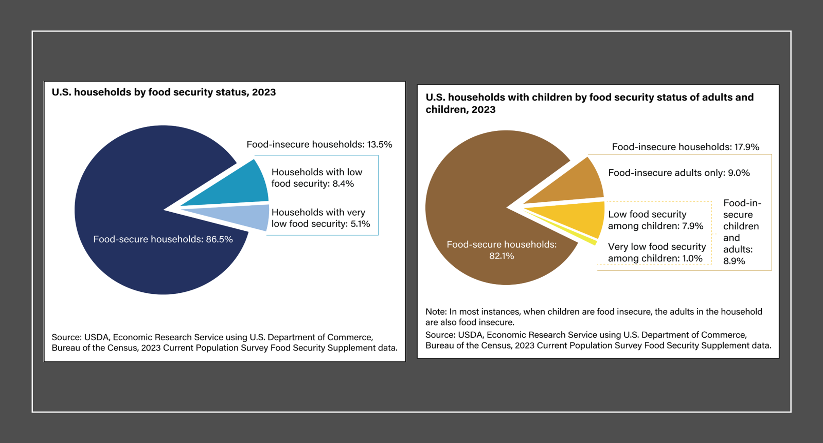
U.S. Household Food Security, 2023

Slide 9
Food Insecurity in Connecticut, Hartford, and the U.S.
Sources: USDA 2023, Annual Report 2024 Commission on Women, Children, Seniors, Equity, and Opportunity,

Slide 10
Why were government food assistance programs created?
These programs were created to:
Reduce hunger and support low-income families in buying and accessing nutritious food during hard times
Improve health, since the lack of nutritious food leads to health problems.
Reduce poverty and improve food security
Strengthen the economy.
When families have food, they stay healthier, kids do better at school, and parents have higher productivity.

Slide 11
SNAP
SNAP (the Supplemental Nutrition Assistance Program) is the largest federal food assistance program for individuals and families.
Helps people with limited incomes to buy groceries.
Participants receive monthly funds on an EBT card (like a debit card) to buy food at stores, farmers markets, and some online retailers.
Benefits are calculated by your household total gross income per household size with some deductions.
You can only buy food or non-alcoholic beverages with your SNAP benefits.

Slide 12
School Meals
Officially called the National School Lunch & Breakfast Program
Covers children and teens (up to age 18)
Free or reduced-price meals at school
Ensures students receive nutritious food
Supports learning & health
The Summer Nutrition Program provides free meals during the summer and school breaks to replace school meals

Slide 13
WIC
WIC (the Special Supplemental Nutrition Program for Women, Infants, and Children) helps pregnant and postpartum women, infants and children under age 5
Provides monthly food benefits for specific nutritious foods (milk, eggs, cereal, fruits, vegetables, whole grains, infant formula, etc.)
Nutrition education
Breastfeeding support
Referrals to healthcare and social services

Slide 14
Non-Governmental Food Resources
Food Pantries +
Mobile Food Pantries
Food Banks
Soup Kitchens +
Meal Programs
Community Kitchens

Slide 15

The Hunger Gap
Food exists but is not affordable.
Housing costs and low wages strain budgets.
Even SNAP, WIC, and other programs may not cover needs.
What kind of trade-offs might people make for food?

Slide 16
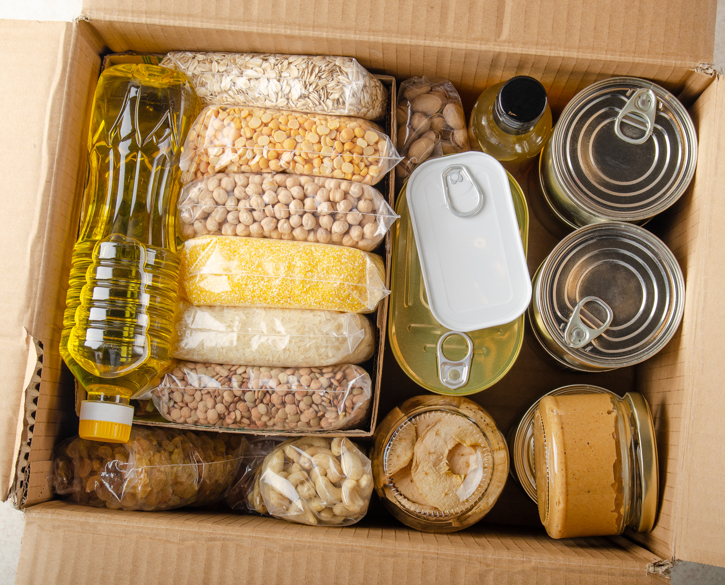
Activity 1:
Community Food Resources Assessment
What are some examples of community resources or programs increasing food access in your community?
Make a list of supermarkets, corner stores/bodegas, food pantries, farmers markets and any other food resources in your school or home area.
For food assistance programs of any king: (1) Add details (address and hours of each place) and (2) Add public transportation routes.
Be prepared to discuss your list the next time we meet.

Slide 17

Activity 2:
Calculate SNAP Benefits
The average SNAP benefit for a family of 5 in Connecticut is approximately $845 per month.
Instructions:
Using the table from this link Food Assistance - SNAP--Eligibility, webpage to calculate the monthly benefit for a family of different household sizes. Choose one family size (for example, 2,4, 5 or 6 people)
Select an online supermarket that accepts SNAP benefits.
Create a one-week grocery shopping list for your chosen family using only the SNAP benefit amount available for one week.
Use MyPlate to make sure your shopping list includes healthy foods from all five food groups.
Plan a nutritious one week-menu while staying within the family’s SNAP budget.
Think if what this family spends during the week will be enough to buy with their SNAP benefits. What does it not cover?

Slide 18

Thank you!
Bluesky
@UConnRudd.Bsky.Social
LinkedIn
UConn Rudd Center for Food Policy and Health
Website
uconnruddcenter.org/adolescent-citizen-scientists

