Slide 1




The Nutrition Facts Label:
Session 3
Adolescent Citizen Scientist Training

Slide 2

Learning Objectives
At the end of this session, students will be able to:
Read and interpret Nutrition Facts labels.
Compare similar food products using nutrition Information.
Identify nutrients to increase and nutrients to limit.
Use the % Daily Value (DV) to make healthier food and beverage choices.

Slide 3
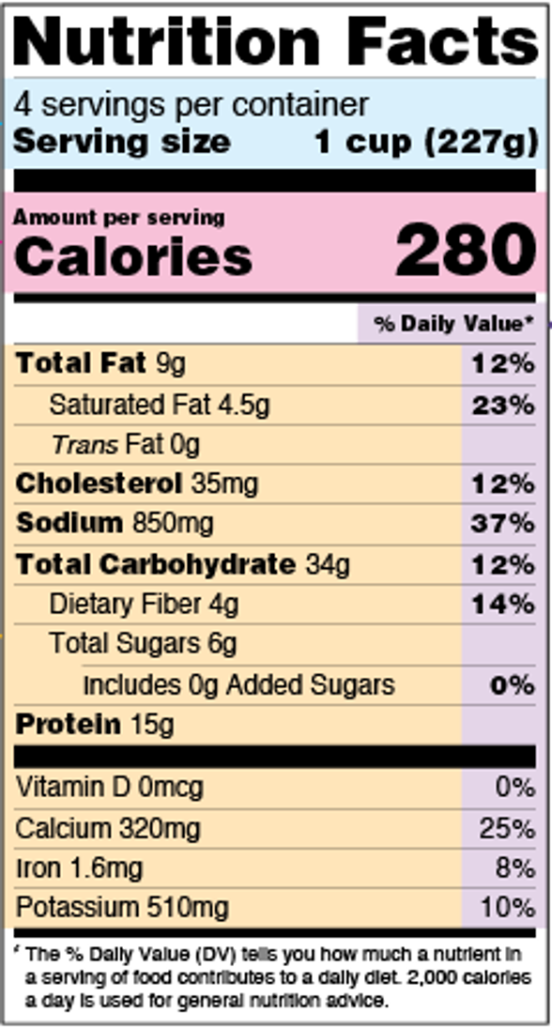
Discussion Questions
Have you ever seen Nutritional Facts labels on foods or drinks?
Why is the purpose of this label?
What are the things that you notice on this label?

Slide 4
Importance of Reading the Nutrition Facts Label
Food labels help us compare similar food or beverage products.
  We can look at different brands and choose the healthiest one.
They provide us with important nutritional information.
  This information helps us determine the nutritional value of a product.
We can check if food claims are true.
  Claims like “low sugar,” “low fat,” “no added sugar” can be verified by reading the Nutrition Facts label
The ingredient list gives us important details.
  They show everything that is added to food
  Ingredients are listed from the highest to the lowest amount
  This list helps us identify added sugars, preservatives, and other additives . For example, if a “low sugar” claim is on the front of package, what type of sweetener was added to make the product taste sweet?

Slide 5
Nutrition Facts Label
Components
What is a nutrient? A substance found in food or drinks that our bodies use for energy and for other important functions that help us grow, develop, and maintain good health.
The Nutrition Facts lists key nutrients in grams (g), milligrams (mg), or micrograms (mcg).
It includes the % Daily Value, which helps you to understand if a food is high or low in nutrients and supports healthier food choice

Slide 6

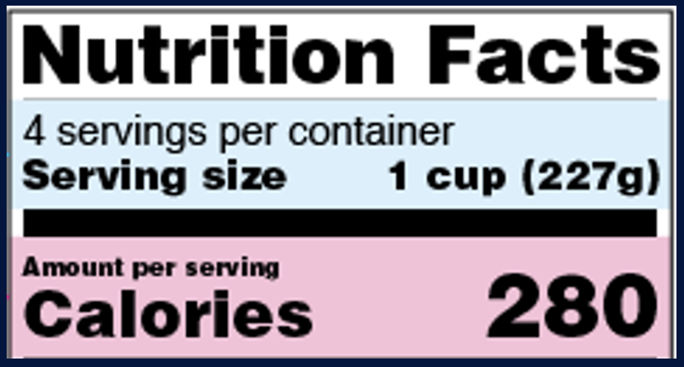
Serving Size, Servings Per Container, and Calories
Start with reading the serving size. All the information on the label is based on one serving.
  What is the serving size for this product?
Many packages contain more than one serving.
  How many serving does this container have?
The label shows the number of calories per serving.
  How many calories does this product have per serving?
100 calories per serving is considered a moderate amount, while 400 calories or more per serving is considered high amount.

Slide 7
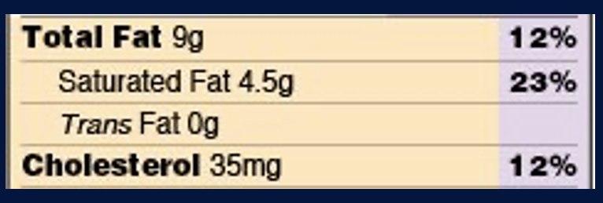
Fats
Total fat includes all the types of fat in the food.
Saturated fat is found mostly in animal products such as meat, butter, and cheese.
It is usually solid at room temperatures.
Eating too much saturated fat can raise blood cholesterol levels.
Trans fats are an unhealthy type of fat. They increase the risk of heart disease and stroke over time.
They are created when liquid oils are changed into solid fats through a process called hydrogenation.
  On food labels, trans fats may be listed as “partially hydrogenated oils”

Slide 8

Sodium
Sodium is added to foods to improve flavor and help preserve them.
Unhealthy foods often contain high amounts of sodium.
High consumption of sodium can lead to high blood pressure.

Slide 9
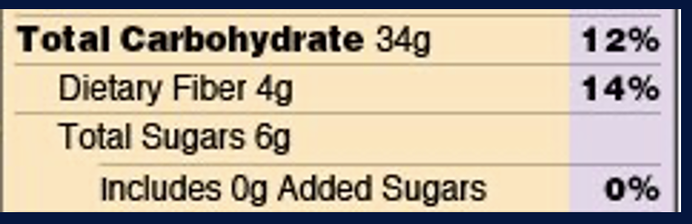
Total Carbohydrates
Total Carbohydrates include:
  Dietary Fiber
  Total Sugars
  Added Sugars
Dietary fiber is a type of carbohydrate that keeps your digestive system healthy, and it help you feel full longer.
Total sugars include both natural sugars and added sugars. Limit or avoid foods with added sugar since it can lead to weight gain, increasing the risk of type 2 diabetes and other health problems.

Slide 10
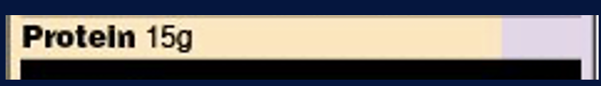
Protein
Protein is a nutrient found in a variety of plants and animal foods.
It is necessary for proper growth, development, and repairing the cells in your body.
It is recommended to eat a variety of protein foods from plant and animal sources.

Slide 11
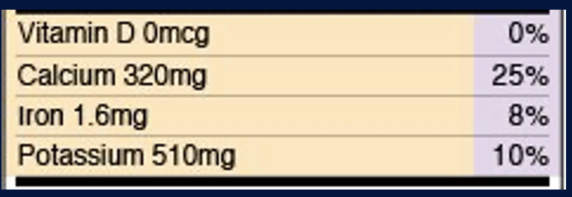
Vitamins and Minerals
Vitamins and minerals are needed in small amounts, but they play a big role in keeping our bodies healthy.
Calcium helps build strong bones and teeth.
Vitamin D helps your body use calcium for your bones.
Iron helps to carry oxygen in the blood to all parts of the body. Low iron levels can lead to anemia, which may cause tiredness and weakness.
Potassium is important for the health of your heart.

Slide 12

Percentage of Daily Value (%DV)
The % Daily Value (%DV) shows how much of a nutrient in one serving contributes to your daily needs or limits.
It helps you compare foods and make healthier choices.
Use %DV to see if a food is low or high in a specific nutrient.

Slide 13
% Daily Value Quick Guide
Quick Guide:
  5% DV or less = Low in that nutrient
  10–19% DV = Good source of that nutrient
  20% DV or more = High in that nutrient
Tips for Healthy Choices:
  Choose foods that are high in fiber, calcium, iron, and potassium.
  Limit foods that are high in saturated fat, trans fat, sodium, and added sugars.

Slide 14
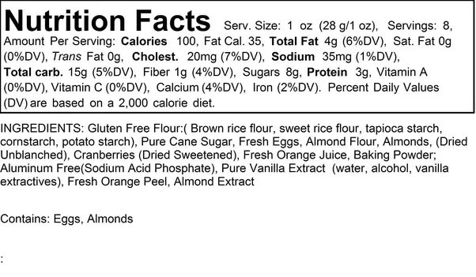
Ingredient Lists
Ingredients are listed from the largest amount to the smallest amount by weight.
  The first few ingredients make up most of the product
A shorter ingredient list of often means that there are less added ingredients.
Use the ingredient list to identify ingredients to limit, such as added sugar (pure cane sugar, sugar, maple syrup)

Slide 15
Activity 1
Look at this Nutrition Facts label and explain:
What nutrients are in the product?
What nutrients is this product high in? What nutrients is this product low in?
What vitamin or mineral is the highest in this product?

Slide 16
Activity 1 - Answers
Check out the % Daily Value!
This product is a low source of…
Added Sugars and Vitamin D
This product is a high source of…
Saturated Fat, Sodium, and Calcium

Slide 17
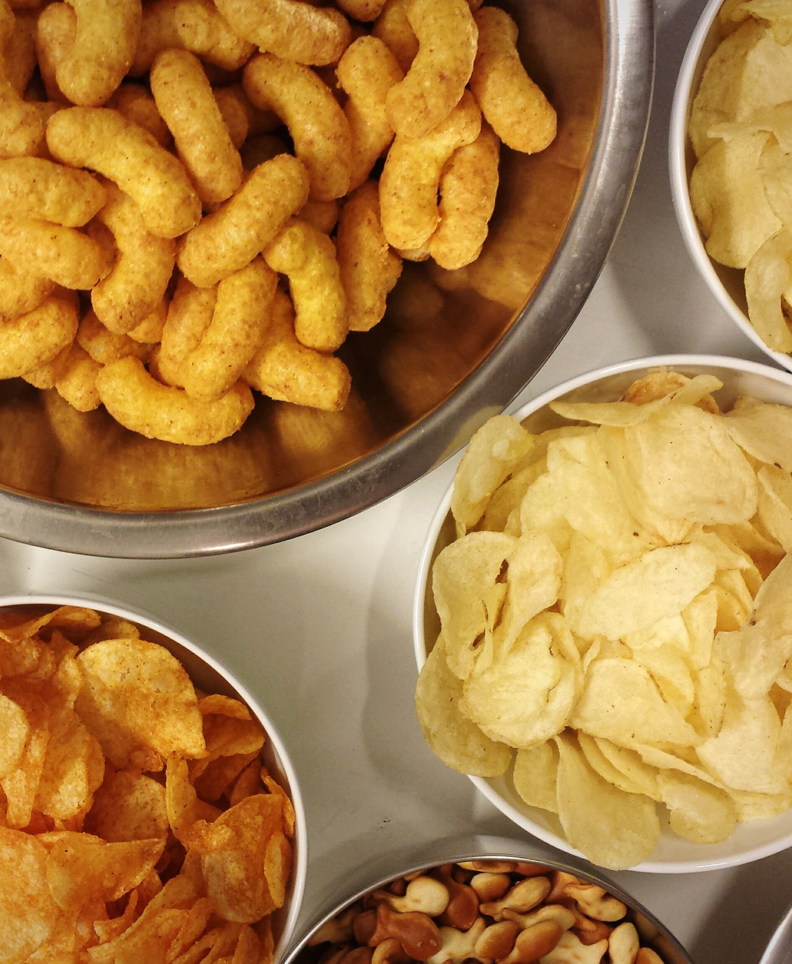
Activity 2
In teams, compare food labels for similar products (different types of snacks, cereals, and drinks) and decide and explain which ones are the most nutritious.
Take notes and be prepared to explain.

Slide 18
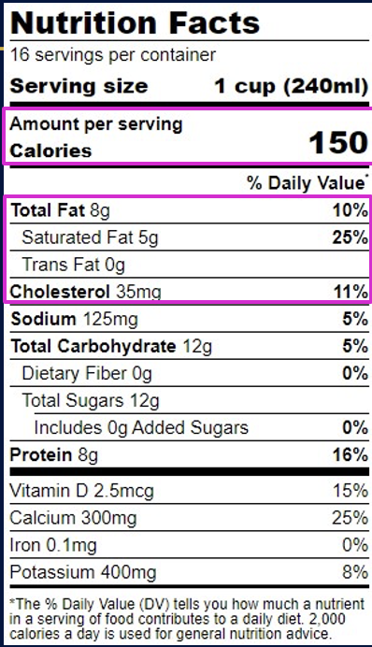
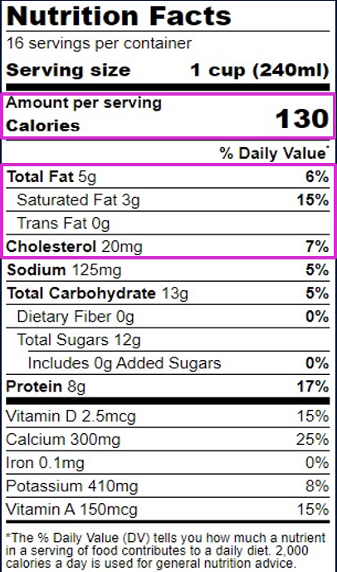
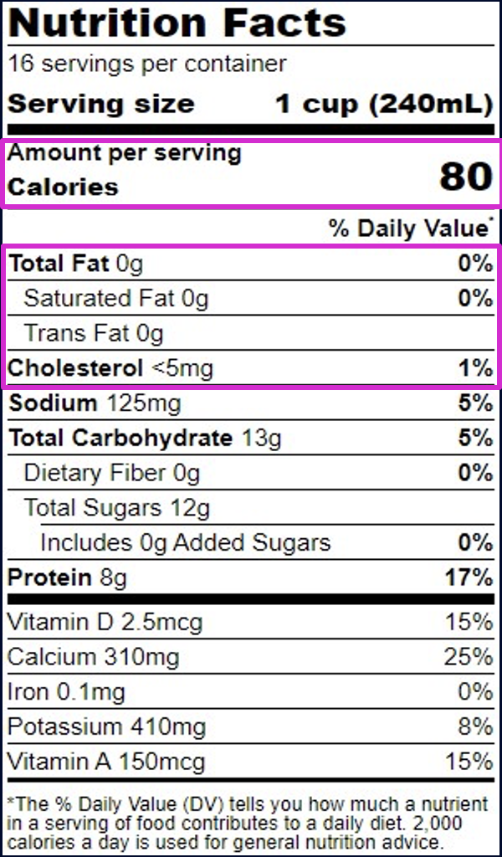
Comparing the Nutrition of Different Milk Options
Whole Milk
2% Reduced Fat Milk
Skim/Fat-Free Milk

Slide 19

Wrap-Up
Reflection Questions:
What surprised you most about nutrition labels?
How can labels help you make healthier choices?

Slide 20
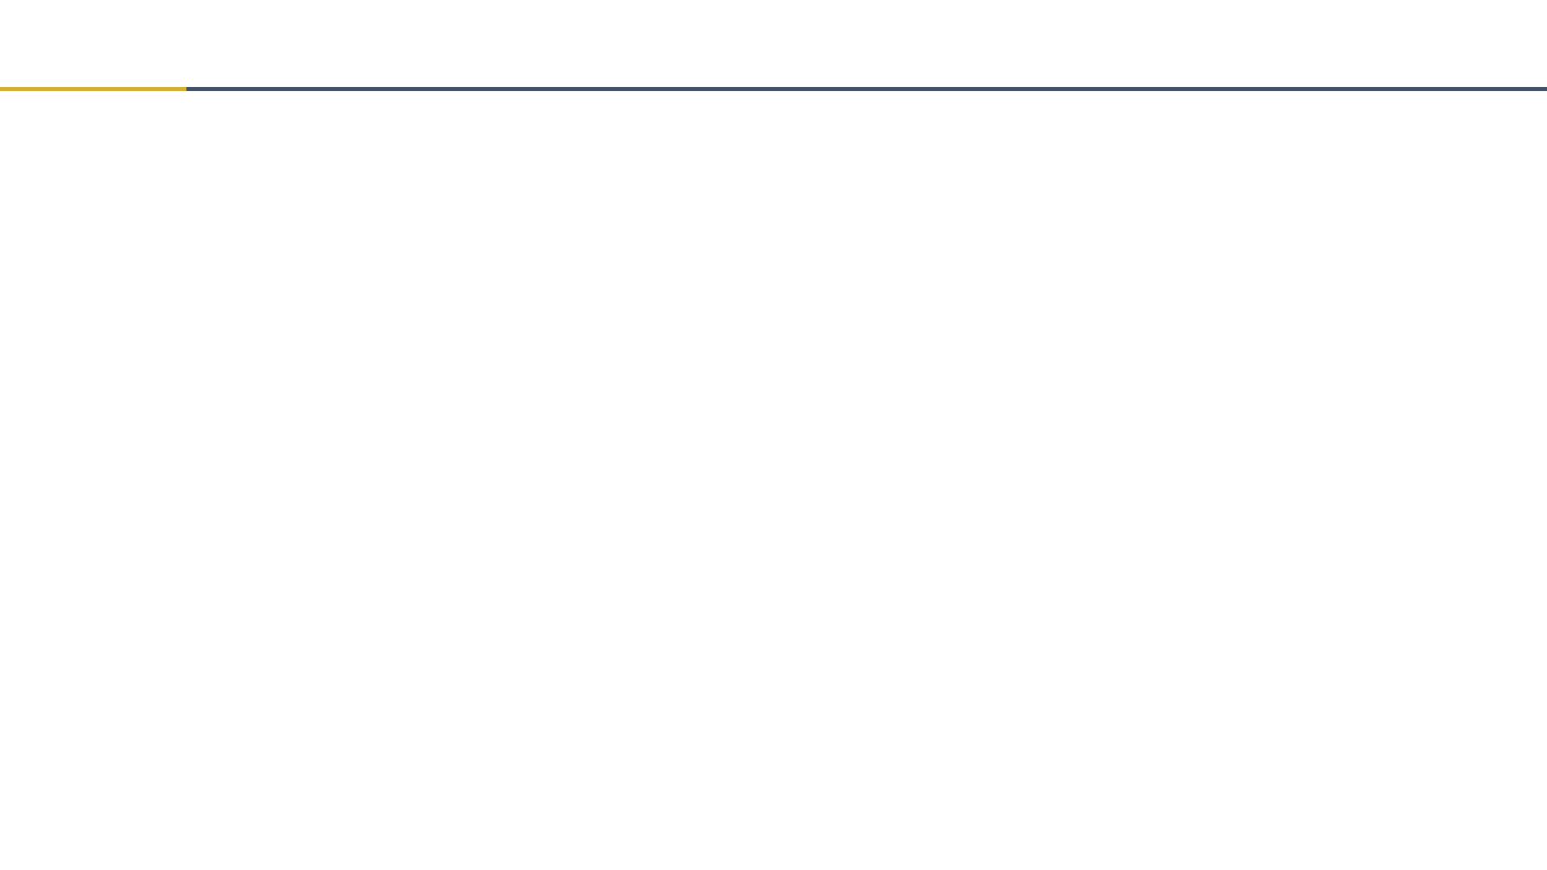
Thank you!
Bluesky
@UConnRudd.Bsky.Social
LinkedIn
UConn Rudd Center for Food Policy and Health
Website
uconnruddcenter.org/adolescent-citizen-scientists

