Slide 1




Healthy Eating with MyPlate:
Session 2
Adolescent Citizen Scientist Training

Slide 2

Learning Objectives
By the end of this session, students will be able to:
Identify the five food groups from MyPlate.
Create balanced meals using MyPlate.
Know how to make informed food and beverage choices.
Understand the importance of physical activity.

Slide 3
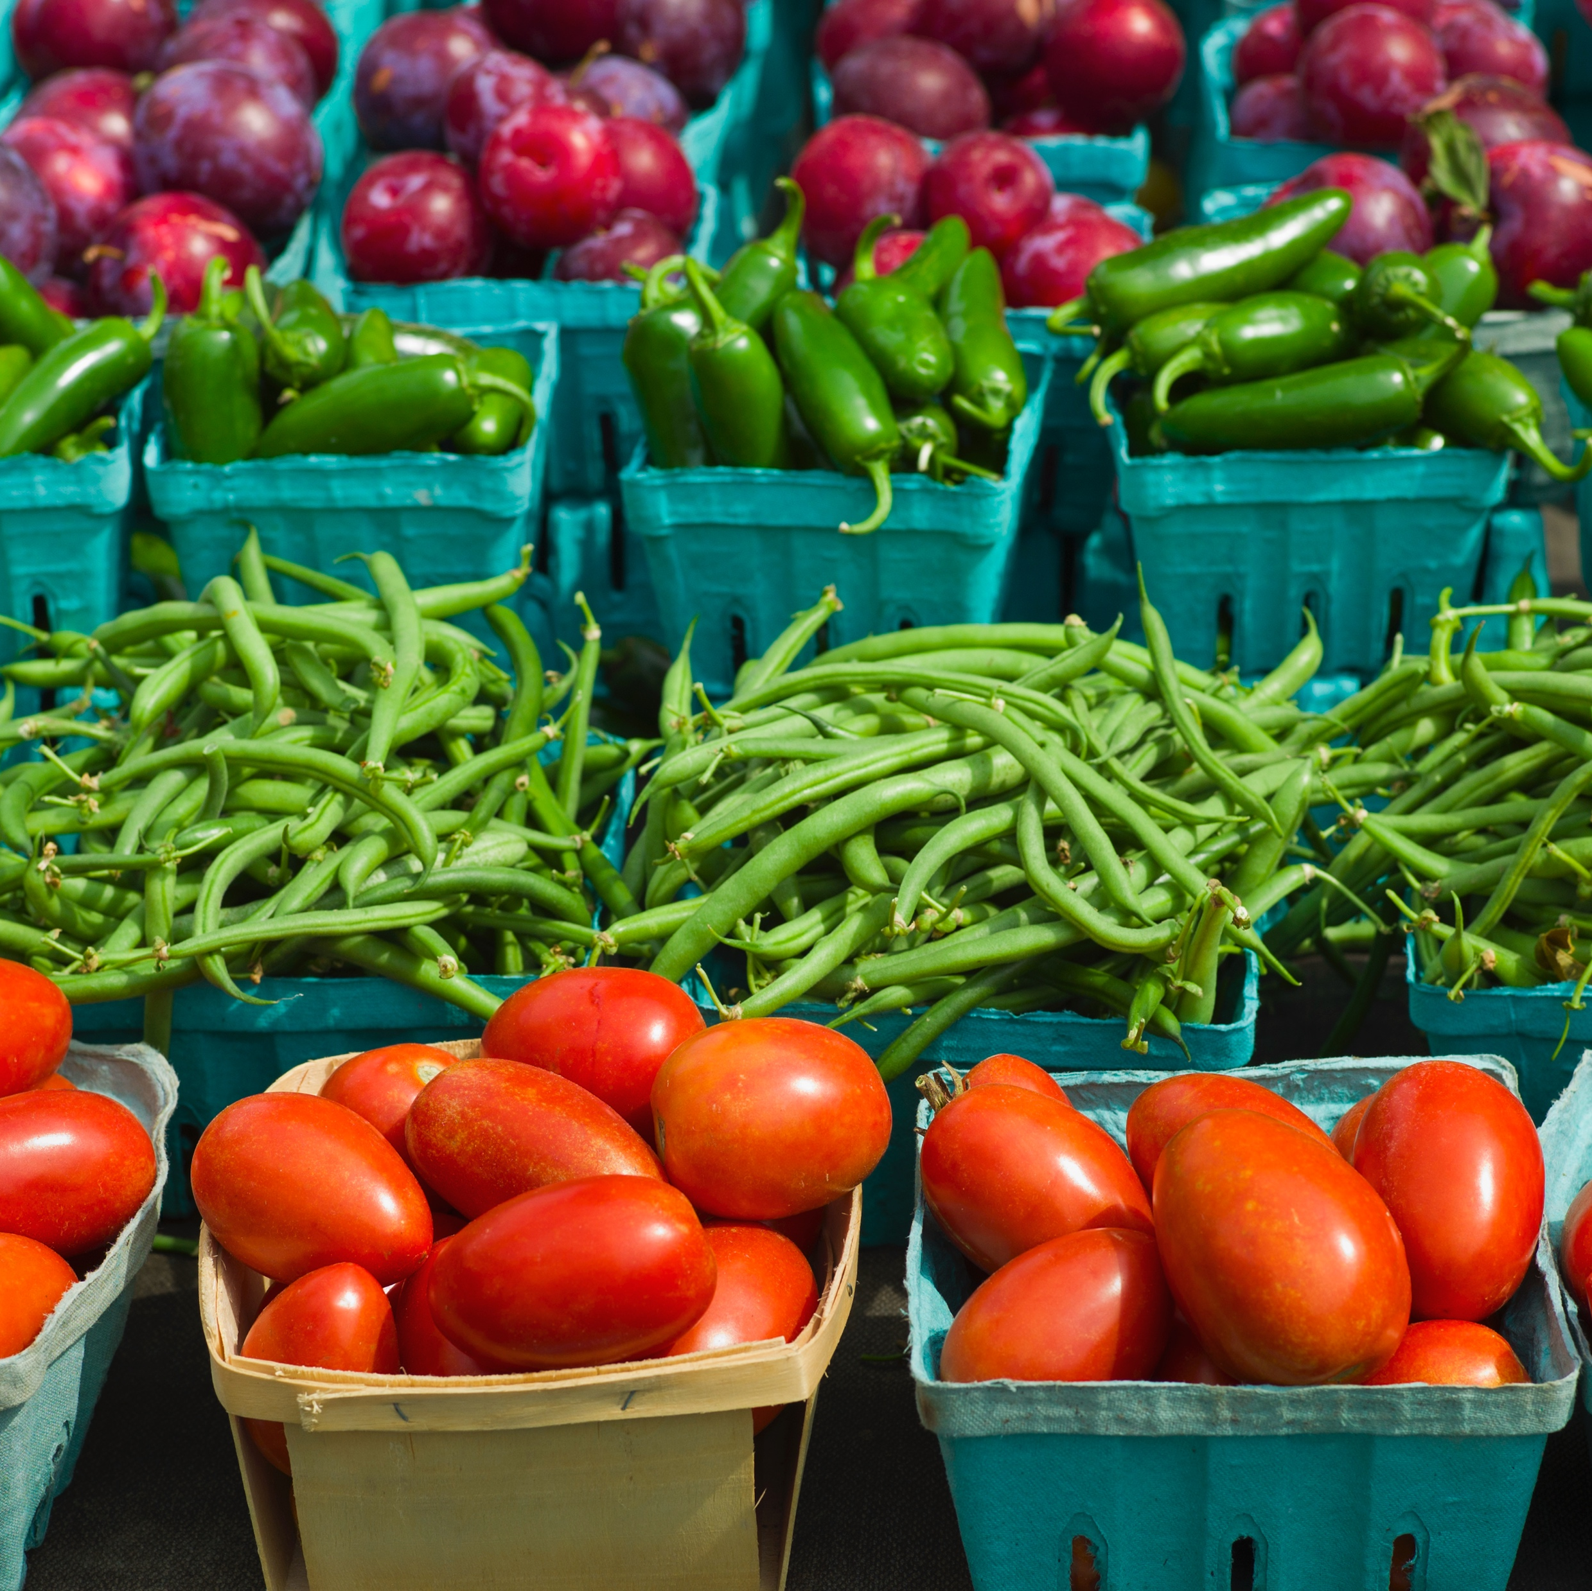
Discussion Questions
Why do we need to eat healthy foods?
What foods do you consider healthy foods?

Slide 4
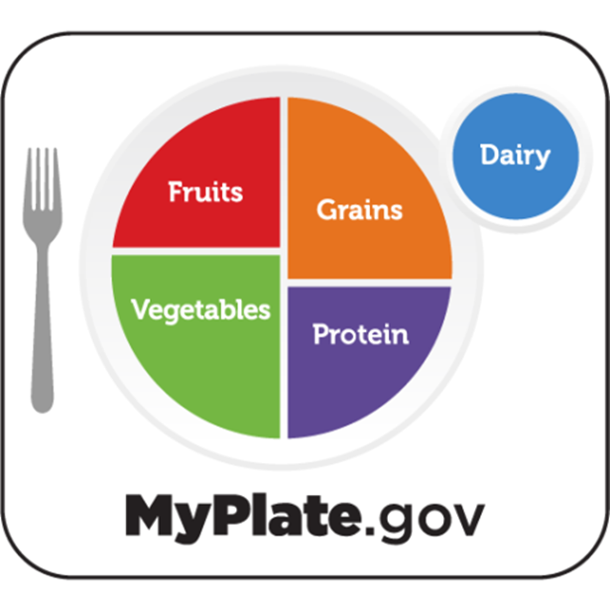
Understanding MyPlate
Have you seen MyPlate?
What is MyPlate?
  Guide for healthy eating.
  Designed by U.S. Department of Agriculture (USDA).
MyPlate has five food groups.
Source: https://kidshealth.org/en/teens/myplate.html

Slide 5
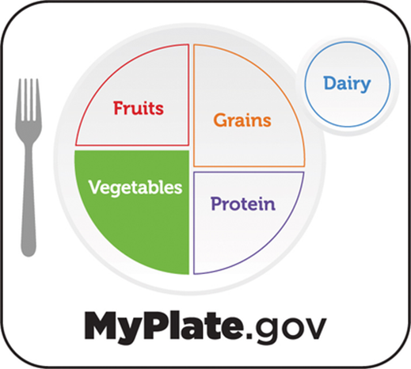
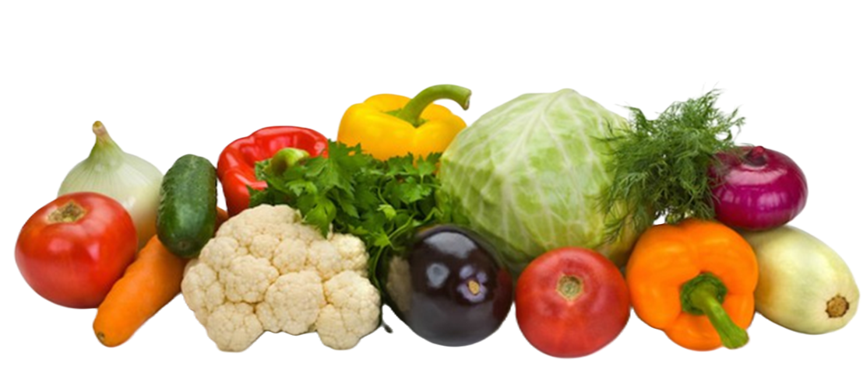

Vegetable Group
Vegetables provide vitamins, minerals, and fiber.
Support a healthy immune system and keep your digestive system working well.
Eating a variety of dark green, red, and orange vegetables is recommended to add a variety of nutrients and other components.
It is recommended that youth eat 2.5 to 4 cups of vegetables every day.
One portion of vegetables is equal to one cup of raw or cooked vegetables or 2 cups of raw leafy greens.

Slide 6
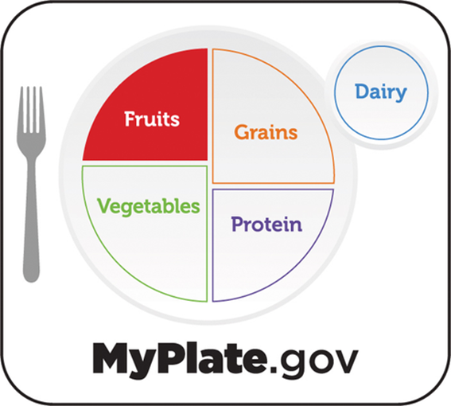
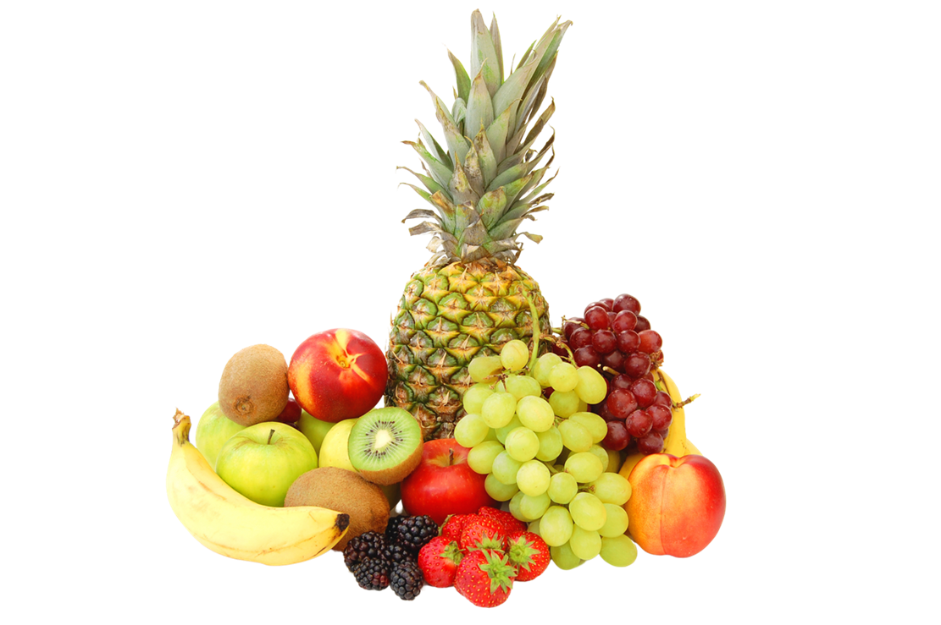
Fruit
Group
Fruits are rich in vitamins, minerals, and fiber.
They can be eaten as a snack or included as part of a meal.
It is recommended to eat 2 cups of fruit each day.
MyPlate recommends:
“Make half your plate fruits and vegetables”

Slide 7
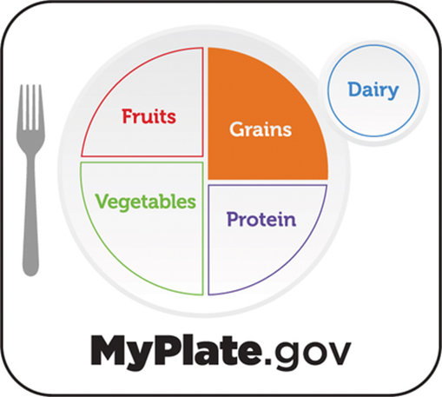
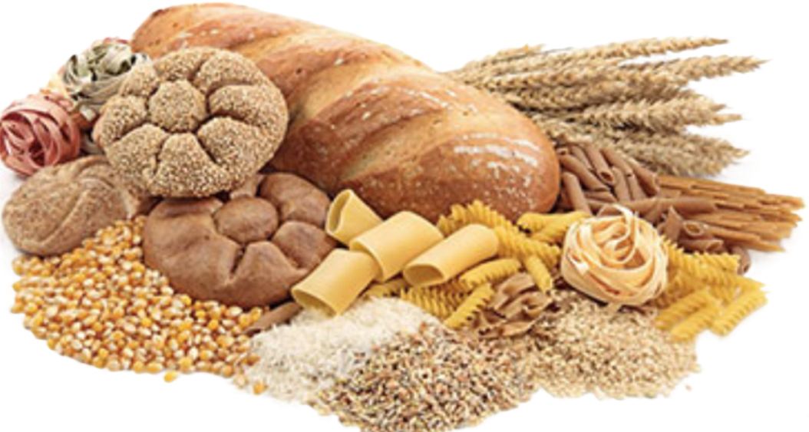
Grain Group
Foods like bread, rice, pasta, tortillas, oatmeal, cereal, and crackers are part of the Grain group.
Foods from this group provide energy to help you complete your daily activities.
Youth are recommended to have 6 to 8 portions of grains per day. One portion is one-ounce equivalent.
One-ounce equivalent approximately equal to 1 slice of bread, 1 cup of ready to eat cereal, ½ cup of cooked rice, pasta, or hot cereal, or 3 to 4 small crackers.
MyPlate recommends:
“At least half of all grains you eat should be whole grains”

Slide 8
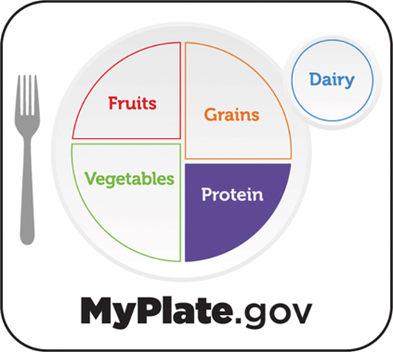
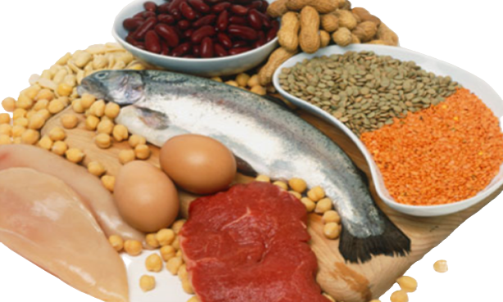
Protein Group
Protein helps build strong muscle, supports growth and bodily functions.
Try plant-based proteins such as beans, lentils, nuts.
Limit processed meats such as hot dogs and sausage.
Include a variety of proteins each day.
5 to 7 ounces equivalents per day is recommended.
1-ounce equivalent= 1 egg, ¼ cup of cooked beans or lentils, 1 tablespoon of peanut butter, 1 ounce of lean meat, poultry, or fish.
MyPlate recommends:
“Choose lean proteins”

Slide 9
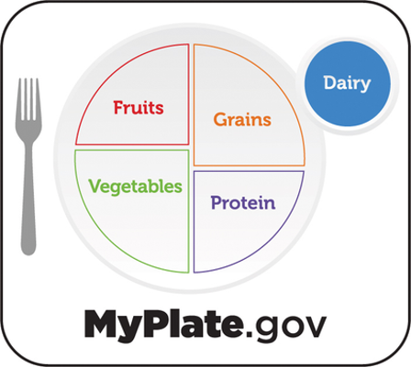
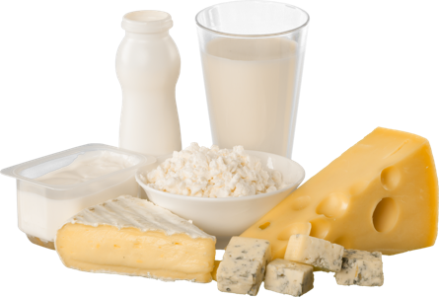
Dairy
Group
The Dairy Group provides important nutrients that will give you strong and teeth, since foods from this group are a good source of calcium, vitamin D and protein.
Choose fat-free or low-fat dairy products most of the time.
Youth ages 9 to 18 need about 3 cups of dairy each day.
One cup of dairy includes:
  1 cup of milk
  1 cup of yogurt
  1½ ounces of cheese like cheddar or mozzarella

Slide 10
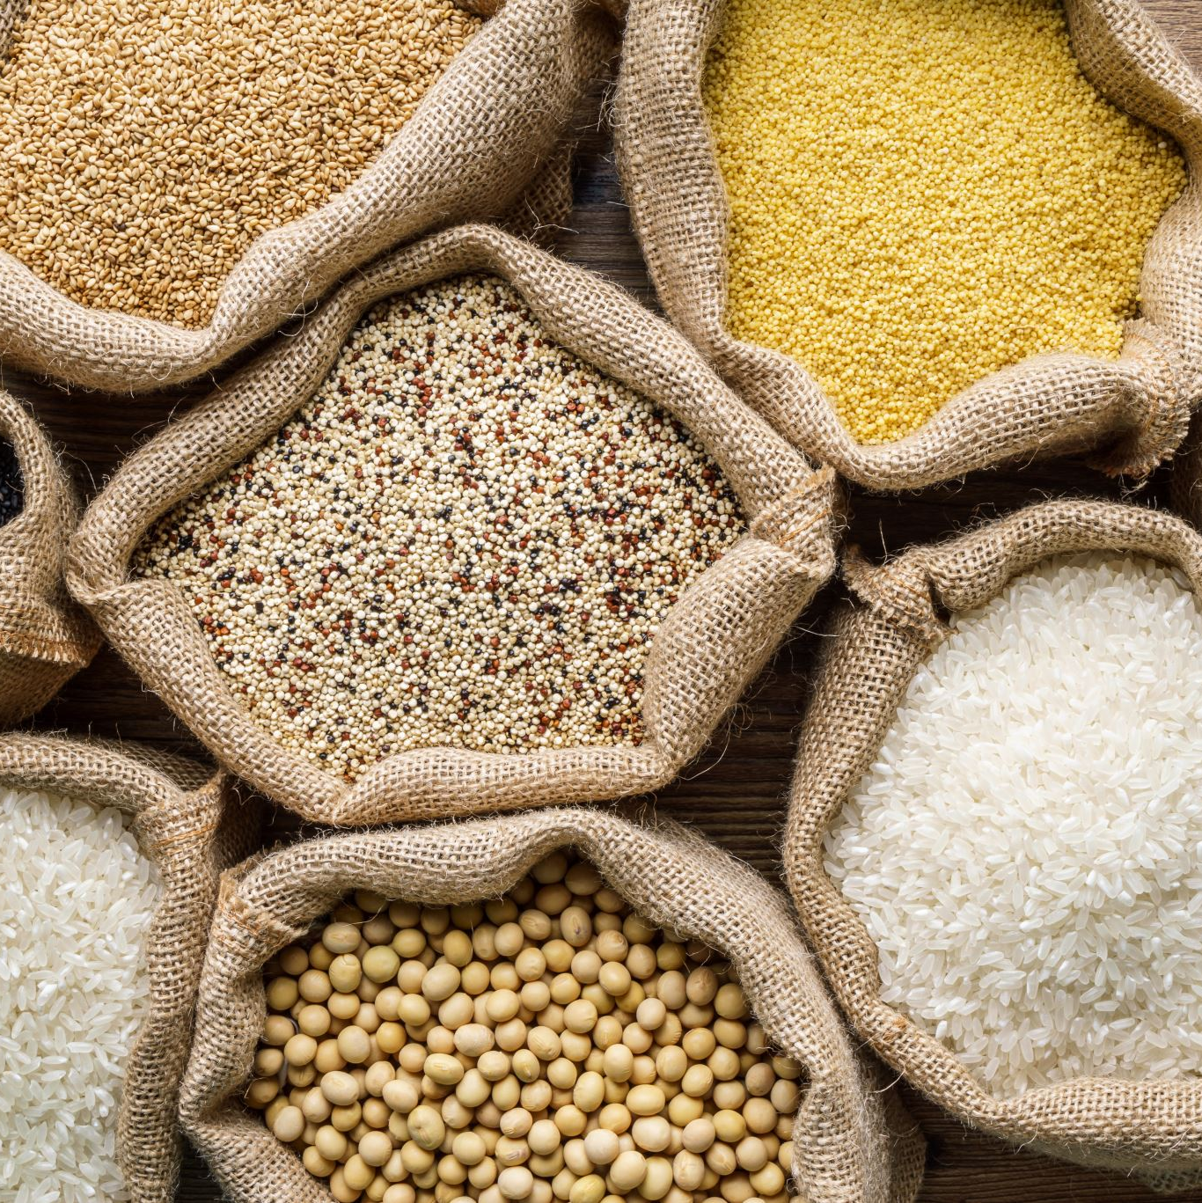
MyPlate can include foods from all cultures
Examples:
Grains: rice, plantains, tortillas, oatmeal, pasta.
Protein: beans, tofu, chicken, fish.
Vegetables: peppers, collard greens, squash.
Fruits: mango, papaya, berries.
Dairy: different types of milk, cheese and yogurts.

Slide 11
Water is an essential nutrient
Water Functions:
60% of the body is made up of water
Regulates body temperature.
Transports nutrients and oxygen throughout the body.
Facilitates the remove of waste from the body.
Supports healthy digestion.
Keeps your brain alert and working well.
Lubricates joints and protects organs.
Recommendations for Youth:
Drink water throughout the day using a reusable water bottle, especially when active or outdoors in hot weather.
Choose water with meals and snacks.
Fruits and vegetables naturally contain a high amount of water.
Sugary drinks = empty calories, more risk of weight gain, type 2 diabetes, and dental cavities
Avoid energy drinks: too much caffeine, ingredients that interact with caffeine in dangerous ways, and sugar. May cause anxiety, sleep problems, and dehydration.

Slide 12
Why daily physical activity matters
Benefits:
Builds strong bones and muscles
Improves focus, memory, and academic performance.
Reduces stress and anxiety.
Gives you better sleep so you feel more energized.
Helps maintain healthy body weight.
Supports overall physical and mental health.
Physical Activity Recommendations:
Youth ages 6 to 17 should get at least 60 minutes of moderate to vigorous physical activity every day.
Choose a variety of enjoyable physical activities.
Limit the time spent in front of a TV or digital device and move throughout the day.
Source: U.S. Dept of Health and Human Services. Physical Activity Guidelines for Americans, 2nd edition. Washington, DC: U.S. Dept of Health and Human Services; 2018.

Slide 13
Build your own plate
Activity:
Use paper plate and food cards/models to build a meal plan representing your culture and/or favorite foods.
Students will present their plate and explain their food choices.
Discussion questions:
What surprised you about your plate?
How can you use MyPlate when eating at school, home or with peers?

Slide 14
What did we learn today?
MyPlate: simple guide for healthy eating
  Includes five food groups: Fruit, Vegetables, Grains, Protein foods, and Dairy
Eating foods from all 5 good groups
  Provides nutrients for growth, energy, learning, and overall health
Make half of your plate fruits and vegetables
  Choose a variety
Consume low-fat or fat-free dairy foods
  Help build strong bones and teeth
Water is the best beverage choice
  Keeps the body hydrated and supports many important functions
Physical activity is important
  Have at least 60 minutes of moderate to vigorous physical activity every day
Healthy eating can include foods from all cultures
  Balanced meals can be created using favorite and traditional foods

Slide 15

Healthy Habit Goal
Write a personal ”Healthy Habit Goal” on a sticky note, and post it on the whiteboard:
“A healthy habit I will try this week is…”

Slide 16
Assignment – Food Choices Interview
  Interview a family member or friend and record their responses on paper:
  What foods/drinks do they choose most often?
  Why?
  What influences their choices?
    (Food choices are not always up to the individual. Prompt them to consider other factors in their environment: Are there things other than taste and preference that influence what you eat and drink?
  Report back to the group the next session
Notes:
Provide Assignment 2 handout

Slide 17

Thank you!
Bluesky
@UConnRudd.Bsky.Social
LinkedIn
UConn Rudd Center for Food Policy and Health
Website
uconnruddcenter.org/adolescent-citizen-scientists

