Slide 1

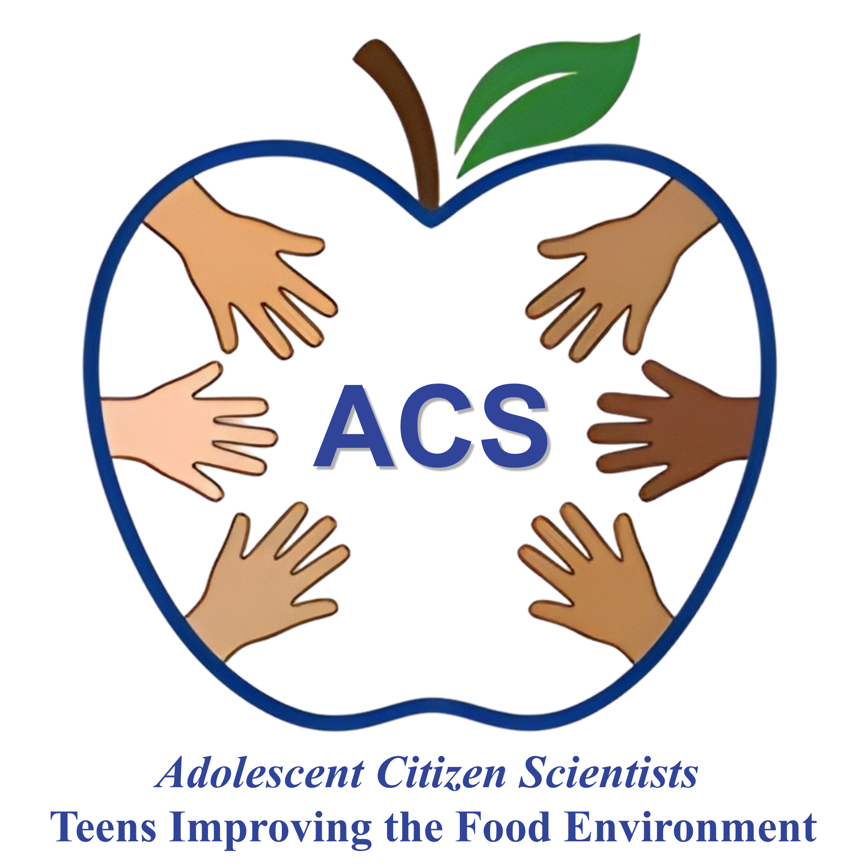


Nutrition Throughout the Life Course:
Session 1
Adolescent Citizen Scientist Training

Slide 2
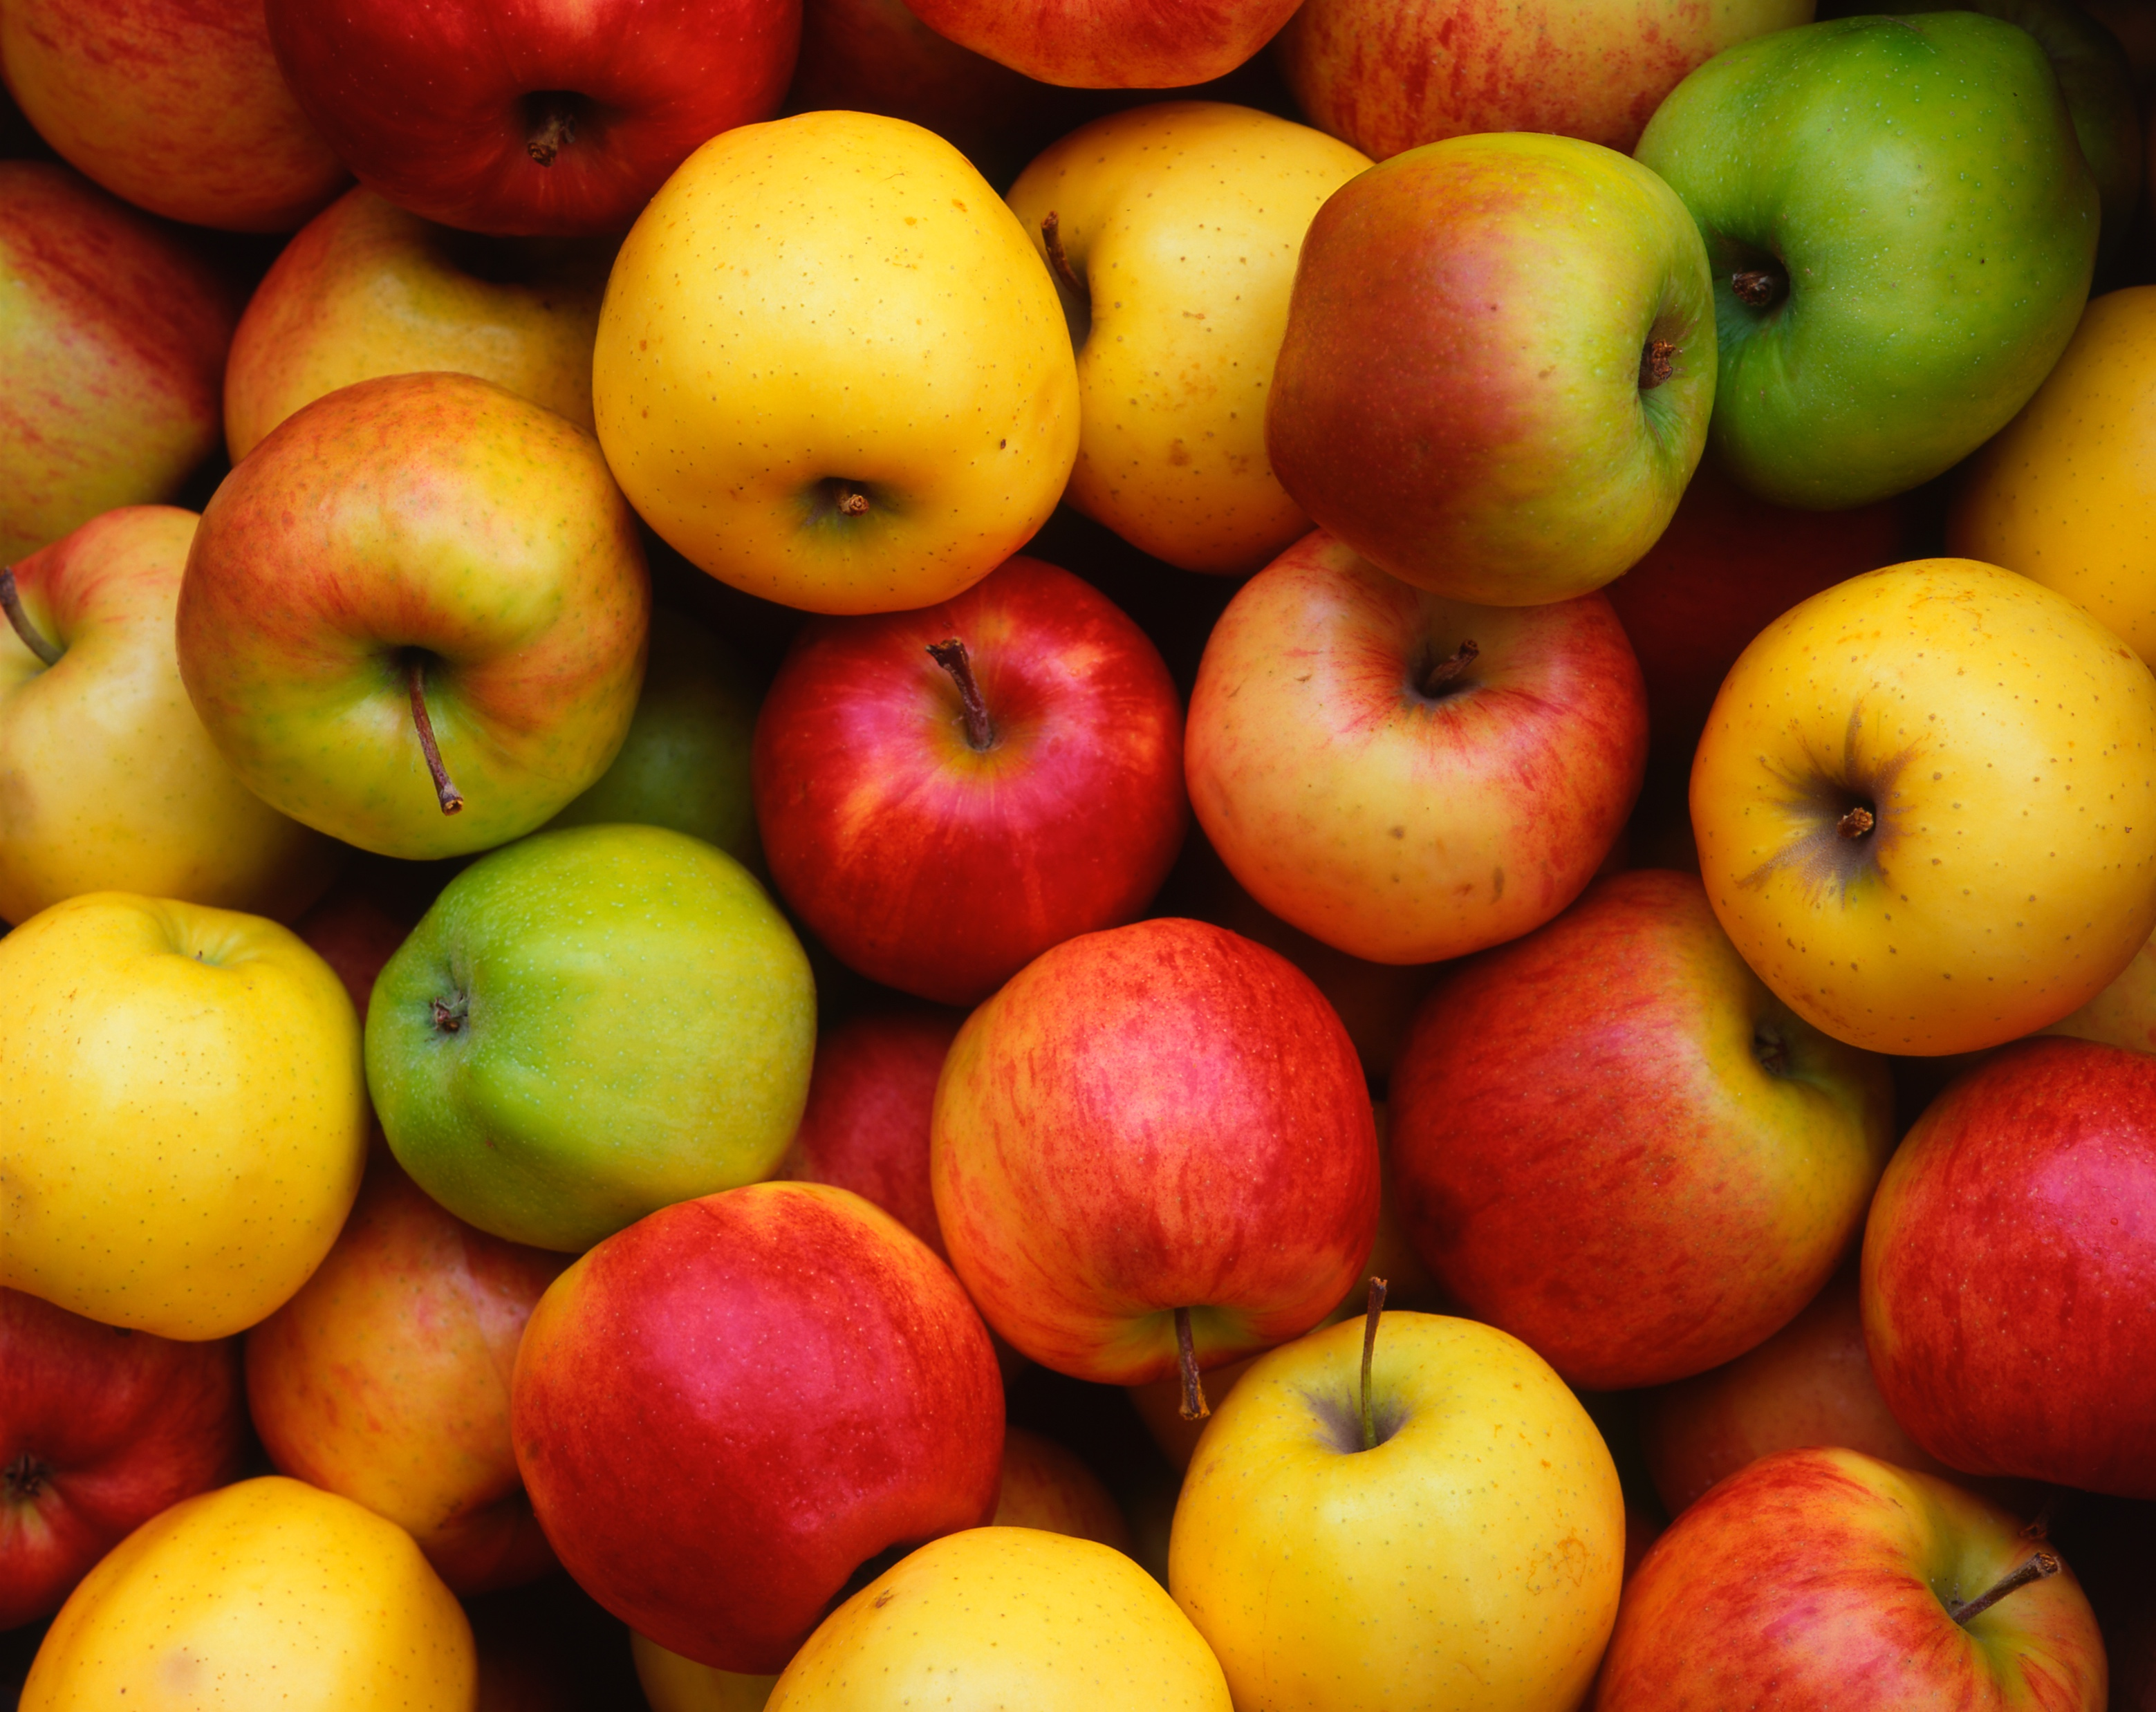
Learning Objectives
By the end of this session, students will be able to:
1. Explain how nutrition supports growth, development, and health across the lifespan.
2. Describe how nutrition needs change across different stages of life
3. Identify healthy eating challenges among adolescents.
4. Discuss how nutrition influences academic performance and long-term health.

Slide 3
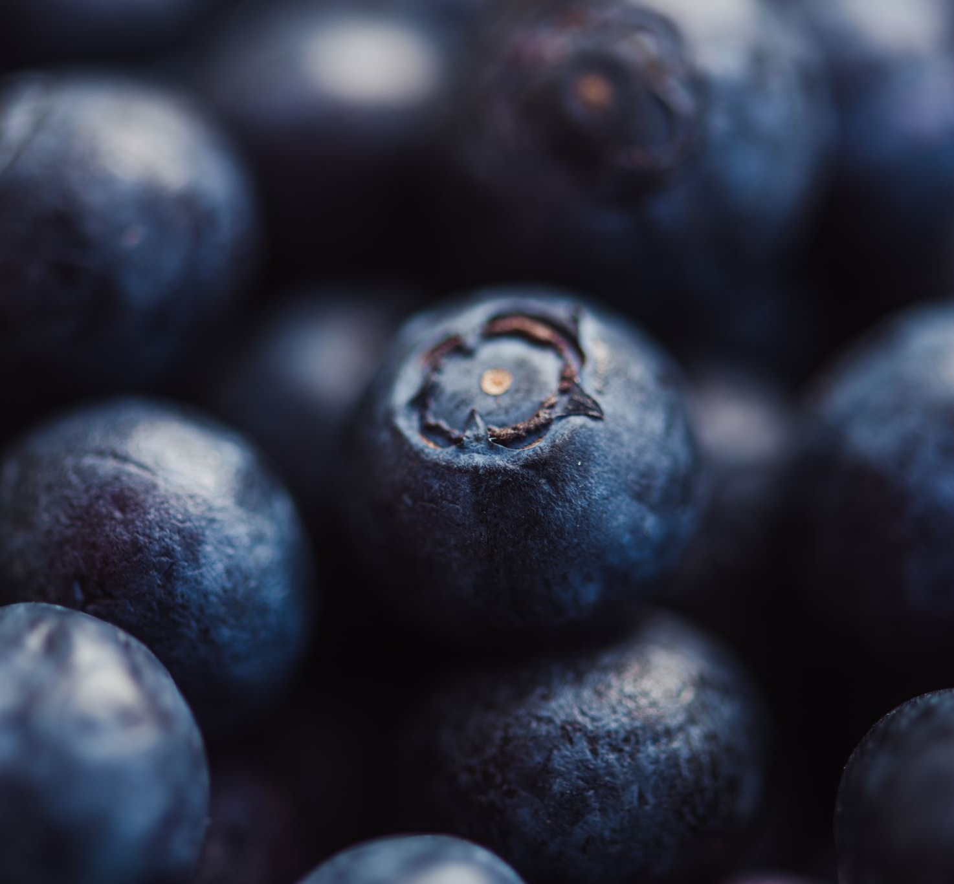
Discussion Questions
What was your favorite food as a young child?
What are your favorite foods now?
How have your food preferences changed over time?
What foods remind you of family traditions or culture?

Slide 4
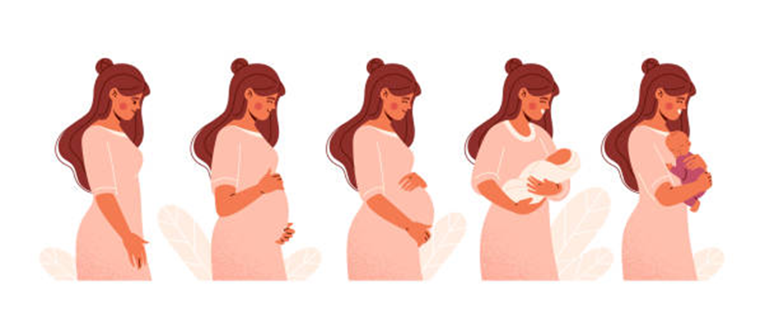
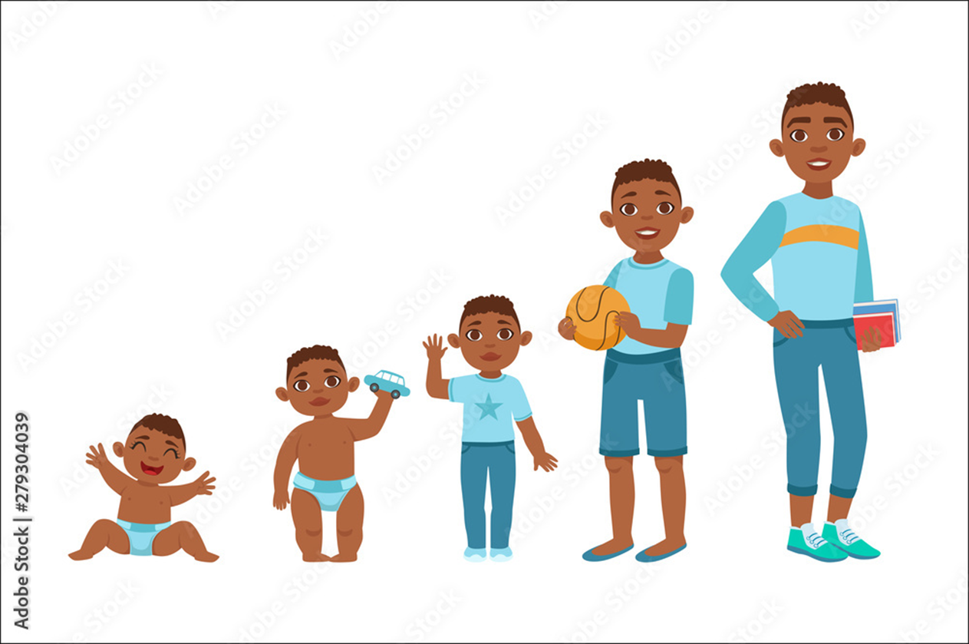
Nutrition is important throughout every stage of life
Our nutrition needs and food choices change as our bodies go from pregnancy, infancy, childhood, adolescence, adulthood, and older age.
Foods and beverages provide us with the nutrients that our bodies need to grow, develop, obtain energy, stay healthy, and prevent disease.
Our nutrition needs and food choices change as our bodies go from pregnancy, infancy, childhood, adolescence, adulthood, and older age.

Slide 5

The Dietary Guidelines for Americans
The Dietary Guidelines for Americans (DGA) are developed every five years by the U.S. Department of Health and Human Services, provide evidence-based dietary recommendations.
The Healthy Eating Index (HEI) is a tool used to measure how a person is adhering to the recommendations of the Dietary Guidelines.
HEI score can range from 0 to 100, with a lower score meaning less adherence to DGA’s recommendations.

Slide 6

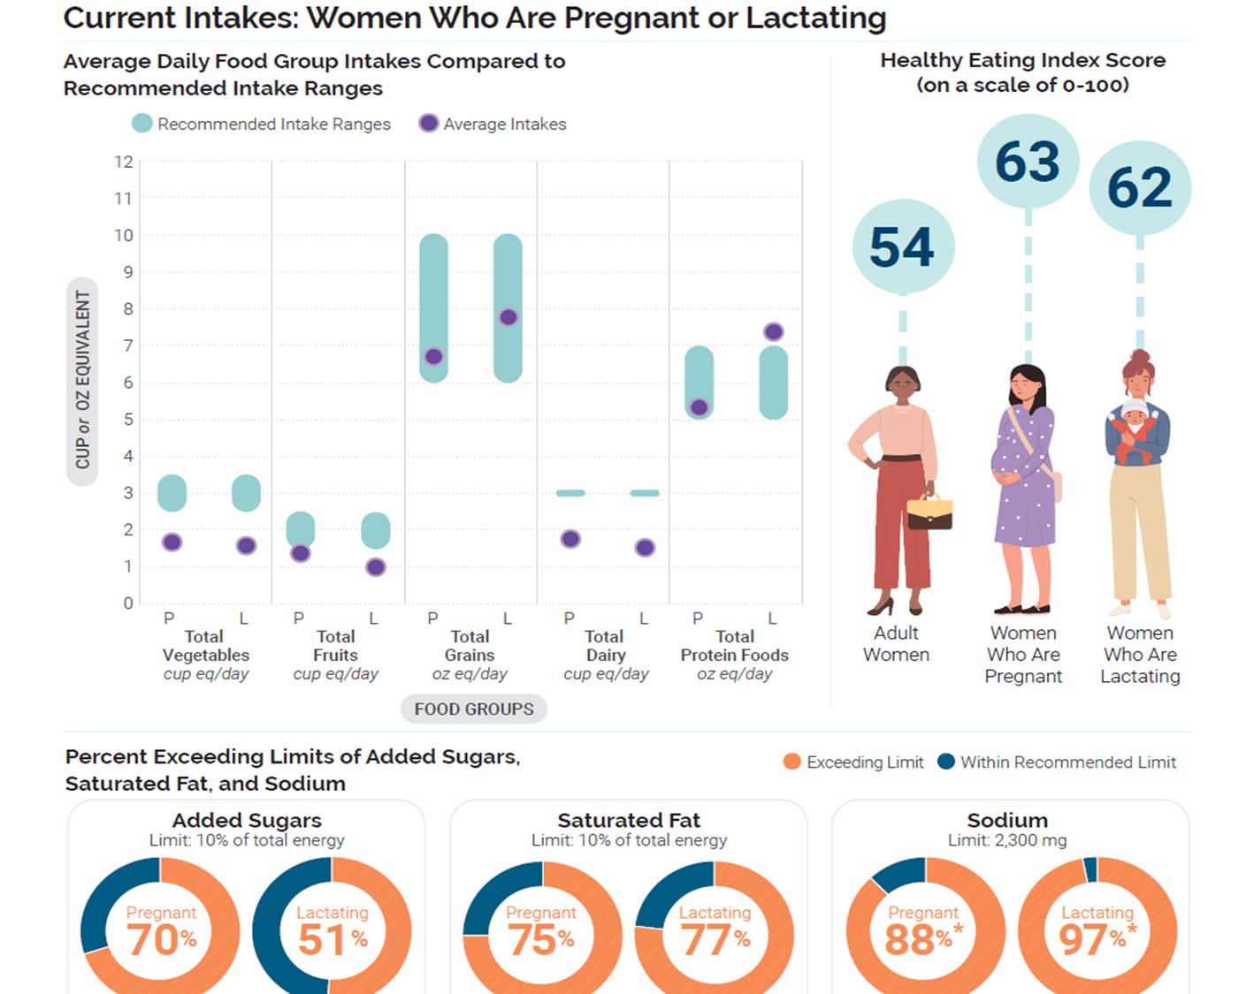
Pregnancy and Lactation
Good nutrition during pregnancy supports healthy growth, brain development, lactation, and postpartum recovery.
  Important to eat foods that are rich in folate, iron, calcium and protein.
  Fiber rich foods such as fruits, vegetables, whole grains and legumes are a rich source of vitamin and mineral as well as fiber, all of which helps with digestion.
  The Healthy Eating Index scores of U.S. Adult, pregnant, and lactating women are 54, 63, and 62, respectively.
Discussion question:
  What do the Healthy Eating index scores and food group intake from this graph tell us?
Source: U.S. Department of Agriculture & U.S. Department of Health and Human Services. (2020).
Current Intakes: Women Who Are Pregnant or Lactating [Figure 5-1].
In Dietary Guidelines for Americans, 2020–2025 (9th ed., Chapter 5). https://www.dietaryguidelines.gov/

Slide 7

Infancy (0-12 months)
Exclusive Breastfeeding
Introduction of solids
Exclusive breastfeeding is recommended for the first six months of life.
At around 6 months, solid foods should be introduced, focusing on iron-rich foods, like pureed meats, fortified cereals, and a variety of fruits and vegetables.
Food preferences
Avoid added sugar
Important time to learn the taste of foods and develop food preferences.
Avoid introducing foods and beverages with added sugars.

Slide 8
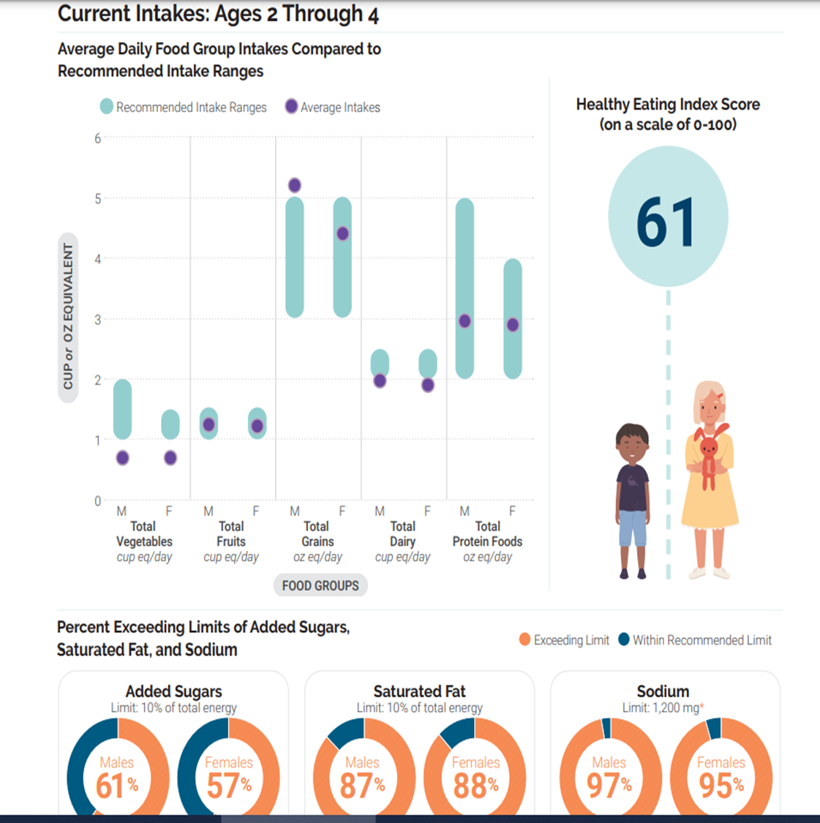
Early Childhood (2-5 years)
Important time for establishing healthy eating habits, which can prevent obesity and encourage a lifetime of good nutrition.
  Balanced Diet: Emphasis on a diverse diet that includes fruits, vegetables, whole grains, protein sources (meat, fish, beans), and dairy.
  Portion Sizes: Smaller portion sizes are appropriate for young children, as their energy needs are lower than adults.
Discussion question:
  What do the Healthy Eating index scores and food group intake from the graph tell us?
Source: U.S. Department of Agriculture & U.S. Department of Health and Human Services. (2020). Current Intakes: Ages 2 Through 4 [Figure]. In Dietary Guidelines for Americans, 2020–2025 (9th ed.). https://www.dietaryguidelines.gov/

Slide 9
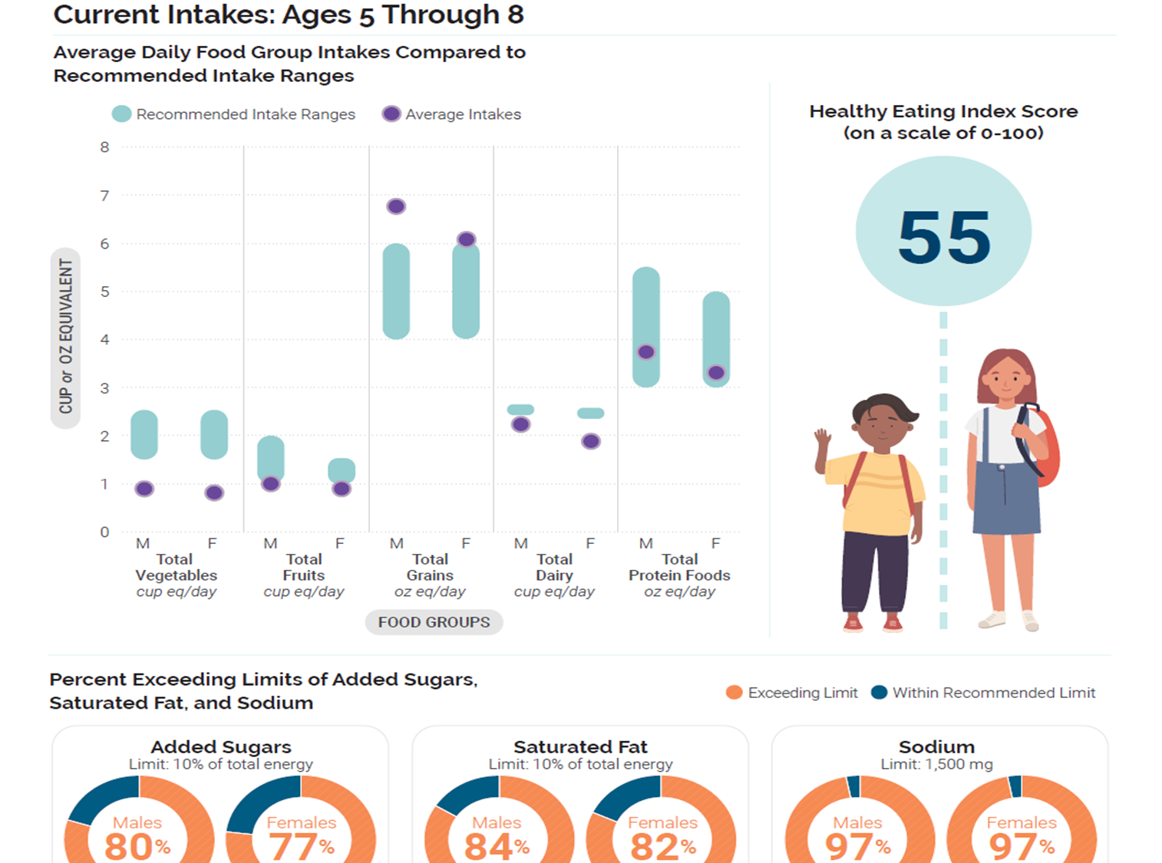
Childhood (6-12 years)
Eating healthy needs to be supported, peer & other influences began to shape eating habits
  Encourage foods that are rich in vitamins and minerals, such as whole grains, lean proteins, fruits, and vegetables.
  Nutritional needs increase to support growth spurts and higher activity levels.
  Limit sugary foods and beverages to prevent childhood obesity and dental problems.
Discussion question:
  What do the Healthy Eating index scores and food group intake from the graph tell us?
U.S. Department of Agriculture & U.S. Department of Health and Human Services. (2020). Current Intakes: Ages 5 Through 8 [Figure 3-4]. In Dietary Guidelines for Americans, 2020–2025 (9th ed., Chapter 3: Children and Adolescents). https://www.dietaryguidelines.gov/

Slide 10
Adolescence (13 to 18 years old)
Main changes
40-60% of adult bone mass is accrued during adolescence.
The brain undergoes intense growth and remodeling with higher neuroplasticity.
During this development period strong physical and cognitive growth happens.
Nutrition
Nutrition needs increase significantly due to growth spurts during puberty.
Foods that are rich in calcium, vitamin D and iron are especially important.
A varied diet rich in fruits, vegetables, whole grains, and lean proteins is key.

Slide 11
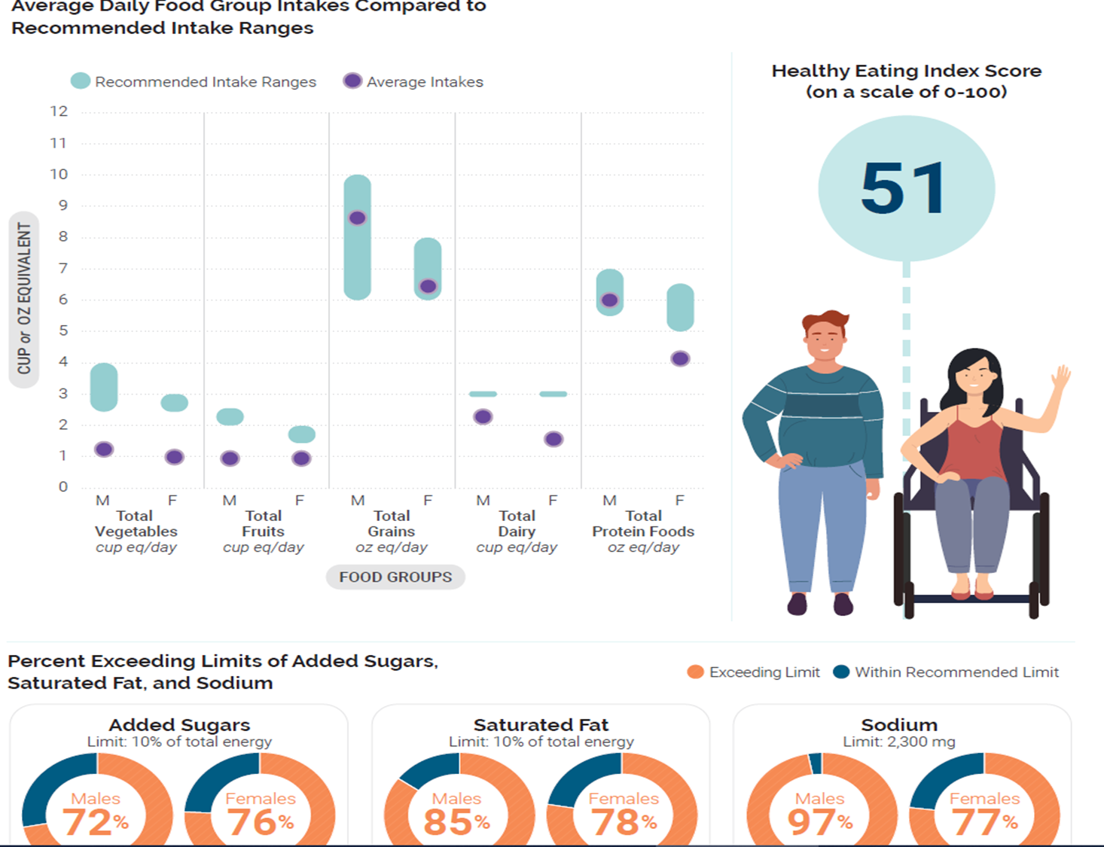
Challenges in
Adolescence
Big challenge:
  Prevent the consumption of fast foods, sugary drinks, and unhealthy snacks, typical of poor dietary patterns.
Discussion question:
  What do the Healthy Eating index scores and food group intake from adolescence tell us?
Source: U.S. Department of Agriculture & U.S. Department of Health and Human Services. (2020). Current Intakes: Children and Adolescents [Figure]. In Dietary Guidelines for Americans, 2020–2025 (9th ed.). https://www.dietaryguidelines.gov/

Slide 12
Nutrition for adults and older adults
Balanced nutrition
Health Promotion
Drink plain water and avoid sweetened beverages.
Emphasize foods high in nutrients and low in empty calories.
Eat healthy and exercise to prevent chronic diseases.
Reproductive Health
Older Adults
Among young adults (19-30 years old) adequate nutrition is essential for health during preconception and pregnancy.
Eating healthy food and adequate hydration is especially important.

Slide 13
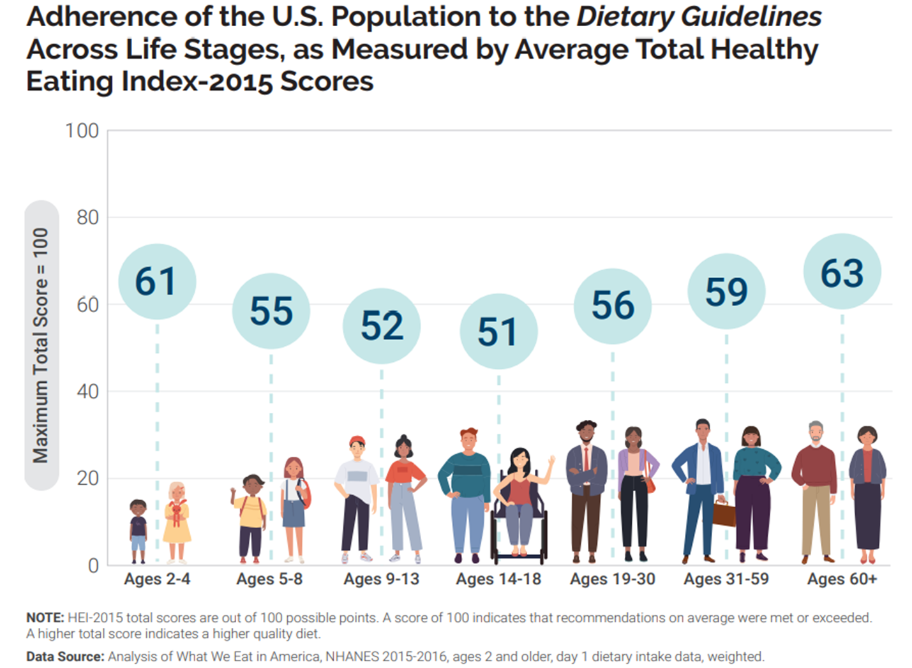
Healthy Eating Index at Different Stages of Life
Remember that a score of 100 would mean a person’s eating habits are totally aligned with the Dietary Guidelines for Americans.
Discussion questions:
  What age group has the lowest score and why do you think this group scored the lowest?
  What makes healthy eating challenging for people your age?
  What are some ideas to improve teen nutrition?
Source: U.S. Department of Agriculture & U.S. Department of Health and Human Services. (2020). Average Total Healthy Eating Index-2015 Scores by Life Stage [Figure]. In Dietary Guidelines for Americans, 2020–2025 (9th ed.). https://www.dietaryguidelines.gov/

Slide 14
What are three things that you learned today?

Slide 15

Thank you!
Bluesky
@UConnRudd.Bsky.Social
LinkedIn
UConn Rudd Center for Food Policy and Health
Website
uconnruddcenter.org/adolescent-citizen-scientists

