Slide 1

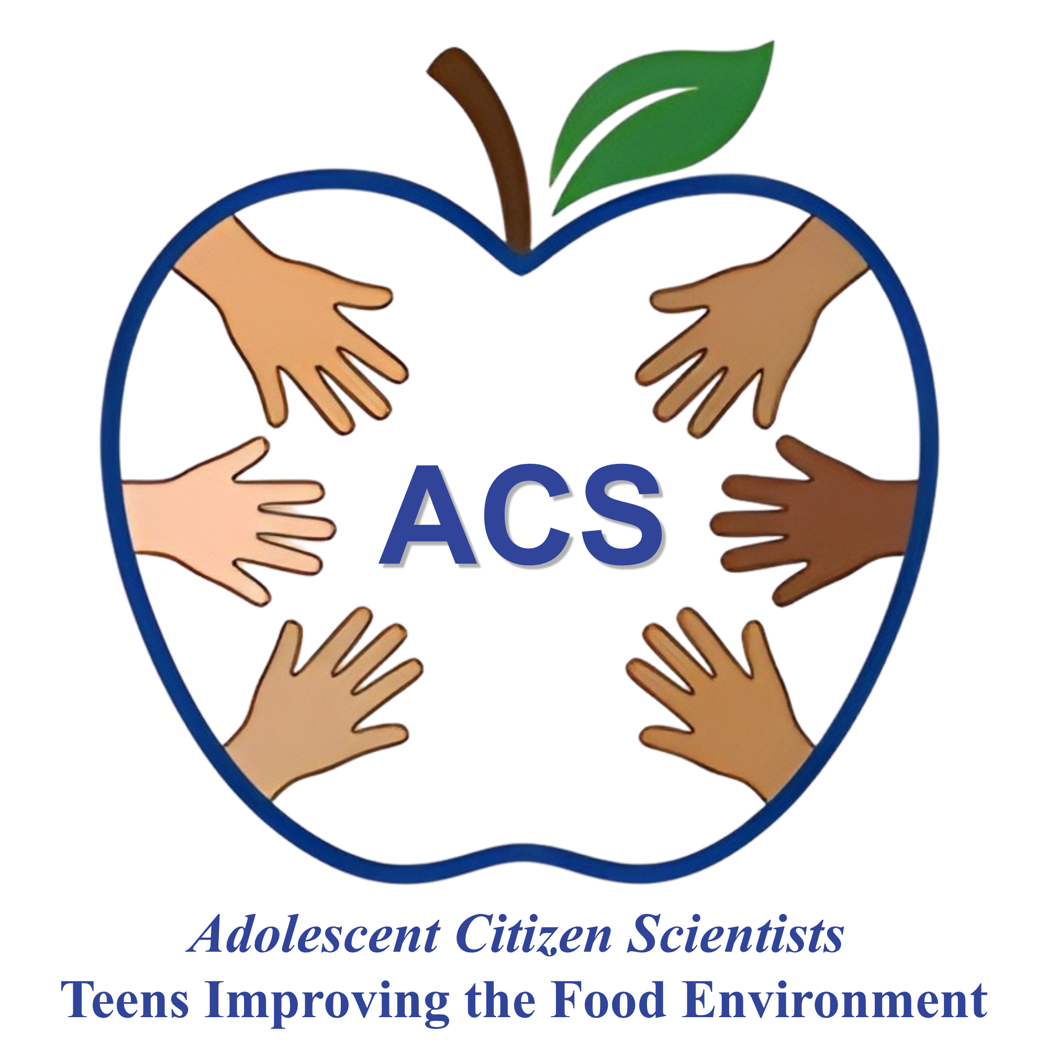


Health Equality, Equity and Justice
Adolescent Citizen Scientist Training

Slide 2
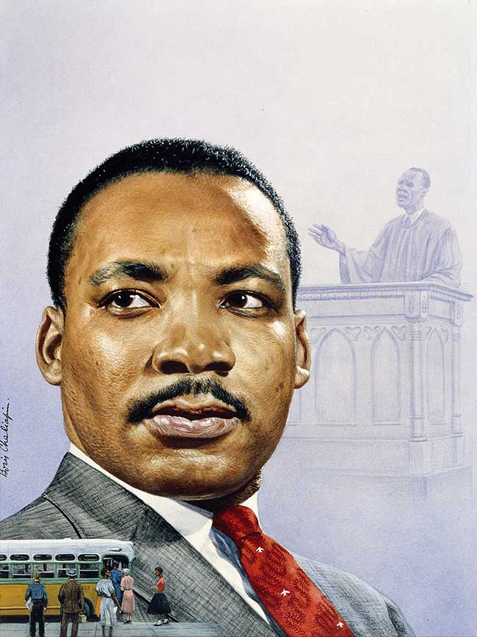
Learning Objectives
By the end of this session, students will be able to:
Explain what health equality, equity and justice are
Explain why poverty causes poor health
Explain why racism causes poor health
Identify how to improve health equity in the short, middle and long- term.

Slide 3
Icebreaker
Questions
What was your favorite place to visit as a young child?
What is your favorite place now?

Slide 4
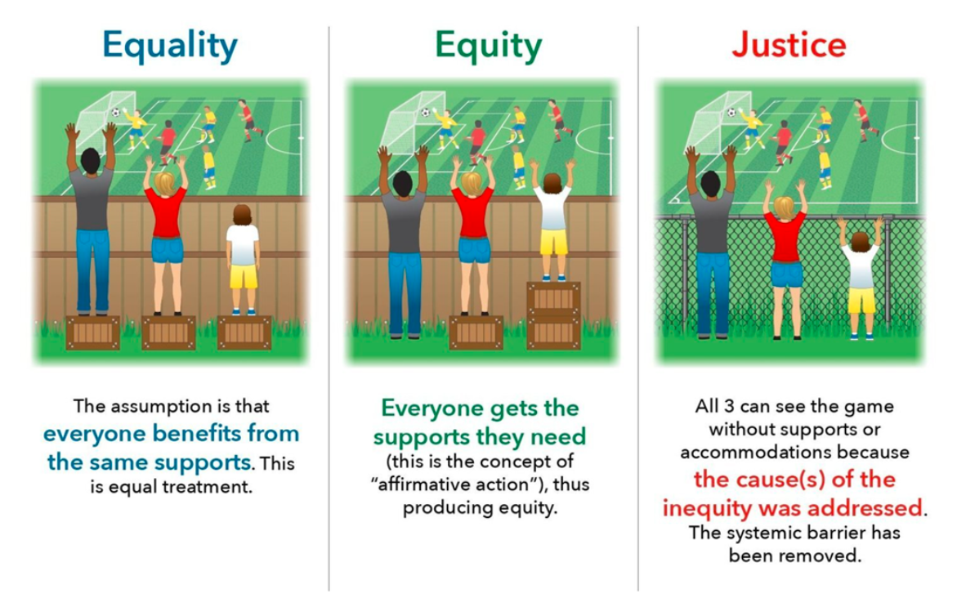
The difference between equality, equity and justice

Slide 5
Session activity
We will discuss three scenarios to decide whether they represent equality, equity or justice principles.

Slide 6
Scenario 1
Giving $100 per month to all people in the country to buy food
(no matter how wealthy or poor they are)

Slide 7

Scenario 1 - Answer
Giving $100 per month to all people in the country to buy food (no matter how wealthy or poor they are)…
is an example of equality!

Slide 8
Scenario 2
Giving $500 per month to very poor people, $250 to somewhat poor people, and nothing to high income people to buy food

Slide 9
Scenario 2 - Answer
Giving $500 per month to very poor people, $250 to somewhat poor people, and nothing to high income people to buy food….
is an example of equity!

Slide 10
Scenario 3
Giving access to quality education and jobs with a stable income so that everyone in the country can be food secure

Slide 11
Scenario 3 - Answer
Giving access to quality education and jobs with a stable income so that everyone in the country can be food secure…
is an example of justice!

Slide 12
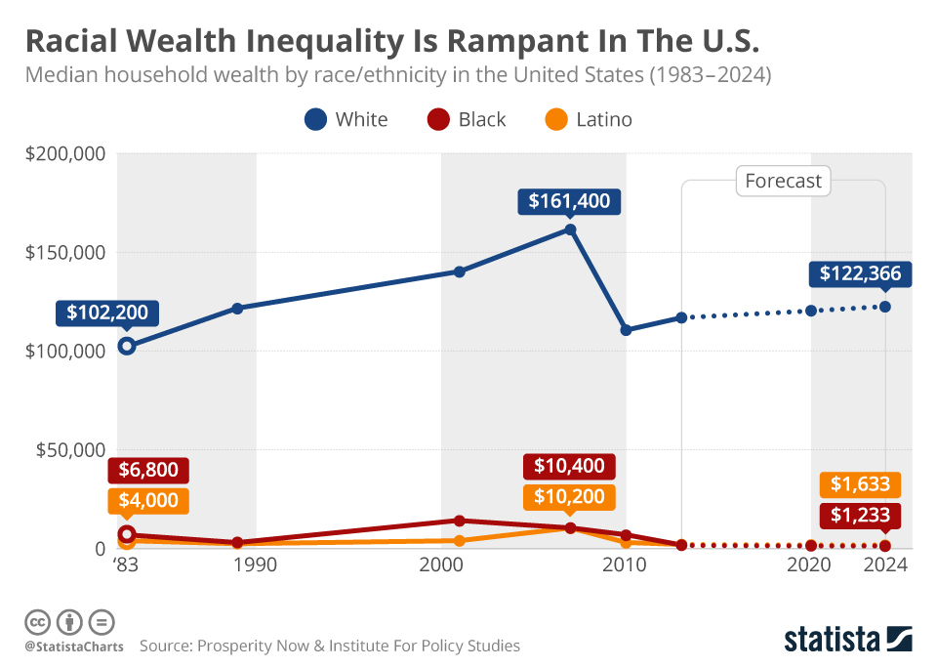
Racial/ethnic wealth inequalities in the US are alarming
Explained by social injustice driven by poverty and racism
Strongly affect the physical and mental health and wellbeing of people

Slide 13
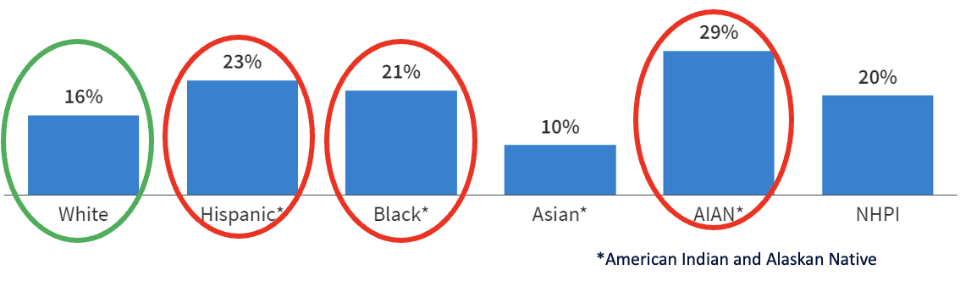
Poverty and social injustice are linked with poorer health outcomes
Percent of Adults Reporting Fair or Poor Health Status by Race and Ethnicity, 2022
Source: KFF analysis of 2022 Behavioral Risk Factor Surveillance System

Slide 14
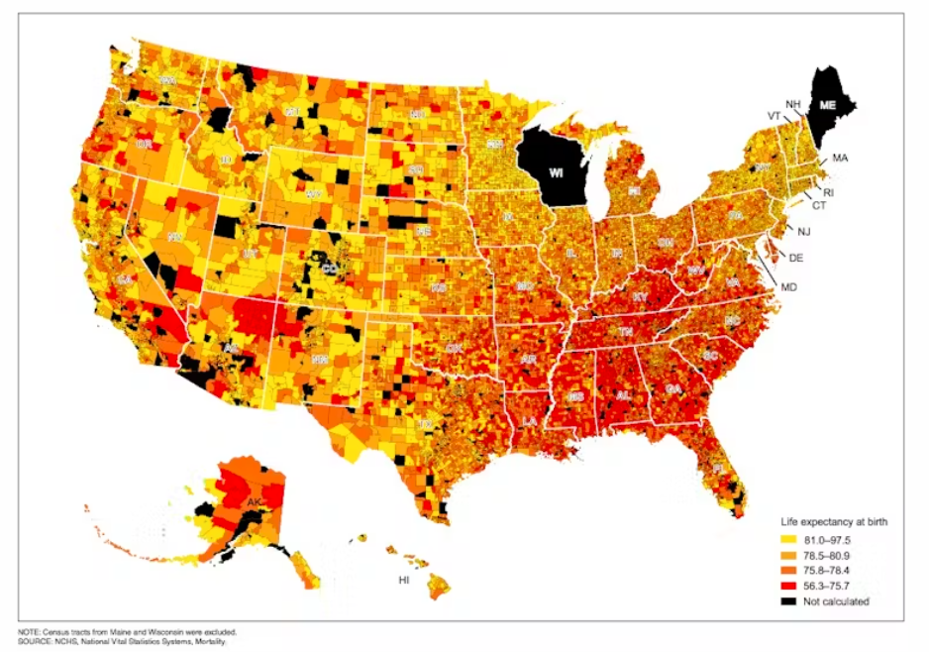
Poverty and social injustice cause people to live less time
Life expectancy at birth by census tract, 2010–2015
In Washington, D.C., people living in the Barry Farms neighborhood have a life expectancy of 63.2 years
Less than 10 miles away, a baby born in Friendship Heights and Friendship Village can expect to live 96.1 years
Source: https://www.alternet.org/2018/10/heres-what-being-born-wrong-zip-code-can-do-your-life-expectancy

Slide 15
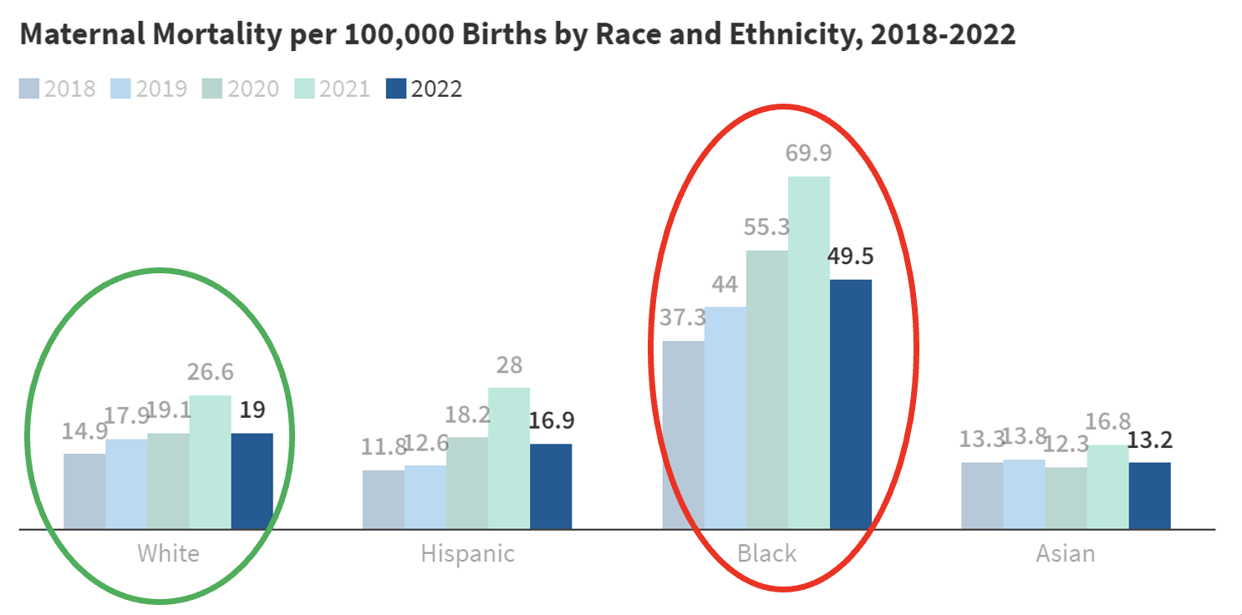
Poverty and social injustice are linked with higher maternal mortality
Source: Hoyert DL. Maternal mortality rates in the United States, 2022. NCHS Health E-Stats. 2024.

Slide 16
Reflection question
Why does poverty and social injustice cause poor health?

Slide 17
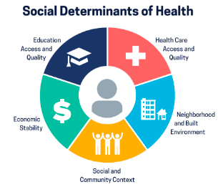
The Social Determinants of Health
Poverty and social injustice are very harmful to health because they limit access to the social determinants of health including:
Healthy food and nutrition
Health care
Physical activity opportunities
Safe neighborhoods free of contaminants and violence
Quality education
Well paying jobs

Slide 18
Health Inequities Among Youth in the US
Health inequities are most frequently described for non-communicable diseases like heart disease, diabetes, and cancer that are generally more common among older people.
However, many of these diseases also exist in younger people
Inequalities have consistently been found for several indicators of poor health during childhood and adolescence, such as
  Overweight or obesity
  Accidents
  Injuries
  Poor physical and mental health

Slide 19
In 2023, Hartford had one of the highest prevalences of obesity across CT, with an obesity rate of 29%
According to DataHaven’s Hartford Equity Report
  About 42% of the capital’s Latino population and 39% of its Black population had obesity compared to 28% of the white population.
According to The CT Department of Public Health
  1 in 5, 5 to 17 years old in CT had obesity in 2020
  30.8% of them identified as Hispanic, vs. 12.5% who identified as Non-Hispanic white
Why do you think this is?
Source: https://ctdatahaven.org/addressing-hartford-s-childhood-obesity-disparities/

Slide 20
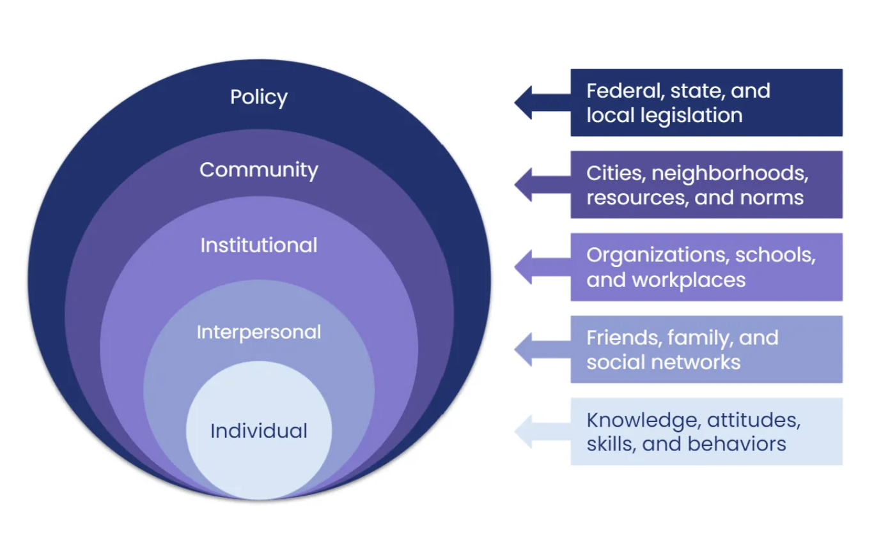
Why is the socio-ecological model (SEM) important to address social injustice and resulting health inequities?
Key for designing policies and programs to address social injustice and resulting health inequities.
Acknowledges that the ability of individuals to make healthy choices and protect their health depends heavily on factors beyond their control.
Calls for addressing social injustice and health inequities though multiple levels, from government policies to specific interventions at the community, household and individual level
Fully acknowledges the social determinants of health as the root cause of social injustice and health inequities
Source: https://kasleykillam.medium.com/the-inspiration-behind-community-microgrants-5bdedff5e48a
Notes:
https://kasleykillam.medium.com/the-inspiration-behind-community-microgrants-5bdedff5e48a

Slide 21
What can the ACS do to address social injustice and resulting health inequities?
Community engaged research that brings together communities with academic institutions is essential to:
  Co-design, implement an devaluate equitable culturally sensitive policies and programs that work!
    Improving nutrition & health outcomes
    Reducing inequities
As ACS, in this project you will be trained on how to do it!
In the long term there is a need to reform the social, economic, food and health structures that facilitate the concentration of power and money in just a few communities.

Slide 22
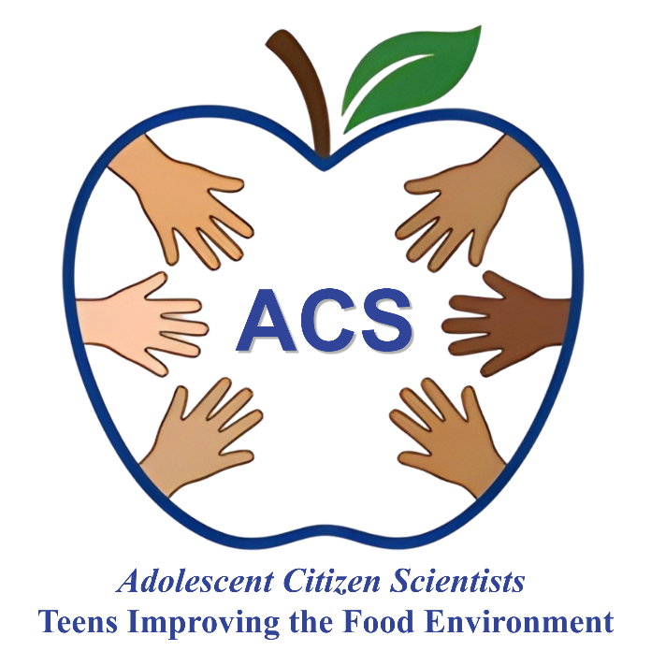

What are three things that you learned today?

Slide 23
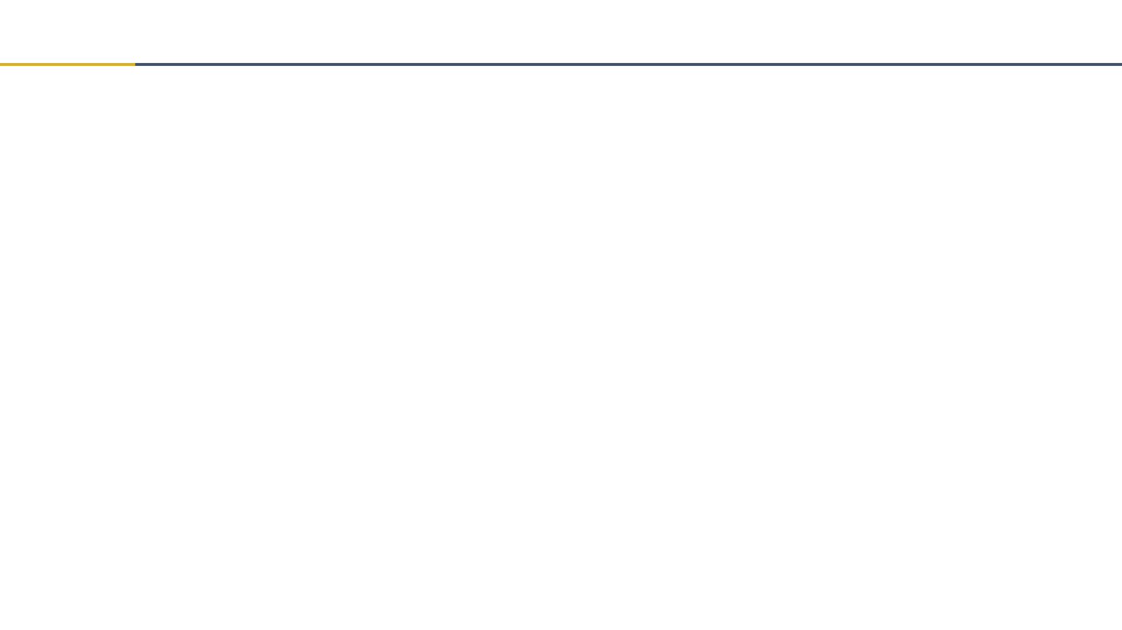
Thank you!
Bluesky
@UConnRudd.Bsky.Social
LinkedIn
UConn Rudd Center for Food Policy and Health
Website
uconnruddcenter.org/adolescent-citizen-scientists

