Slide 1




Co-design of
Community-Engaged Programs
Adolescent Citizen Scientist Training

Slide 2
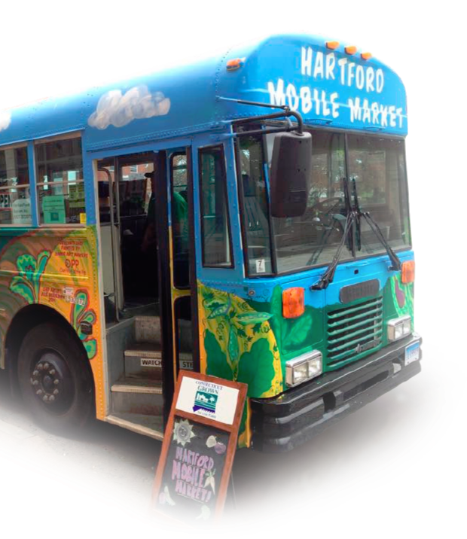
Learning Objectives
By the end of this session, students will be able to:
Explain what program co-design is
Understand the steps required to co-design programs
Understand how co-design steps get applied in the real world

Slide 3
Warm-up
Question:
What steps would be needed to organize a successful surprise birthday party for your best friend?

Slide 4
What is Community-Engaged Program Co-design?
A technique to design programs from the start considering input from key stakeholders​
  Community members​
  Decision makers​
  Funders​
  Technical advisors​
  Other​

Slide 5
Program co-design steps
Program co-design requires a highly participatory and equitable process
Once a program of interest is identified through focus groups…
Listening sessions with stakeholders
Program design refinement
More listening sessions
Assessing program feasibility
More listening sessions
Finalize program design
Equitable co-design is key for meeting program goals

Slide 6
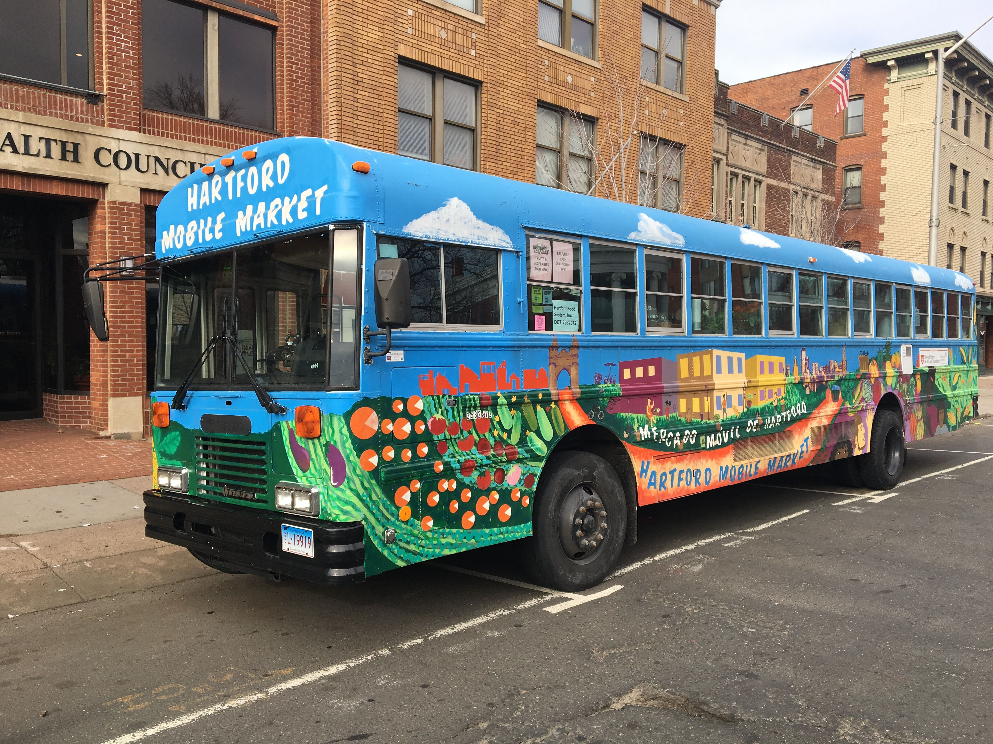


Co-design technique application
The Hartford Produce Mobile Market
Main goal:
Meet communities where they are to improve their food security (following equity principles)

Slide 7
​Community consultation to address food insecurity and hunger in Hartford
Formative research on fruit and vegetable access:
Based on focus groups and community dialogues
Coordinated by a multi-disciplinary team
Goal was to develop an innovative, feasible and sustainable method of increasing access to fruits and vegetables in Hartford’s South end
Co-design process:
Brainstorming sessions among team members
A focus group and individual conversations with community agency staff who live in Hartford’s South end
Listening sessions and interviews with community members
Dialogues with key leaders from a variety of government and private organizations at the city and state levels, knowledgeable of food insecurity..
Extensive review of literature
Field research to identify neighborhoods where increased access to fruits and vegetables were most needed

Slide 8
Extensive consultations with stakeholders
Community based organizations
Local growers
Farmers markets
Food assistance programs (SNAP, WIC)
City officials
Universities
  Researchers
  Extension system

Slide 9
Summary of iterative process followed to co-design the Hartford Produce Mobile Market
Co-design was successful because it built from:
Prior community-engaged research formative research to address food insecurity in Hartford
Stakeholders’ focus groups
Community dialogues
Establishment of an advisory board
Assigning a steering committee
Key informants’ interviews
Strong representation from community members reflecting the people that the program wanted to serve
Identifying key considerations like parking location, produce sources, sales volume, and payment methods.

Slide 10
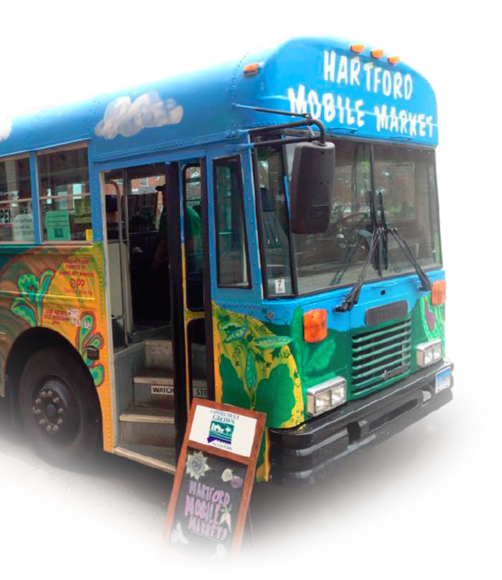

Key Features of The Hartford Mobile Market
Offered both local produce and non-local produce that community members desire, right in their neighborhoods
Accepted SNAP benefits; WIC produce vouchers for local and non-local produce; WIC Farmers Market Coupons and Senior Farmers Market Coupons –for local produce
“Produce prescription” program

Slide 11
How the Hartford Mobile Produce Market was expected to work
Hartford Mobile Market
Increased Produce Access
Increased Produce Purchases
Increased Nutrition Education
Increased Produce Intake

Slide 12
Produce supply system:
Hartford Produce Mobile Market
Regional market & others
Local farms, honey, dry foods
Produce Supply/
Inventory
Key Roles:
HHM Manager: Keeps track of food inventory levels
Unit Driver: Responsible for making sure the unit is well-maintained

Slide 13

Tracking produce purchases
Hartford Mobile Produce Market
Payment Methods Accepted at HMM:
SNAP
WIC
Strategies to Promote the HMM:
Low prices
Community outreach
Cash
Others
Marketing
Customer satisfaction surveys
Sales tracked using a:
Fiscal Management Information System

Slide 14
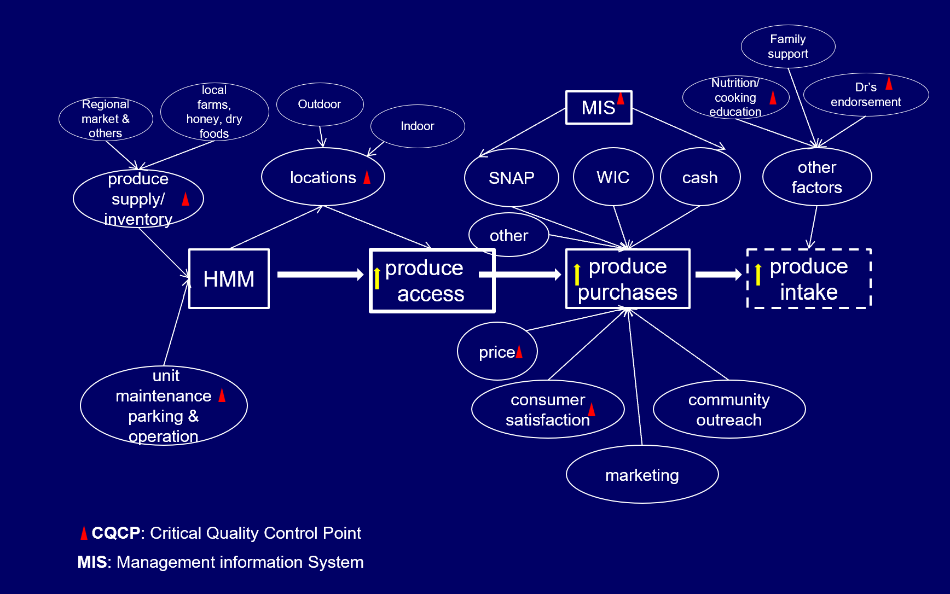
Full operation processes of the co-designed Hartford Mobile Produce Market

Slide 15
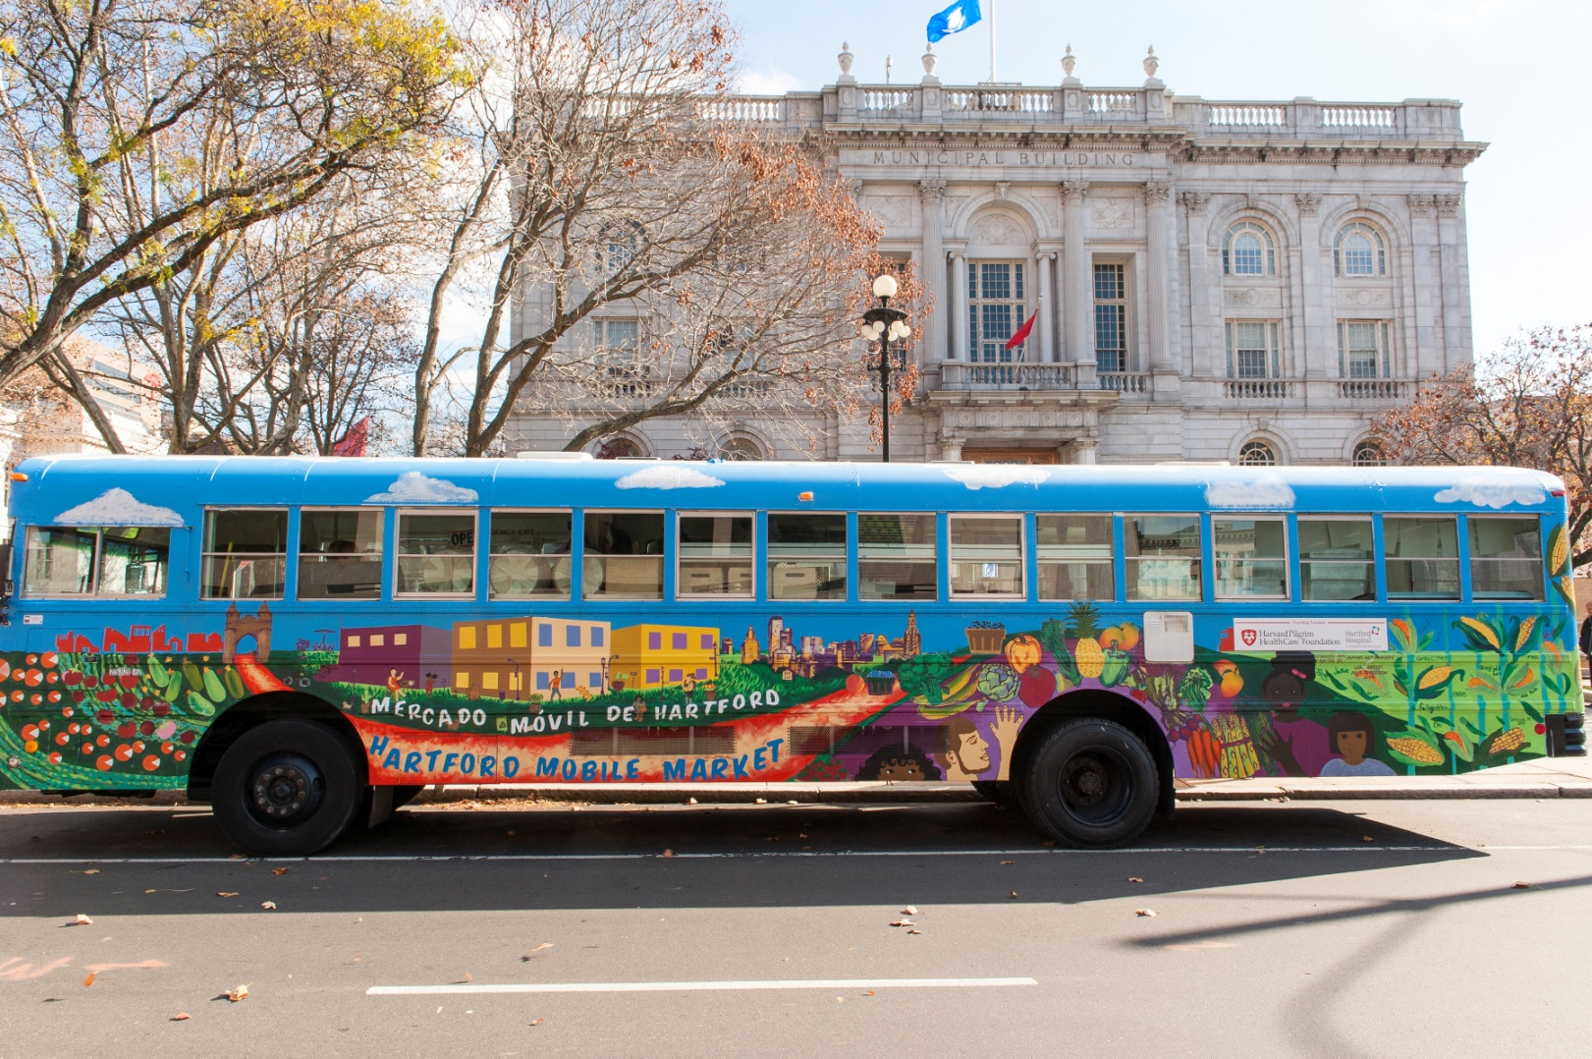
Does the Hartford Mobile Produce Market work?
A research study showed that people from the community who received a $10 coupon and information on the weekly schedule of the mobile produce market purchased more fresh produce and consumed more fresh fruit.
Clients were very satisfied with HMM.
IT WORKS!

Slide 16
Conclusions
The Harford Produce Mobile Market (HMM) is culturally sensitive and community-based
HMM was successfully implemented and led to higher access and consumption of produce
  more money spent on produce, and higher intakes of fruits
HMM customer satisfaction was very high
HMM has strong implications for food assistance program recipients and produce prescription programs nationwide
COMMUNITY-ENGAGED PROGRAM CO-DESIGN WORKS!!!

Slide 17
Next steps
Your final project for the ACS training will involve
  Deciding on which initiative(s) may be useful to help improve food and nutrition security among students in your school and beyond
  Developing the materials for this initiative, and
  Helping implement the initiative(s)
Get ready to start applying what you learned in this module to your own real-world project!

Slide 18

What are three things that you learned today?

Slide 19

Thank you!
Bluesky
@UConnRudd.Bsky.Social
LinkedIn
UConn Rudd Center for Food Policy and Health
Website
uconnruddcenter.org/adolescent-citizen-scientists

