Slide 1




Food Marketing:
Session 3
Adolescent Citizen Scientist Training

Slide 2
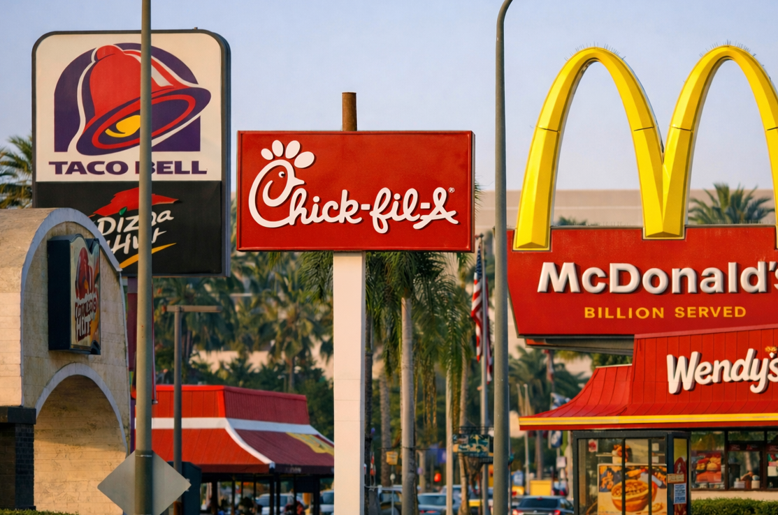
Questions of the day
What food marketing is targeted to me and my community?
What can we do about it?

Slide 3
Today’s agenda
What food marketing looks like in your community
Nutrition quality of marketed foods
How food companies target you and your community
How teens can make a difference

Slide 4
Marketing in your community assignment
Report back to the group
Show some of your pictures
Describe what you saw
  Product/brands
  Marketing techniques
  Target audience

Slide 5
Discussion: Assignment
What are your impressions of food marketing in your community?
Brands and types of products you saw a lot
  Any healthy ones?
Common marketing techniques and messages
Who companies seem to target the most
  Why do you think they do that?
How you feel about what you saw
  Do you think kids in other communities see the same things?
Notes:
Group discussion about the pictures that students shared

Slide 6
Brainstorm
What brands and products do you see the most?
Online
In your community
In other places
Notes:
Brainstorm: List specific brands (e.g., McDonald’s, Coca-Cola) and/or products (e.g., QuarterPounder, Doritos Spicy Sweet Chili)

Slide 7
How healthy are they?
Look up products’ nutrition facts panels.
What’s inside?
Serving size: Is this realistic? Do you usually eat more or less than that?
Calories, fat, added sugar, sodium, protein: Are these nutrients good for your health?
Ingredients: Real food or additives and chemicals? Is this product minimally processed?
Notes:
Look up the nutrition facts panel labels online. Most companies post their nutrition information.
Here are the websites for food companies with a lot of marketing:
McDonalds: https://www.mcdonalds.com/us/en-us/about-our-food/nutrition-calculator.html
Starbucks: https://stories.starbucks.com/uploads/2019/01/nutrition-1.pdf
Wendys: https://www.wendys.com/nutrition-allergens
PepsiCo (Pepsi, Frito Lay snacks, Gatorade) https://www.pepsicoproductfacts.com/home/Brands
You can also look them up on a grocery store website like Walmart: https://www.walmart.com/cp/food/976759?povid=GlobalNav_rWeb_Grocery_GroceryShopAll

Slide 8
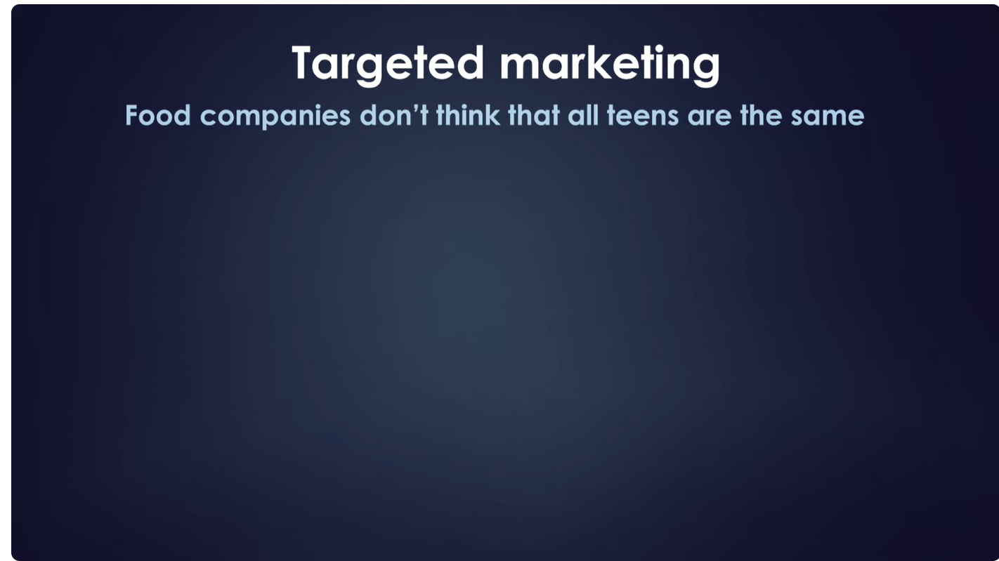
Video: So what’s the harm?
Food marketing works
Food companies target marketing to Black and Latino consumers
https://youtu.be/qy4utlhtdXI
Notes:
This video recaps the research on how food marketing affects young people and describes how companies target marketing to Black and Latino consumers.
Start video at 5:50 - Food marketing works
Continue to targeted marketing (6:23 to 7:29)

Slide 9
Targeted marketing: Key facts
Low-income communities of color have more food marketing in their communities
Black teens see 60% more food ads on TV than White teens
Food companies spend 8.5% of TV advertising budgets on Spanish-language TV
  But no ads for healthy foods!

Slide 10
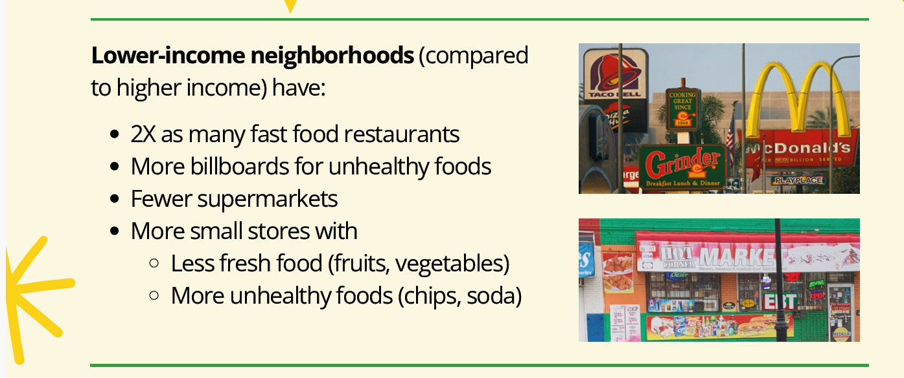
Targeting lower-income communities

Slide 11
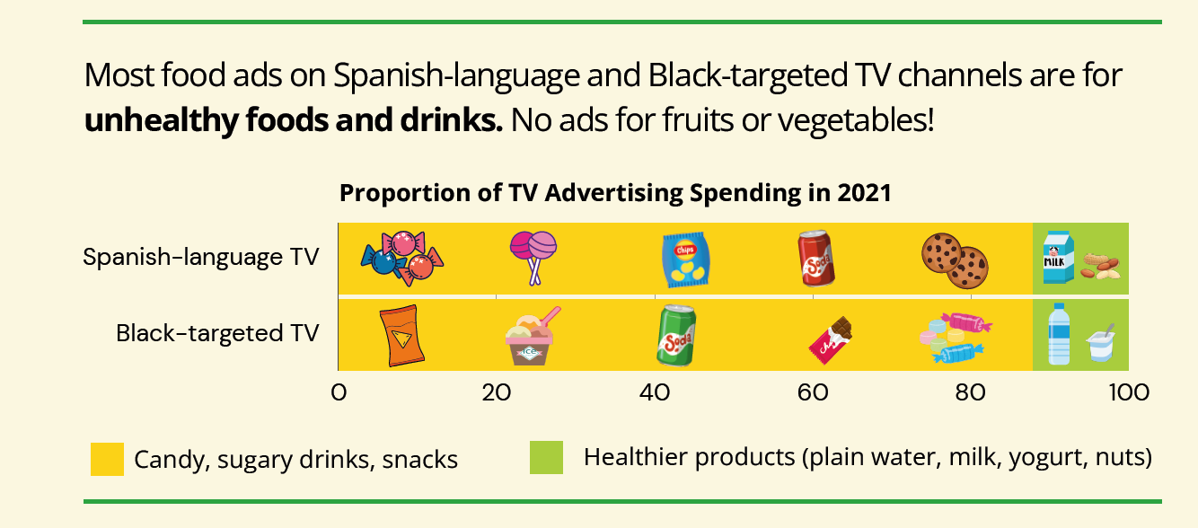
Targeting Latino and Black consumers

Slide 12
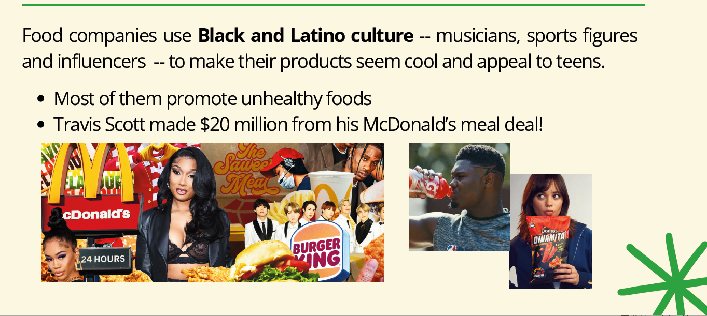
Targeting young people of color
Notes:
Can you think of more unhealthy food campaigns by Black or Latino celebrities?

Slide 13
Discussion: Targeted marketing
What do you think about these targeted marketing facts?
  Do any of them surprise you?
Do you think these things happen in your community?
What do you think about the companies that do this?
  Do you think it’s right?
Notes:
Group discussion about the targeted marketing facts information presented in the previous slides

Slide 14
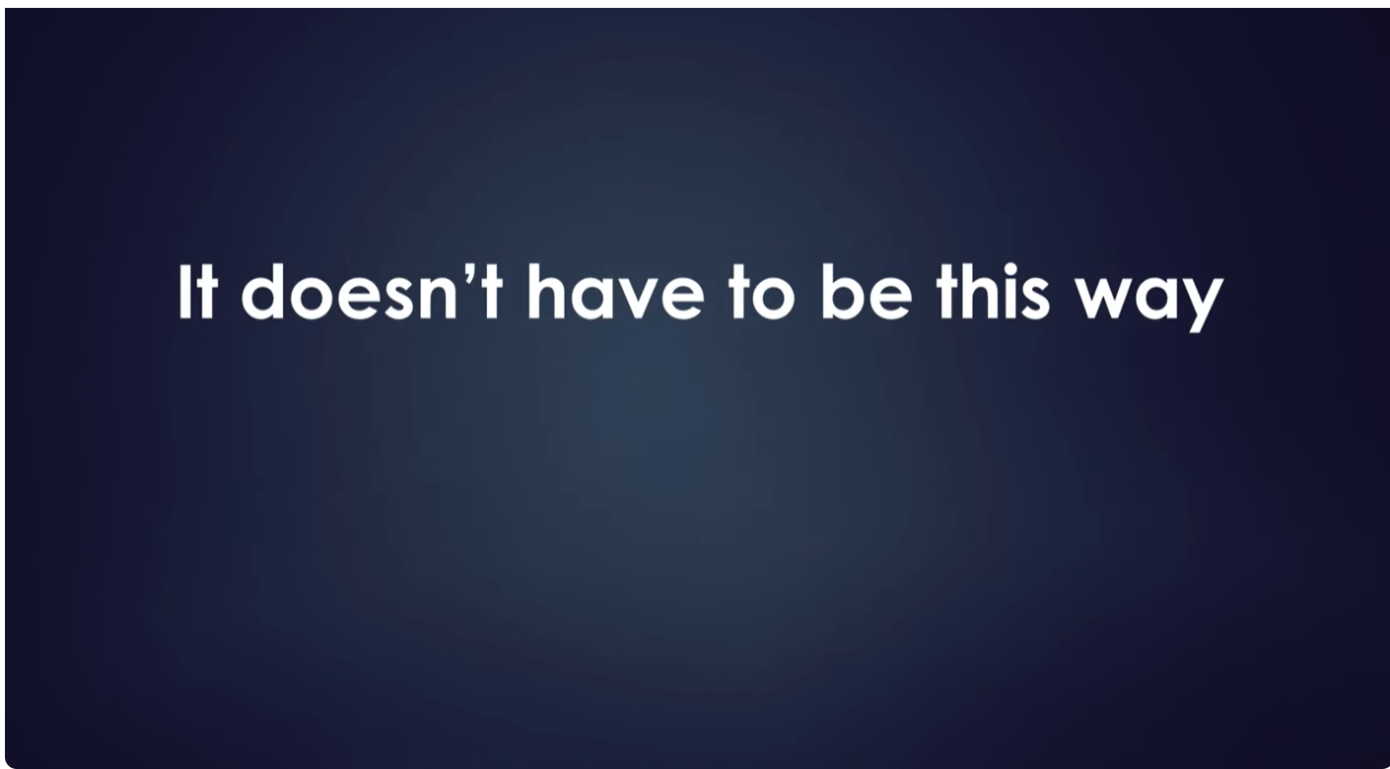
Video: But what can we do?
https://youtu.be/qy4utlhtdXI
Notes:
Start video at 7:29 – Attitudes about targeted marketing
Continue to what can be done (7:52 to end)

Slide 15
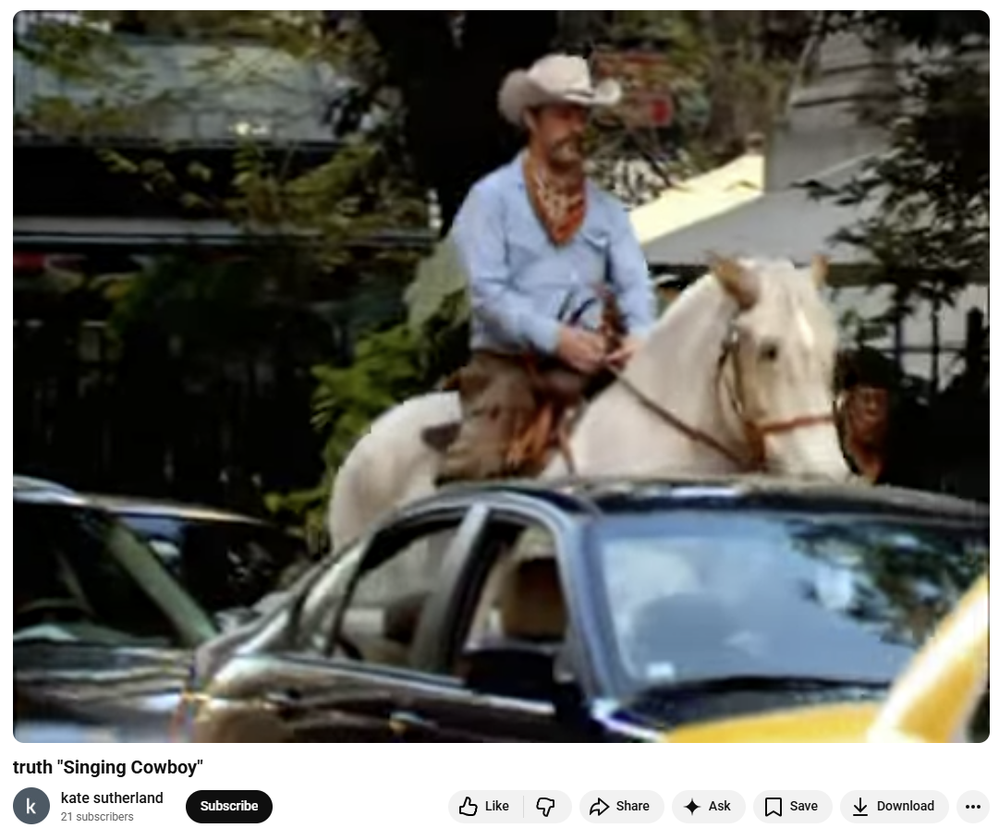
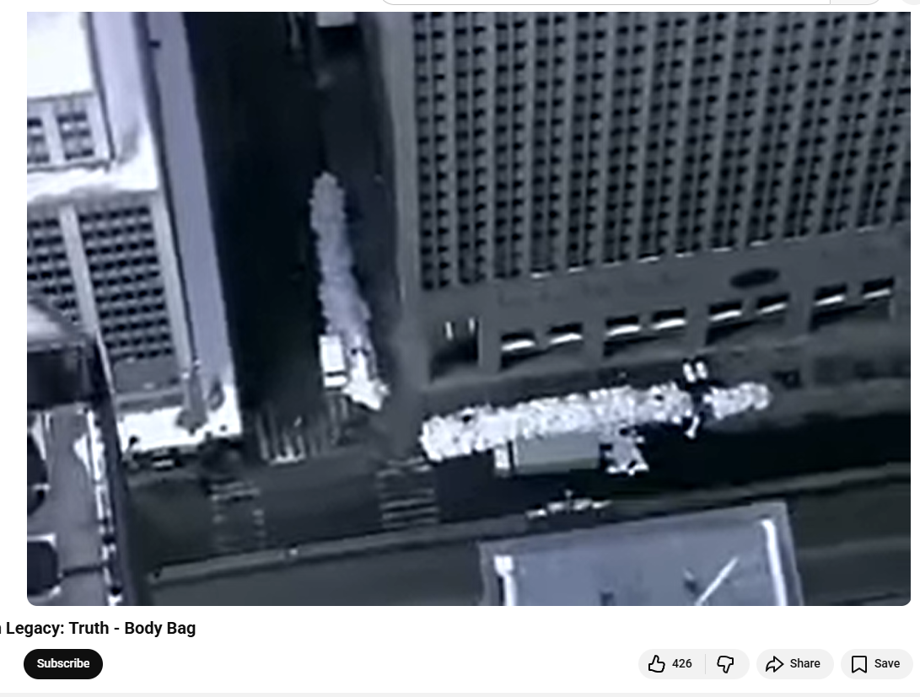
“Truth” - Countermarketing Campaign
Designed to counteract the tobacco industry’s deceptive marketing messages
Successfully reduced youth tobacco use
https://www.youtube.com/watch?v=v_cMQt3nmjI
https://youtu.be/S0fJyeW3v4o
Notes:
Countermarketing campaigns are designed to counteract deceptive marketing from industry. Here’s an example of the most successful countermarketing public health campaign.
Show videos

Slide 16
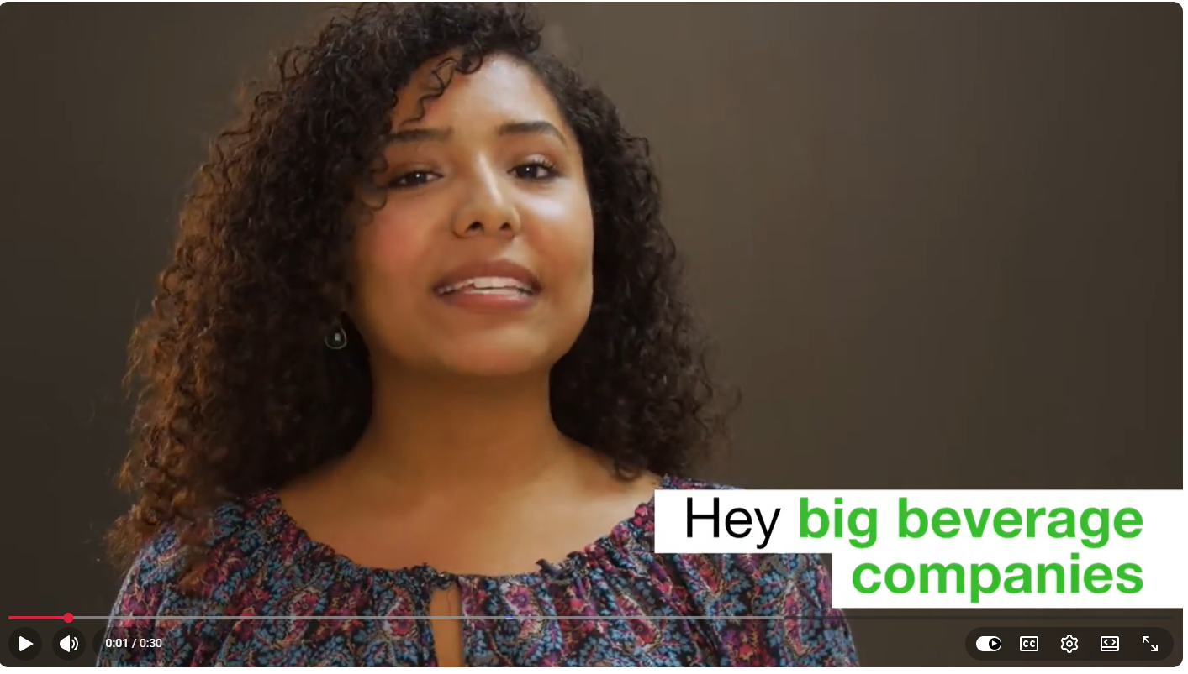
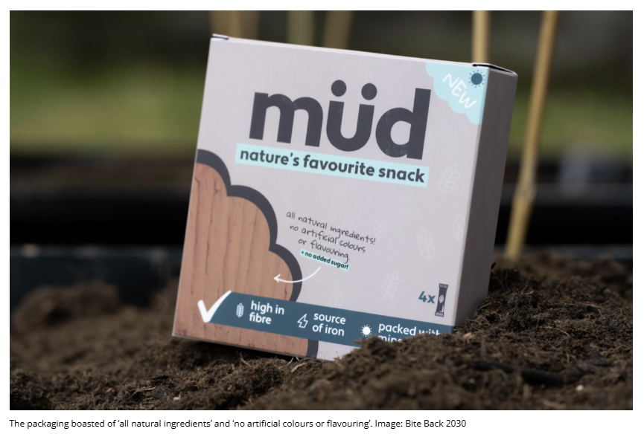
“Big Food” - Countermarketing Campaigns
Anti food-industry examples
Led by teens!
  Howard County Unsweetened
  https://www.youtube.com/watch?v=JcMNVxDlwuM
“Mud” campaign – BiteBack 2030 (UK)
Notes:
Here are some campaigns aimed at the food industry that were led by teens.
Show Howard County Unsweetened video
Provide Handout xx “Teenage activists deliver wheelbarrows of mud to Kellogg’s factory”

Slide 17
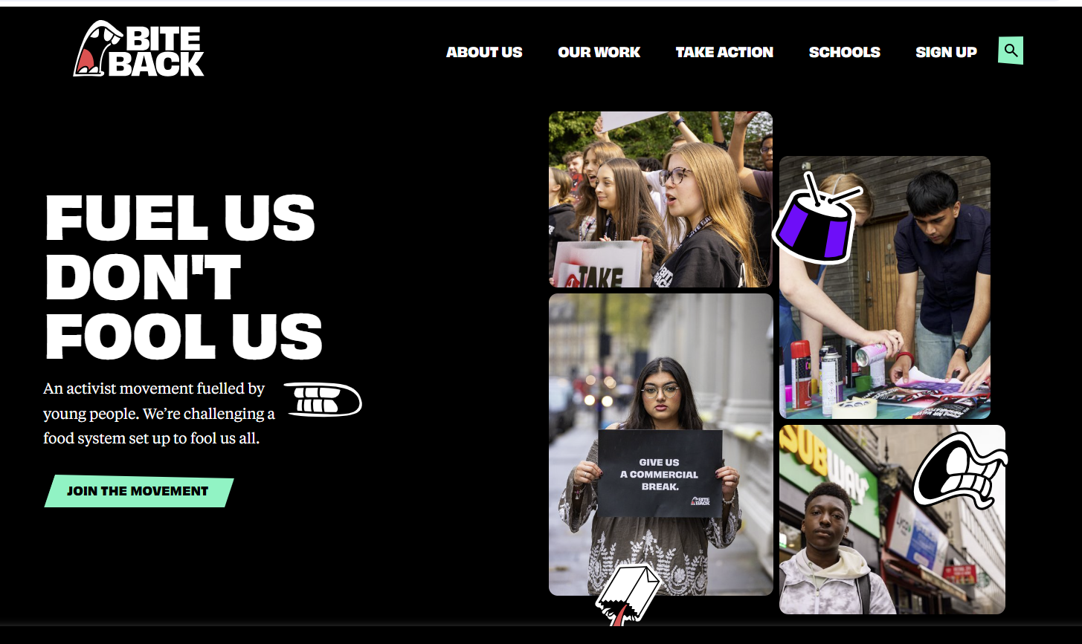
Video: Teens can make a difference
https://www.biteback2030.com/

Slide 18

For more resources
Toolkit to advocate for policy change
https://www.changelabsolutions.org/sites/default/files/PathwaysToPolicyPlaybook_FINAL_20180531.pdf

Slide 19
Wrap-up
Thinking about the food marketing information you’ve seen and heard
What sticks out to you the most?
Was anything you heard new or surprising?
Did anything make you feel differently about food marketing?
What can you do about it?

Slide 20
Thank you!
Bluesky
@UConnRudd.Bsky.Social
LinkedIn
UConn Rudd Center for Food Policy and Health
Website
uconnruddcenter.org/adolescent-citizen-scientists

