Slide 1




Food Marketing:
Session 2
Adolescent Citizen Scientist Training

Slide 2

Question of the day
How does food marketing affect us?

Slide 3
Today’s agenda
Digital food marketing to teens
How to analyze food marketing
How food marketing works
Assignment for next session

Slide 4
Digital food marketing assignment
What did you think about the assignment?
Was it easy or difficult?
Did you learn anything new?
How did seeing this marketing make you feel?
Notes:
Delete this slide if students did not do Assignment 1

Slide 5
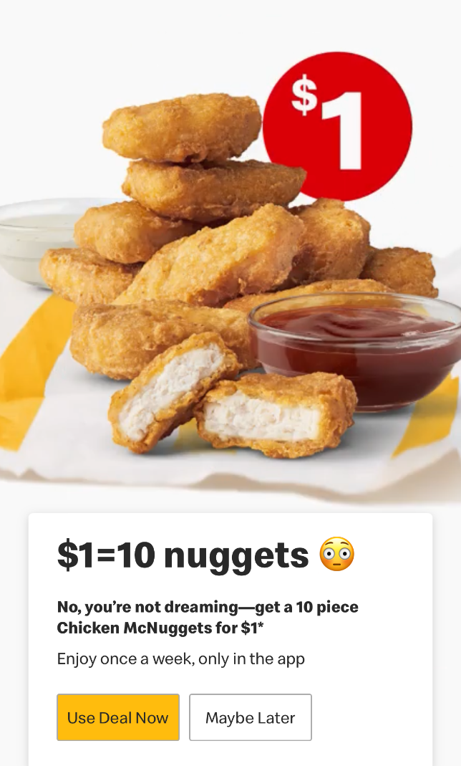
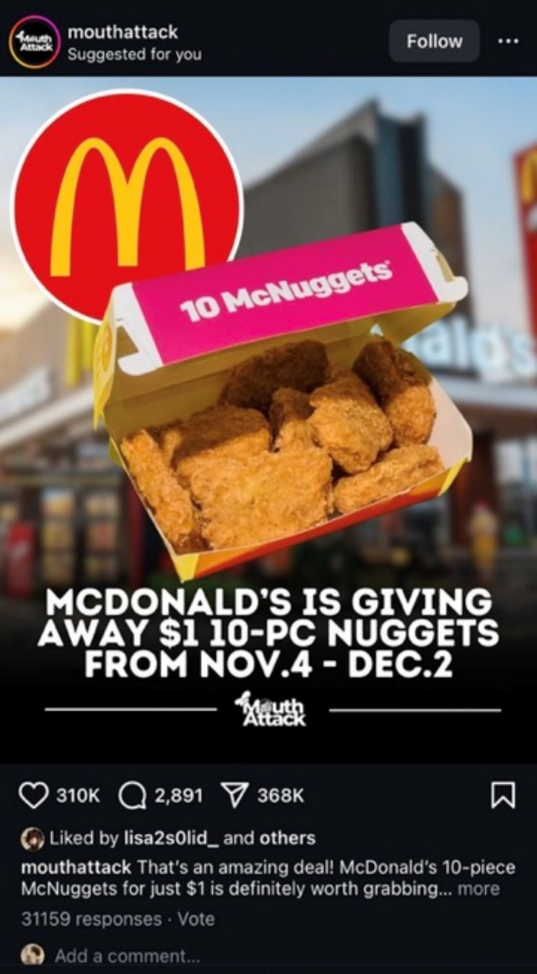
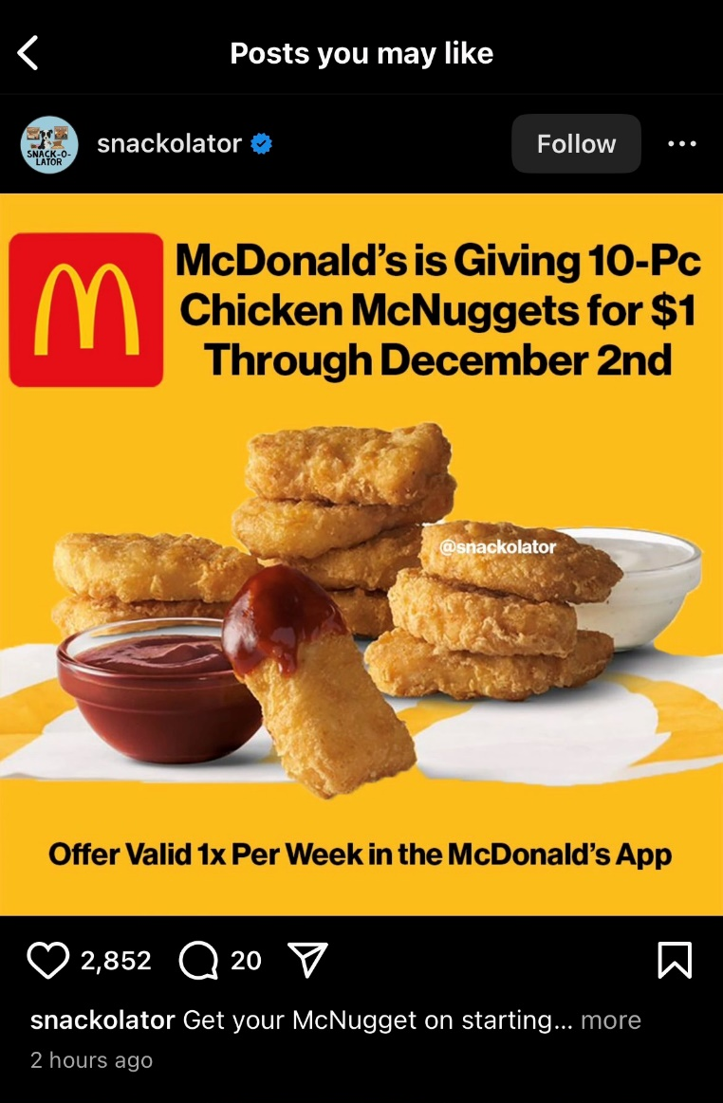
Digital marketing to teens: Examples (1)
McDonald’s app notification
Notes:
If students completed Assignment 1, replace slides 5-10 with examples that the students provided.

Slide 6
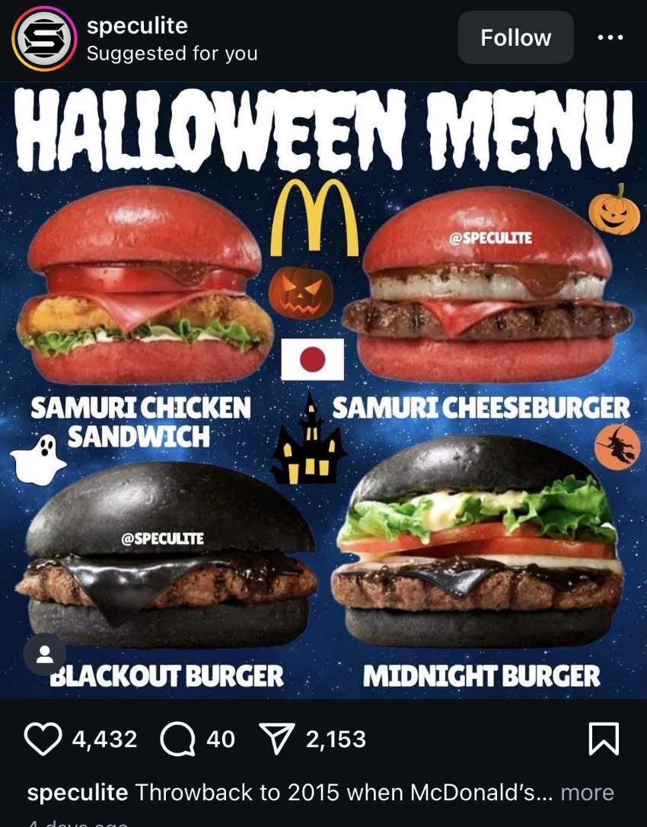
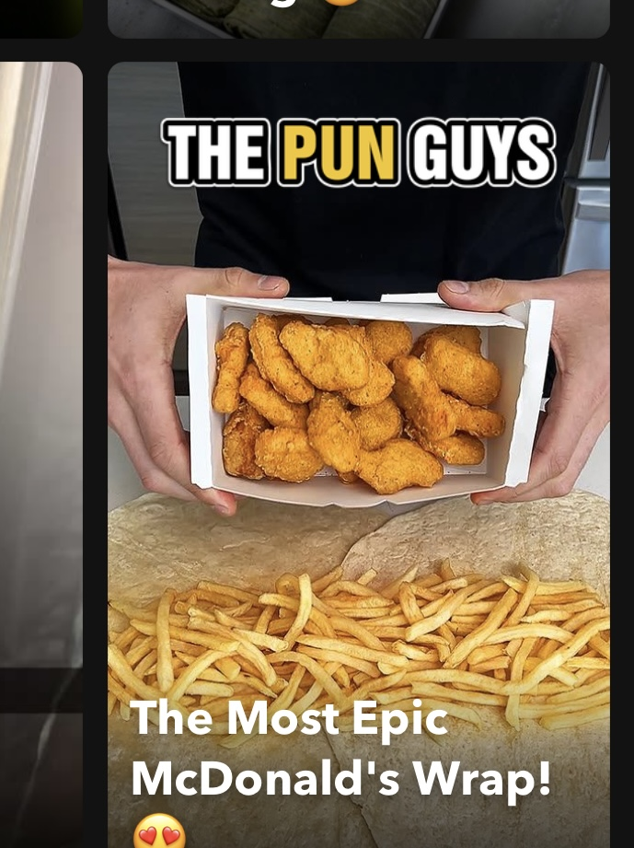
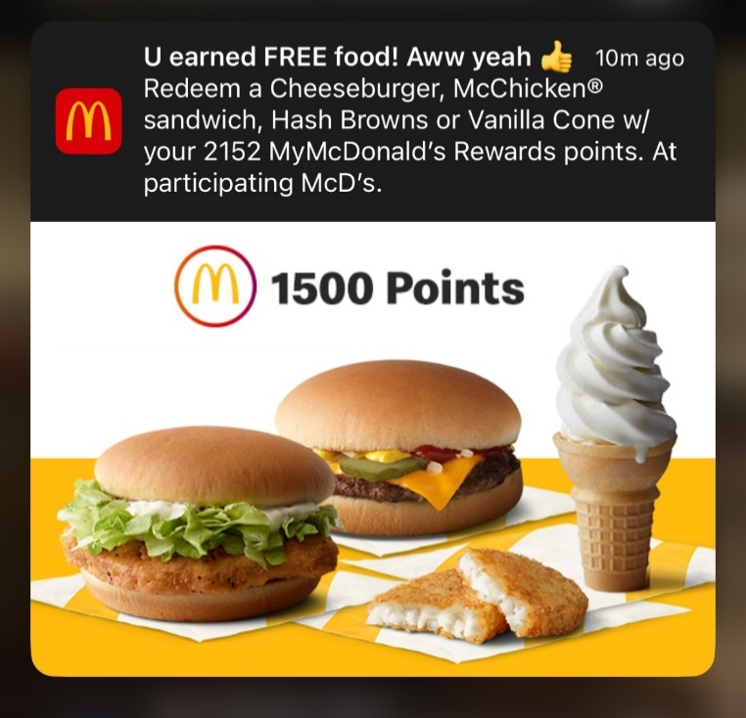
Digital marketing to teens: Examples (2)
McDonald’s app notification
Notes:
If students completed Assignment 1, replace slides 5-10 with examples that the students provided.

Slide 7
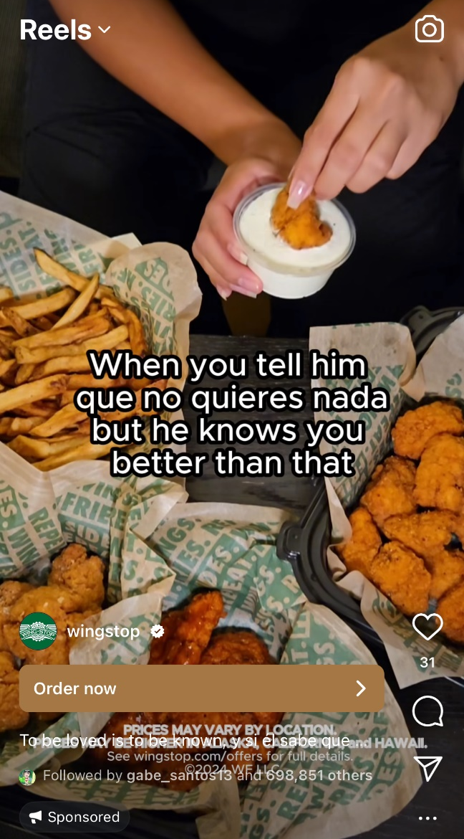
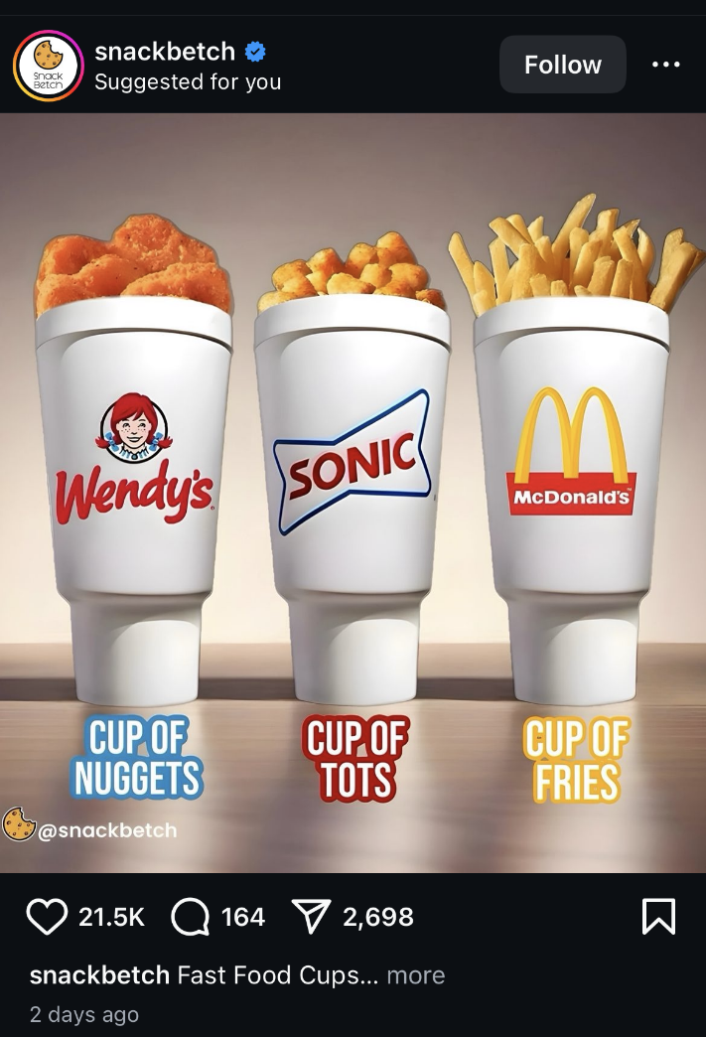
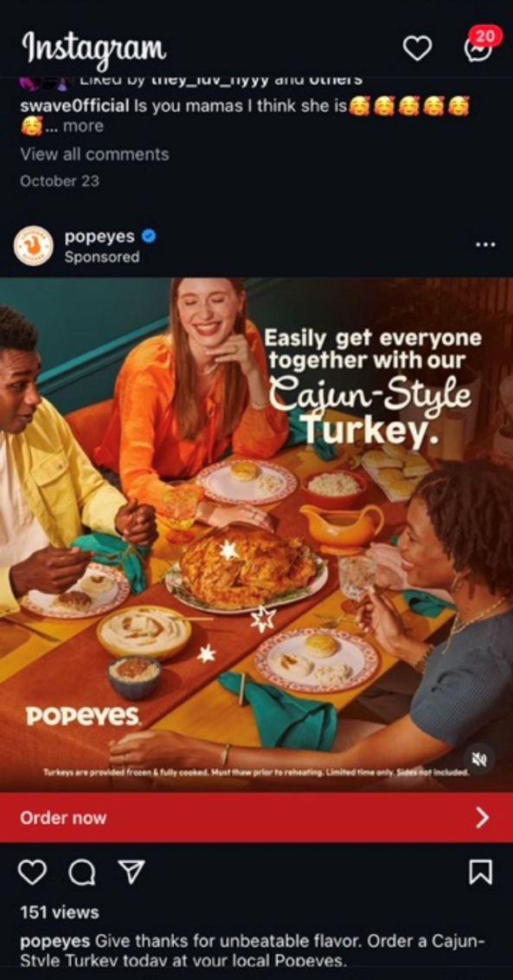
Digital marketing to teens: Examples (3)
Instagram “explore” page
Instagram Reels
Notes:
If students completed Assignment 1, replace slides 5-10 with examples that the students provided.

Slide 8
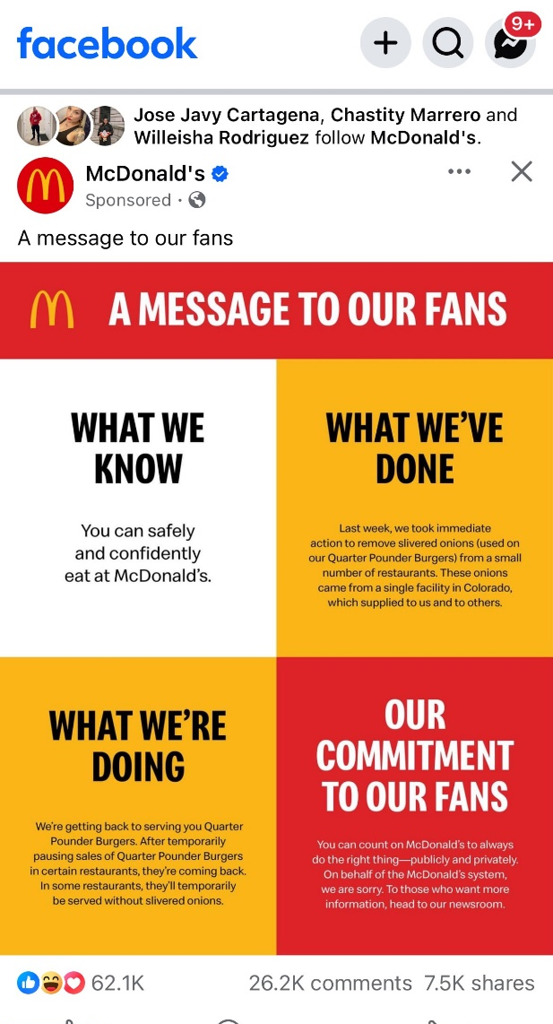
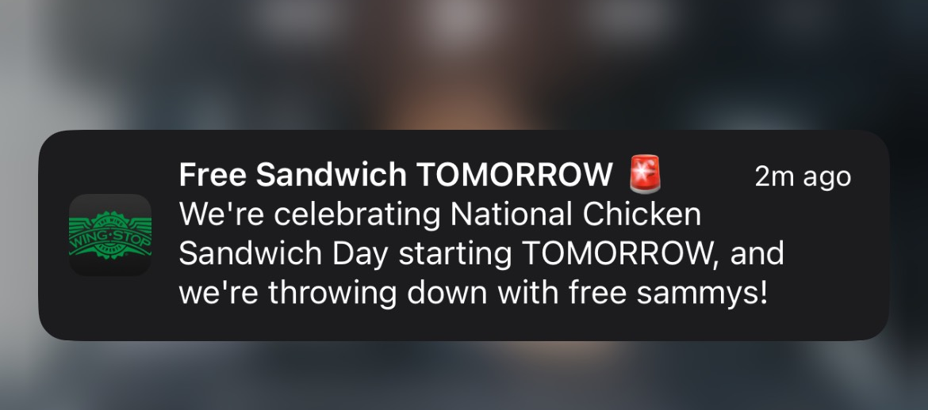
Digital marketing to teens: Examples (4)
Snapchat
Notes:
If students completed Assignment 1, replace slides 5-10 with examples that the students provided.

Slide 9
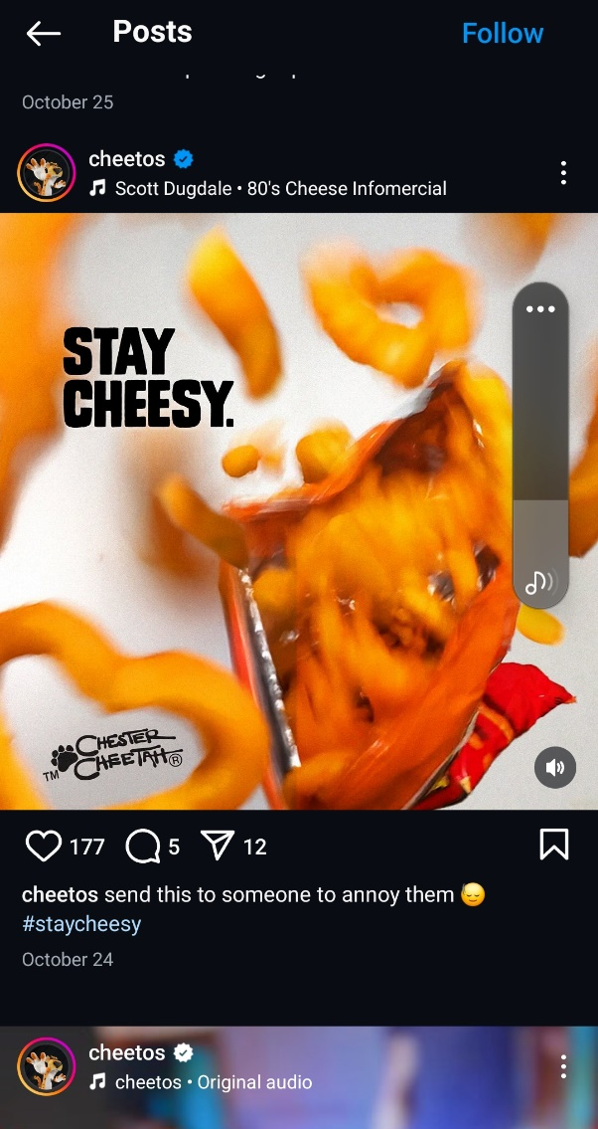
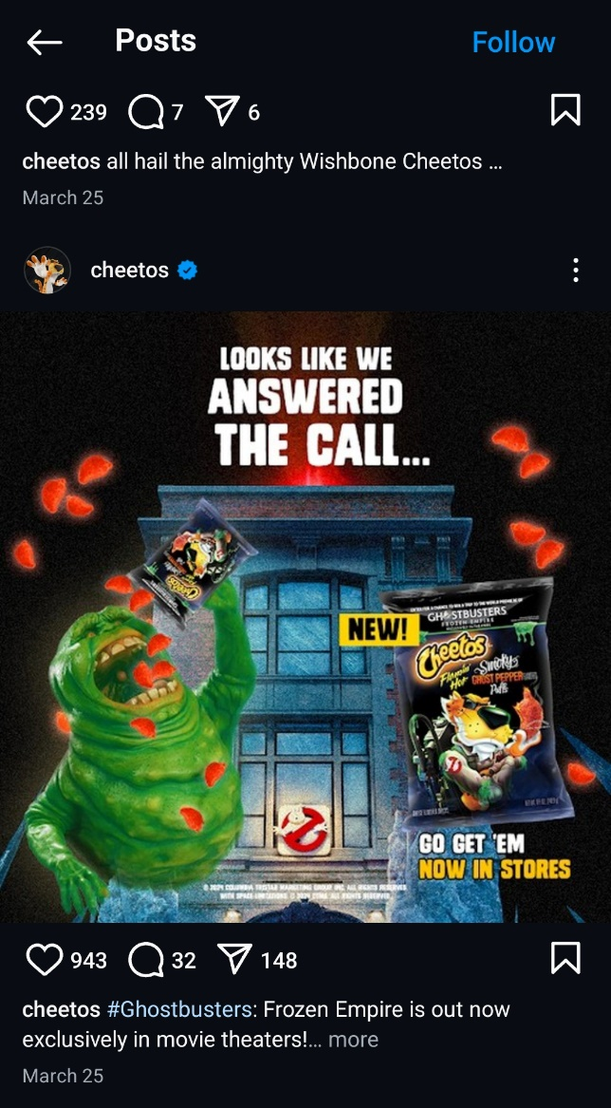
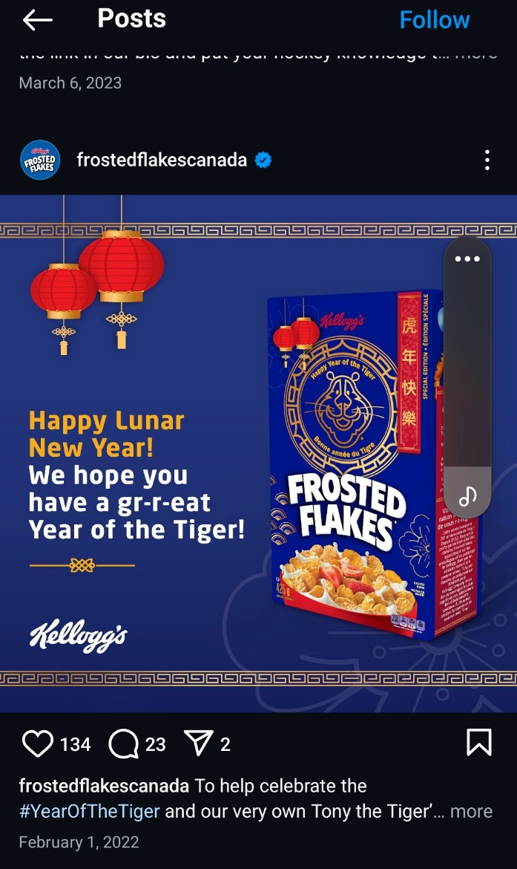
Digital marketing to teens: Examples (5)
Notes:
If students completed Assignment 1, replace slides 5-10 with examples that the students provided.

Slide 10
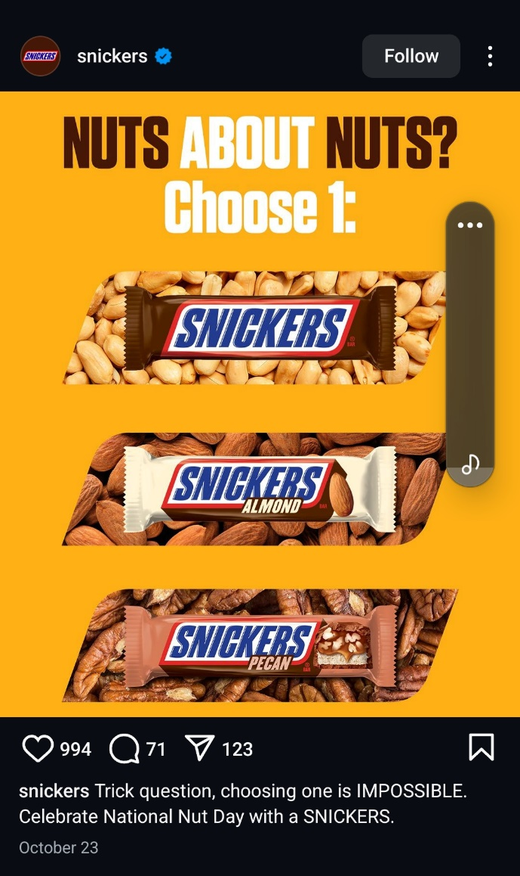
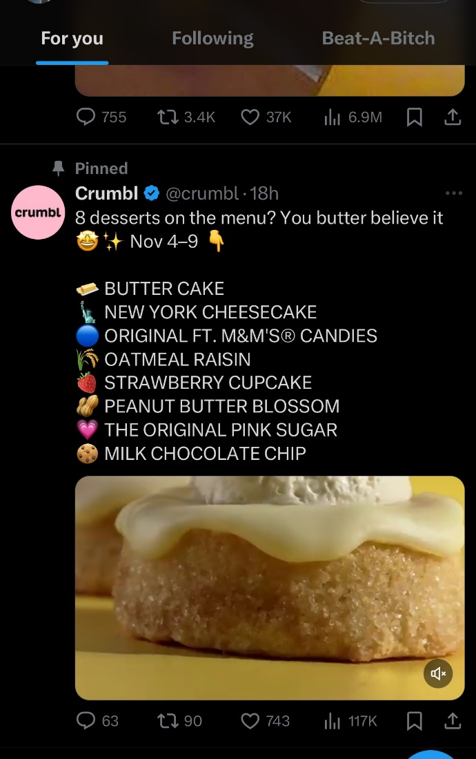
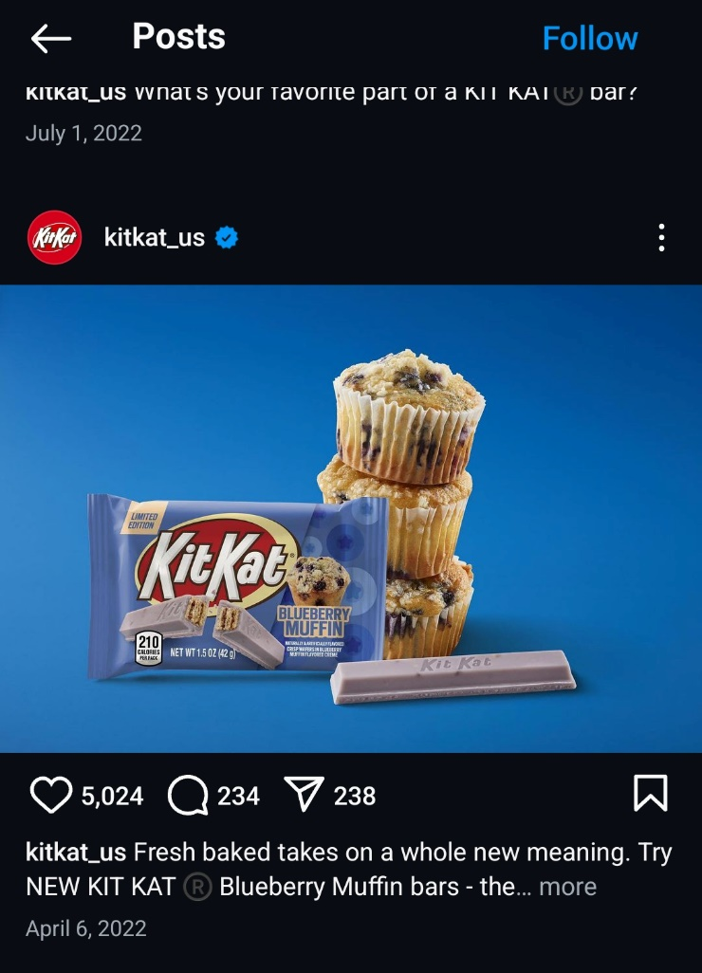
Digital marketing to teens: Examples (6)
Notes:
If students completed Assignment 1, replace slides 5-10 with examples that the students provided.

Slide 11
Food for thought
What do you think about these ads?
What do you think about the products in these ads?
Do you think these ads work? Why or why not?

Slide 12
Small group activity
Use the “Analyzing food ads” handout
Pick a few digital ads
With your group, answer the questions in the handout for each example
Report back to the rest of us
Notes:
Provide copies of Handout: Analyzing Food Ads

Slide 13
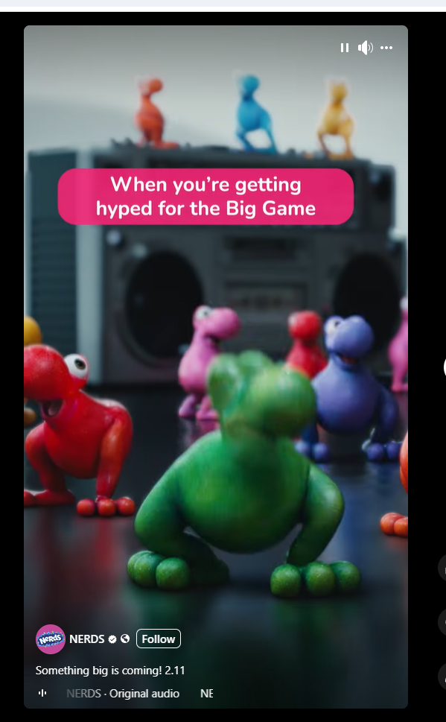
Let’s do this one together
https://www.facebook.com/reel/908805304054283

Slide 14
Group 1 ads

Slide 15
Group 2 ads

Slide 16
Discussion:
Ad techniques
What kinds of techniques do food companies use to target teens?
Do you think the ads that adults see are different? In what ways?
Notes:
Refer to pages 2 and 3 in Handout from Session 1 (Marketing definition and Finding food marketing)

Slide 17
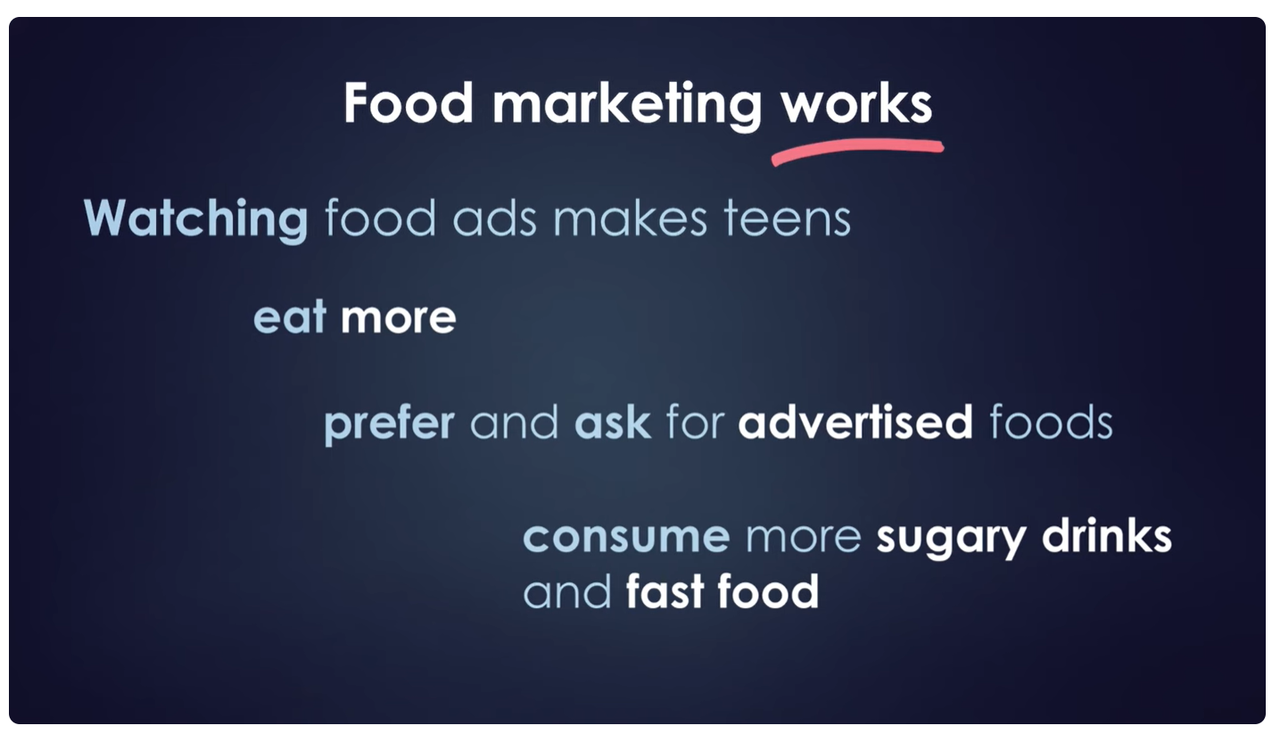
Research on food marketing shows:

Slide 18
Discussion:
Food ads and you
Do you think food ads affect you?
Why or why not?

Slide 19
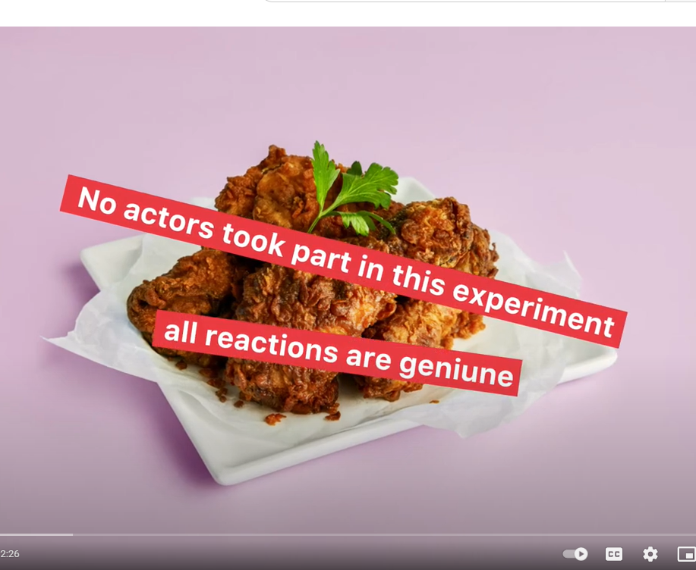
Video: Social experiment
And marketing works….
Even when you’re not paying attention
https://www.youtube.com/watch?v=TLf2gOrL1iM

Slide 20
Discussion: Food ad effects
What do you think about this video?
Was any of the information you heard today new or surprising?
Did anything you hear make you feel differently about food marketing?

Slide 21
Assignment 2
Food marketing in your community
  Spend 30 minutes walking around your community
  Pick a location where you often go (around school, your neighborhood, a store you visit)
  Take pictures of the food marketing you see that seems to be targeted to someone like you, your friends or your family
  Try to find at least 1 healthy food example
  Report back to the group
  Show some of your pictures
  Describe what you saw
Notes:
Provide Assignment 2 handout

Slide 22
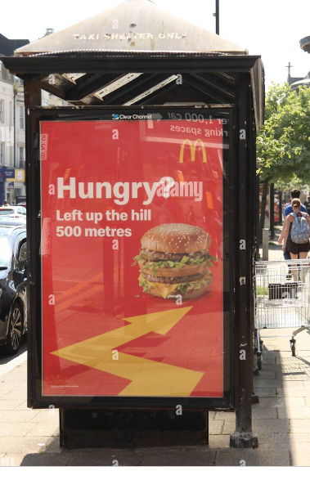
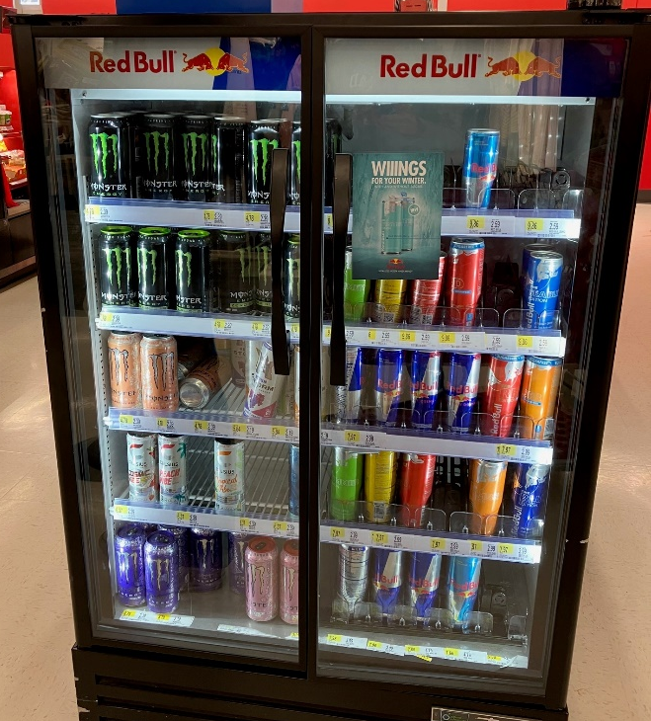
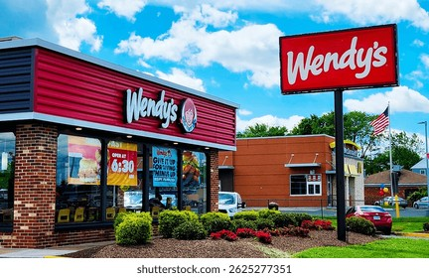
Examples of targeted marketing in your community
Outdoor signs or billboards
Displays in stores
Restaurants or storefronts

Slide 23
Looking ahead
At our next session
Share examples of food marketing in your community
Discuss types of food and drinks marketed the most and how food companies target you, your friends and family
Learn how teens can make a difference

Slide 24
Thank you!
Bluesky
@UConnRudd.Bsky.Social
LinkedIn
UConn Rudd Center for Food Policy and Health
Website
uconnruddcenter.org/adolescent-citizen-scientists

