Slide 1




Food Marketing:
Session 1
Adolescent Citizen Scientist Training

Slide 2



Name that LOGO
1
2
3

Slide 3



Name that CHARACTER
4
5
6

Slide 4
Name that TAGLINE
________________ ARE FOR KIDS
TASTE THE FEELING
TASTE THE RAINBOW
GIMME A BREAK
________________ GIVES YOU WINGS

Slide 5
Name that TAGLINE (cont’d)
YOU’RE NOT YOU WHEN YOU’RE HUNGRY
THE SNACK THAT SMILES BACK
SOUR, SWEET, GONE
MAGICALLY DELICIOUS

Slide 6
Answers
1. McDonalds
2. Monster
3. Starbucks
4. Pringles
5. Cheetos
6. Frosted Flakes
7. Trix
8. Coca-Cola
9. Skittles
10. Kit Kat
11. Red Bull
12. Snickers
13. Goldfish
14. Sour Patch
15. Lucky Charms

Slide 7
Food Brands Discussion
How many did you get right?
Does this surprise you? Why or why not?
Why do you think we chose these brands?
What do you notice about these examples?
Notes:
*Brands were chosen to include those with a lot of marketing to children and/or adolescents

Slide 8
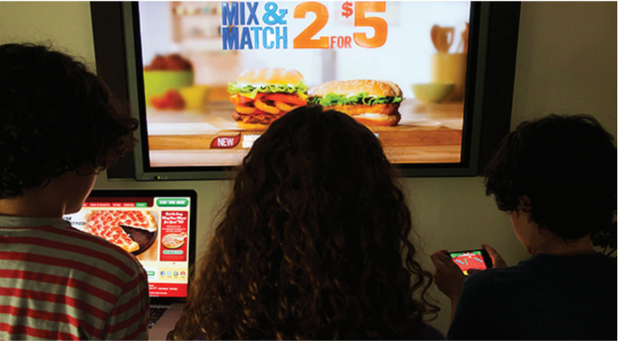
Question of the day
What is food marketing?

Slide 9
Today’s agenda
What you already know about food marketing
Summary and discussion
Assignment for next session

Slide 10
Definition of “food marketing”
Any form of commercial communication, message, or action that increases sales and consumption of a product or a brand.
Brand vs. product
Product = physical item offered for sale (e.g., Frappuccino, Hot Cheetos)
Brand = overall marketing identity (e.g., Starbucks, Cheetos)
Targeted marketing
Marketing that tries to influence a specific type of consumer (e.g., teens, parents)
Notes:
Share Handout 1. Read page 1 only (Marketing Definitions)

Slide 11
Brainstorm
Where do you see food marketing?
What does it look like?

Slide 12
Discussion: Handout 1
Finding Food Marketing
What do you think about this list?
Is any of this information new or surprising?
Notes:
Refer to pages 2 and 3 in Handout 1

Slide 13
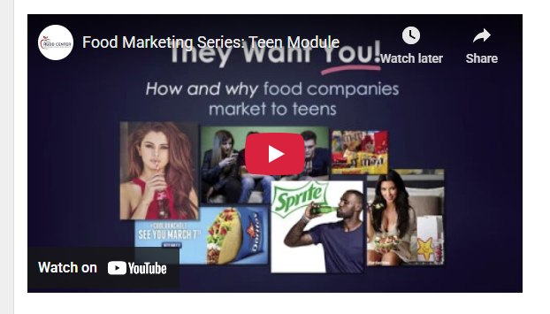
Video: Food marketing to teens
Watch at: https://youtu.be/qy4utlhtdXI
Notes:
Note to presenter: End video at 5 min 50 sec. You will watch the rest in subsequent sessuibs,

Slide 14
How much do food companies spend on advertising?
$13.5 billion per year in total!
Unhealthy categories, including fast food, sugary drinks and candy spent the most.
*Source: UConn Rudd Center analysis of Nielsen data

Slide 15
How does that compare?
That same year, the U.S. Centers for Disease Prevention and Control (CDC) spent just $1.2 billion on all its chronic disease and health promotion programs, including anti-smoking, AIDS prevention, and healthy eating.
What is your school district budget?
*Source: UConn Rudd Center analysis of Nielsen data

Slide 16
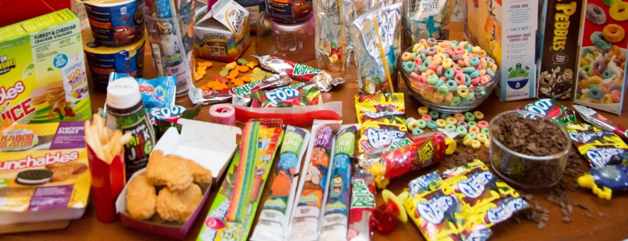
Food marketing to children and teens
Big business: $2 billion per year
That’s how much food companies spend on all types of food marketing to children and teens (not just advertising).
Marketing their least healthy products
Fast food, candy, sugary drinks (soda, sports drinks, energy drinks), sweet and salty snacks were most often targeted to children and teens.

Slide 17

What do you think?
Why do food companies target kids?

Slide 18
Why do food companies target kids?
Pester their parents
Spend their own money
Influence their friends
Frequent reminders are hard to forget or resist
Create lifelong loyal customers

Slide 19
Assignment 1
Finding Digital Food Marketing
  Find marketing that shows up while you’re using your smartphone, tablet or computer
  At least 5 examples
  A variety of types of marketing (e.g., banner/video ad, YouTube video, social media post)
  Fill out the sheet in the handout for the next session
Notes:
Provide Assignment 1
Note: If you do not want to include this assignment, Session 2 includes examples of digital marketing targeted to teens that you can discuss with your students.

Slide 20
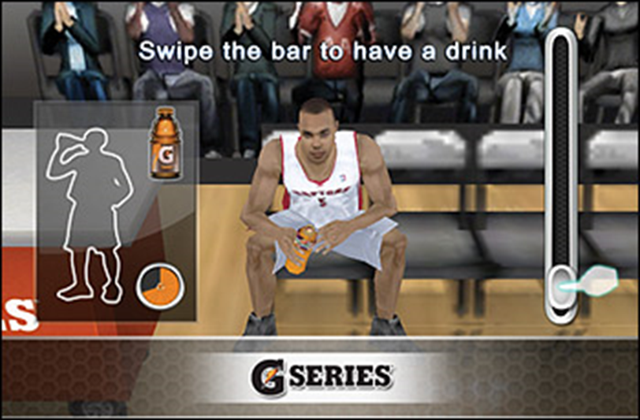
Example of digital marketing you might find
Brand (product) | Where was it? (media platform type and name) | Type of marketing/creative strategy/technique | Who do you think is the target?
Gatorade G series | Video game, NBA 2K | Product placement, sports messages, health halo | Gamers, NBA fans, basketball players

Slide 21
Looking ahead
At our next session
Share food marketing examples you found.
Analyze food marketing techniques. Do they work?
Discuss types of food and drinks targeted to you.

Slide 22
Thank you!
Bluesky
@UConnRudd.Bsky.Social
LinkedIn
UConn Rudd Center for Food Policy and Health
Website
uconnruddcenter.org/adolescent-citizen-scientists

