Slide 1
Feeding Scenarios: Infants
February 2023

Slide 2
Breast or Formula Feeding
The decision to breastfeed or formula feed is up to the mother, but child care providers are crucial in supporting families who want to breastfeed, and the American Academy of Pediatrics (AAP) recommends breastfeeding as the preferred choice
An infant should be fed iron fortified infant formula or breastmilk exclusively from birth through the end of 5 months

Slide 3
Formula Feeding
The infant should always be held when being fed (no propping bottles)
All formula should be made that day and labeled with the infant’s name and the date and time it was made
The bottle should be warmed in a bottle warmer or crock pot, never in a microwave
If not consumed, bottle contents must be thrown away within 1 hour
No cereal or medicine is allowed in the bottle

Slide 4
Encourage families to breastfeed in your center or daycare home. Offering a comfortable chair and space can be helpful
Expressed human milk may be brought from home if frozen and kept cold during transit
Milk brought from home should be labeled with infant’s name, date and time it was expressed
Defrost in the refrigerator or under warm running water and then place in a bottle warmer or crockpot to warm
Never shake human milk
When handling human milk, your hands should be washed as many times as you would when handling any food product
Breastfeeding

Slide 5
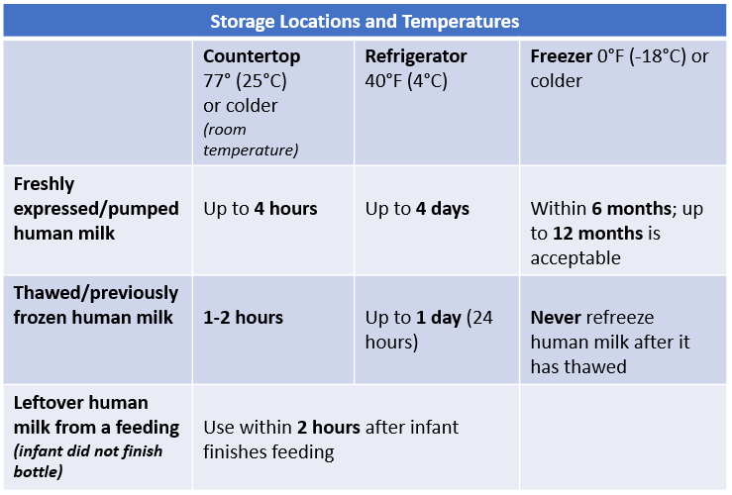
Human Milk Storage Guidelines
Source: https://nrckids.org/CFOC/Database/4.3.1

Slide 6
Accidentally Feeding Human Milk to the Wrong Child
The childcare program should:
Notify both families of the mix-up & reassure transmission of infectious disease is small
When discussing with the parents/guardians of the child who was given another mother’s milk:
Inform them that their child was given another mother’s expressed human milk
Encourage them to notify the child’s primary care provider and share any specific details known
Assess why the wrong milk was given and develop policies and procedures to prevent future mistakes
Source: https://nrckids.org/CFOC/Database/4.3.1.4
Notes:
Few illnesses are transmitted via human milk, and in fact, the unique properties of human milk help protect children from colds and other typical childhood viruses. Nonetheless, both families need to be notified when there is a milk mix-up, and they should be informed that the risk of transmission of infectious diseases via human milk is small.

Slide 7
Responsive Feeding of Infants by a Consistent Caregiver/Teacher
Give-and-take approach where the infant communicates feeding (hunger and fullness) cues and the caregiver responds appropriately
Most successful when a consistent caregiver learns an infant’s individual cues
Hunger cues include:
Opening and closing the mouth, rooting, bringing hands to face, flexed arms and legs, clenching fingers/fists, sucking sounds, fast breathing. Crying is a late hunger cue
Fullness cues include:
Shaking the head or turning away from food
Source: https://nrckids.org/CFOC/Database/4.3.1.2
Responsive Feeding
Notes:
Practicing responsive feeding when children are infants teaches positive eating habits and skills that keep them healthy as they get older. That’s because responsive feeding teaches children to:
Recognize when their bodies are hungry and they they’re full (and to trust those feelings)
Clearly communicate their needs to others
Eat when they are hungry and stop when they are full (instead of when someone tells them to)
https://magazine.medlineplus.gov/article/healthy-habits-that-last-a-lifetime-how-to-practice-responsive-feeding

Slide 8
When is an Infant Ready for Solids?
Each infant develops at his/her own pace
Signs of developmental readiness for introduction of solid foods:
The infant can hold his/her head up on his/her own
The infant has interest in food when watching others eat
The infant can push the food from the spoon into the back of the mouth to swallow (oral motor skills)
The infant has doubled birth weight and is at least 4 months of age

Slide 9
What to Feed?
It is best to start solids with vegetables, then move to cereal, fruit and lastly meats
Each new food should be given for 3 days before introducing new foods to watch for allergic reactions
Infants need only 1-2 tbsp of food in the beginning
Foods should not be mixed so that a child can taste individual foods and due to allergy concerns
Begin offering drinking water during meals once solid foods are introduced. Infants 6-11 months could be given water 0.5-1.0 cups (4-8 oz)/day in a cup
These approaches can help encourage children to accept less sweet foods and foods with a variety of new flavors and textures

Slide 10
Transition from Bottle to Cup
In general, infants may be able to drink from a cup (without a lid) as young as 6 months of age and should transition away from a bottle around 12 to 18 months.
Young infants will need their caregiver to hold the cup
Cups with lids (sippy cups) should be avoided
Children may be ready to drink from a cup when they can sit on their own and are able to seal their lower lip around the rim of the cup. This takes practice

Slide 11
Once the infant starts pinching his/her fingers, he/she should be ready to self-feed with foods like beans, puffs and certain cereals
Cheerios work well because they have a hole in the middle, which prevents choking
A good time to start introducing table food is around 8 months of age, but this depends on the infant’s developmental readiness
Most infants will not be ready to use utensils until approximately 18 months of age
Table
Foods

Slide 12
Important to Note
No supplemental drinking water is needed for infants 0-5 months
Do not give any juice or sugar-sweetened beverages to infants of any age
Do not give cow’s milk until after the child’s first birthday or as a child‘s health-care provider recommends
Do not give honey to children until after the first year. Honey may contain spores that could lead to a serious foodborne illness (infant botulism)

Slide 13
Resources and References
Caring for Our Children National Standards. Chapter 4.3. Requirements for Special Groups or Ages of Children: 4.3.1 Nutrition for Infants: https://nrckids.org/CFOC/Database/4.3.1
American Academy of Pediatrics. Healthy Beverage Consumption in Early Childhood: Recommendations from Key National Health and Nutrition Organizations: Summary of Oral Health Considerations: https://www.aapd.org/globalassets/media/policies_guidelines/e_healthybev.pdf
USDA, Food and Nutrition Service. Feeding Infants in the Child and Adult Care Food Program. https://www.fns.usda.gov/tn/feeding-infants-child-and-adult-care-food-program
USDA, Food and Nutrition Service. Infant Nutrition and Feeding. https://wicworks.fns.usda.gov/sites/default/files/media/document/infant-feeding-guide.pdf
For more information on CACFP requirements please visit: https://portal.ct.gov/SDE/Nutrition/CACFP-Child-Care-Centers. Before implementing any changes to your program’s food and nutrition policies or practices, contact your CACFP representative to ensure you are meeting all rules and regulations.
Disclosure: The information in this module is based on a variety of sources listed above. It highlights key points relevant to this topic, but is not exhaustive. Please refer to the above resources for more information.

Slide 14
Thank You!
Made possible with funding from
the Centers for Disease Control and Prevention

